Slide 1
ISO 9000 & Sales Law
Sales Law - Winn
Make-up Class Video Lecture
November 2009

Slide 2
ISO 9000 & Sales Law
What is the problem?
What is the solution?
What is a quality management system?
Example: 5 Whys
What is ISO 9000?
ISO 9000 Certification
Members of ISO 9000 family of standards
Other ISO Plan-Do-Check-Act management standards
Legal Plan-Do-Check-Act requirements not based on standards
Plan-Do-Check-Act examples outside of commerce
Legal mandates to use ISO 9000?

Slide 3
What is the Problem?
What is the problem ISO 9000 is intended to address?
Theoretical scientific advances not matched by practical engineering advances in productive systems
Institutional rigidities obstruct creative problem-solving
Taylorism: Time & motion studies; expanded division of labor to increase productivity
Dehumanizing, deskilling of labor conditions
Fordism: combine mass production and mass consumption
Very large production runs of standardized products from highly automated assembly lines
Balance of economic power shifts to big manufacturers away from distributors and retailers
Consumers and workers passive, markets dominated by big, hierarchical corporations

Slide 4
What is the Solution?
Reverse Direction of Exercise of Market Power
Focus on customer requirements, allow customer to “pull” instead of producer “push” plus advertising to create demand
“Outside-in” network, not “top-down” hierarchy
Create an institutional framework to promote collaboration and problem-solving
Charles Sabel’s “democratic experimentalism” in the economy
Anthony Giddon’s “contract of responsibility” in Risk Society

Slide 5
What is a Quality Management System? I
Shewhart: empirical observation plus statistical analysis
Workers solve “special” problems, managers solve “common” problems
Quality requires both workers and managers to think critically about processes
Deming: Expanded Shewhart’s methods with Plan-Do-Check-Act cycle and 14 Management Principles
Reward not punish problem reporting
Look for root causes of problems, not quick fixes
Integrate responsibility for quality throughout all processes in place of end-of-line inspections

Slide 6
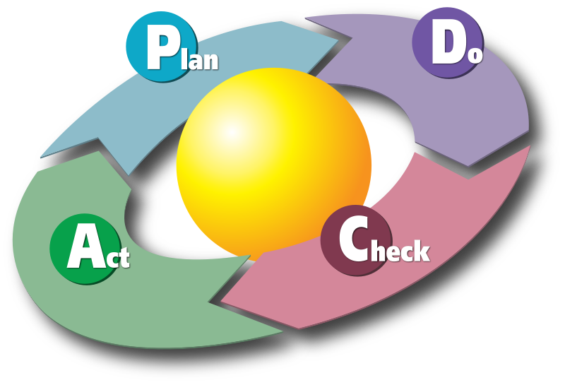
Plan-Do-Check-Act Cycle
See ISO 9001:2008 Introduction p. vi for more detailed version

Slide 7
What is a Quality Management System? II
Toyota Production System: also known as “Toyota Way” or “just-in-time” or “lean production”
Reduce all processes to simplest elements
Combine elements to eliminate irrationality, inconsistency and waste
Engage everyone in monitoring and continuous improvement
Stop production until cause of problem has been identified and addressed
Ask “Why” five times to find root causes
Collaborate with suppliers and customers
Motorola’s Six Sigma System (6σ)
Quality management program based on statistical analyses that results in production systems that produce fewer than 3.4 defects per million units

Slide 8
Five Whys: Example
My car will not start. (the problem)
Why? - The battery is dead. (first why)
Why? - The alternator is not functioning. (second why)
Why? - The alternator belt has broken. (third why)
Why? - The alternator belt was well beyond its useful service life and has never been replaced. (fourth why)
Why? - I have not been maintaining my car according to the recommended service schedule. (fifth why, a root cause)
Source: Wikipedia ‘5 Whys”

Slide 9
What is ISO 9000?
Production control system standard developed to address quality problems in military
Require development of formal policies, audit to policy
Production of top quality concrete life preservers is possible
Increase bureaucracy, quality improvements uncertain
ISO 9001:1994 20 requirements, focus on control
ISO 9001:2000 Reforms: focus on process improvements, responsibility of top management to create a learning organization
Closer to Deming’s vision of dynamic, collaborative quality management
Merge design and production by focus on continual process improvement
But retain emphasis on record keeping, audits
Integrate 20 requirements into 5 more general requirements
Quality Management System
Management Responsibility
Resource Management
Product Realization
Measurement, Analysis, and Improvement

Slide 10
ISO 9001 Certification
ISO 9000 Certification
Document processes
Conduct internal audit, fix any problems that arise
Conduct external audit, fix any problems, issue certificate
Certificate renewal every 3 years, internal audits more often
Who can certify?
In most countries, accreditation of ISO 9000 registrars is voluntary [according to ISO, analysis varies if certification is required by law]
ANSI-ASQ National Accreditation Board (ANAB)
Government agency in most countries
ISO Guide 65 provides general requirements for certifying bodies
ISO 17011 standard for certifying body procedures
International Accreditation Forum
Increase international recognition of national accreditation
Certify once, accepted everywhere?

Slide 11
What if supplier provides a defective product?
ISO 9001:2008 7.4 Purchasing
Organization must evaluate and select suppliers based on organization’s requirements, records of supplier evaluations must be maintained 4.2.4
Purchasing information: describe product plus procedures, personnel qualifications, quality management system required
Purchaser verification of conformity to requirements
Normal business practice if defective product discovered
Buyer requires a “non-conformity report” from supplier providing a “corrective and preventive action analysis”
What went wrong?
What was done to fix it? (corrective action)
What was done to make sure it never happens again (preventive action)
If non-conformity report is not acceptable to buyer, then supplier will be disqualified from future business
NB: this slide was added after the video was made to clarify this topic

Slide 12
Members of ISO 9000 Family of Standards
ISO 9000 Generic
ISO/TS 16949 Global Automobile Industry
Replaces QS 9000 US Domestic Auto Industry
ISO 13485 Medical Device Manufacturing
ISO/TS 29001 Petrochemical Industry
AS 9000 Aerospace Industry
PS 9000 Pharmaceutical Packaging Industry
TL 9000 Telecom Industry
OHSAS 18001 Occupational Health & Safety
Others?

Slide 13
ISO Plan-Do-Check-Act Standards (as of 2009)
ISO 9000
Quality Management Systems
ISO 14000
Environmental Management Systems
ISO 20000
IT Service Management Systems
ISO 22000
Food safety systems
ISO 26000
Social Responsibility Management Systems
ISO 27000
Information System Security Management Systems
ISO 28000
Supply Chain Security Systems
ISO 30000
Ship Breaking/Recycling Management Systems
ISO 31000
Risk Management System Standards

Slide 14
Examples of Plan-Do-Check-Act in Law
Federal Trade Commission enforcement actions against merchants that fail to protect customer information
www.ftc.gov/privacy/privacyinitiatives/promises_enf.html
Financial Services
Anti-Money Laundering Program
Identity Theft “Red Flags” Rule
Gramm-Leach-Bliley Safeguards Rule
Health Care
HIPPA Security Rule
Electronic Discovery Case Review and Enforcement of Discovery Obligations (“CREDO”)
Qualcomm Inc. v. Broadcom Corp., 548 F.3d 1004 (Fed. Cir. 2008) sanctions for attorney misconduct
Federal Information Security Management Act
Apply NIST Standards
Others?

Slide 15
Plan-Do-Check-Act Outside of Commerce
“Evidence-Based Medicine” in health care
“Outcome-based assessment” in education
Others?

Slide 16
Legal Requirements for ISO 9000 Certification
One way to qualify to use CE marking in EU
Others?

