Slide 1

UW Advanced TB Research Training Course
September 12, 2022
Immunology & Vaccines
1. Innate Immunity & HDTs: Tom Hawn, UW
2. Back to the future with BCG: Chetan Seshadri, UW
3. Insights from animal models: Kevin Urdahl, SCRI
4. Host-pathogen interactions in the lungs: Rhea Coler, SCRI
5. Status of current vaccines and vaccine trials:
Andrew Fiore-Gartland, FHCC
6. Expert Panel Roundtable: Birgitte Geising, WHO
Willem Hanekom, AHRI
7. Breakout Discussions
8. Report Back and Close

Slide 2
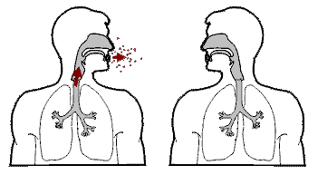
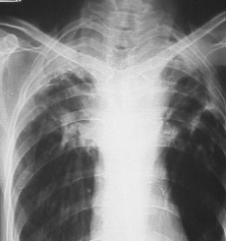


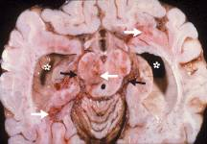
Immunology & TB Pathogenesis
Vaccine challenges
Seshadri, Fiore-Gartland, Urdahl
WHY?
Urdahl
Hawn
Seshadri
Coler
WHY?
Horne (Thurs)
T
Pulmonary Dz (80%)
Lung 1° Infection
Alveolar Mφ
Spread to LN
Bacillemia
T
Lymph Node
Bone (Pott’s Disease)
Genitourinary
Hawn
WHY?
Simmons
(Thurs)
A. Primary Progressive Dz
Or
B. “LTBI”
No Infection
Hewlett NEJM (2004)
“Rich Foci”
Meninges & Brain
Disseminated
Miliary
Clear
Infection
“Reactivate”
T

Slide 3
Innate Immunity & Host Directed Therapies
Thomas Hawn, MD-PhD
Division of Allergy & Infectious Diseases
Department of Medicine
University of Washington
Outline
1. Mtb & Macrophages
A. Sensing Mtb
B. Killing Mtb
2. Mtb & other Myeloid Cells: Neutrophils, Dendritic Cells
3. Mtb & the Innate-Adaptive Interface
4. TB Innate Immunity & Host Directed Therapies

Slide 4
Can TB be cured or eradicated?
Is immune assistance needed?
Mtb mRNA after 6m Rx
N=99 TB subjects in South Africa,
treated per standard protocol
Outcomes:
96% clinically “cured” at M6
M6 sputum cx:
N=76 negative
N=8 positive
N=12 initially negative, turned + by 24M
PET-CT scan at Dx, M1 and M6 of Rx
Mtb mRNA after 6m Rx
N=75
(60 cured, 4 failed, 9 recurrent)
37% of cured group with detectable mRNA
PET-CT after 6m Rx:
14% resolved
52% improved
35% mixed
16% only with intensified lesions
In subjects with apparent clinical cure after 6 months of Rx, many have positive PET-CT and/or detectable Mtb RNA
Malherbe, Nature Medicine, 2016

Slide 5
Innate Immunity & Mtb
Mtb
T
RSTR
Classical: Class I or II restricted
Heterologous Immunity (BCG, NTMs)
2. “Innate T-cells” (CD1, MR1, γδ, HLA-E)
Monocyte, Mφ or DC
LTBI
B
Uptake
Phagosome & Intracellular Niche
Natural Ab
T cell-dependent
T independent
Killing
EFFECTOR
INNATE
ADAPTIVE

Slide 6
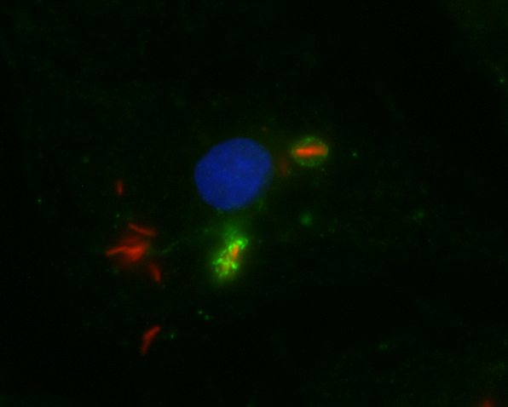
Mtb & Macrophages:
The cellular home of Mtb
>70k years of co-evolution
Point-Counterpoint relationship
Mtb
Phagocytosis
Human monocyte-derived macrophage infected with Mtb-Cherry (red)
Co-staining:
LC3+ autophagosome (green)
DAPI nuclear stain (blue)
Image from Reynolds & Hawn

Slide 7
Mtb resides in phagolysosome compartment with escape to cytosol
Mtb infected dendritic cell, immunogold labelling of LAMP1
Mtb in cytoplasm
Mtb in phagolysosome
f=cytoplasm
e=phagosome membrane
c=Cell wall
van der Wel et al Cell 129:1287-98 (2007)

Slide 8
Innate Immunity & Mtb
Mtb
TLR2
TLR1/6
DC-SIGN
Extracellular
Cytoplasm
Dectin-1
Mincle
TLR9
Mtb
Endosome
Phagosome
Cytoplasmic Sensors
NOD2, NALP3, AIM2, cGAS/STING
NF-κB
Nucleus
NF-κB
Activation of immune response genes

Slide 9
Mycobacteria cell wall: a potent stimulus …
Molecules
Surface Lipids
PDIM
Mycolic Acid,
TDM
Mycomembrane
Arabinogalactan
ManLAM, AraLAM
Peptidoglycan
Peptidoglycan
Periplasm
Plasma membrane
Lipopeptides
Cytoplasm

Slide 10
… with clinical consequences
BCG in Freund’s Adjuvant
BCG used to treat bladder cancer
M. leprae & immune reactions
Mtb & paradoxical worsening
TB-HIV IRIS
Mtb & immune pathology

Slide 11
Mtb & Esx1: an escape mechanism
Type VII secretion system
Enables escape from phagosome to cytoplasm
Esx1 mutant: attenuated, also Type I IFN secretion decreased
BCG lacks Esx1
Phagosome
Esx1
Mtb
Phagolysosome
Lysosome
Notes:
RM: Is this your own unpublished figure?

Slide 12
Phagocytosis & Autophagy: Mtb Killing Pathways
Autophagy
Mtb
Phagocytosis
LAP
(LC3-Associated Phagocytosis)
Mtb
Mtb
Phagosome
ESX1, DNA & STING
Trigger autophagy
Mtb
LC3
RUBICON
Phase 1: Initiation
LAPosome
Lysosome
ROS
Lysosome
Mtb
ULK-p62-TBK1
LC3
Mtb
Mtb
Phase 2: Elongation & Closure
LAPolysosome
Phagolysosome
Phase 3: Maturation
Mtb
Autophagosome
Mtb Killed

Slide 13
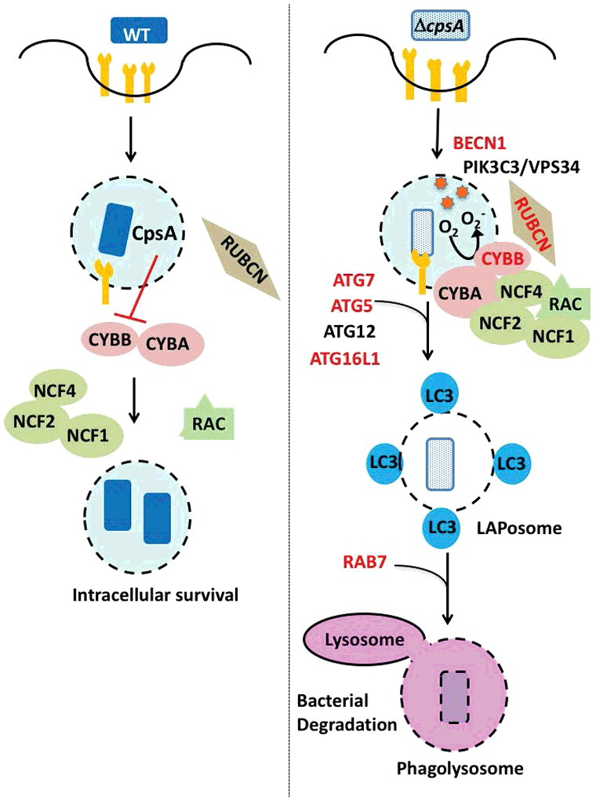
… that can be subverted
Koster PNAS 2017
Koster et al Autophagy 14: 552-554 (2018)

Slide 14
Mtb & Macrophages: the standoff
Host Killing Mechanisms
Phagocytosis
Low vacuole pH
Phagosome enzymes
Autophagy
Nutrient Deprivation
Pro-inflammatory signaling:
e.g. TNF, IL1β
Apoptotic cell death
Metabolism: glycolysis
Mtb Evasion Mechanisms
Block LAP (via CpsA)
Block acidification (PtpA)
Escape phagosome (Esx1)
Switch to cholesterol source
Fe siderophores
Inhibit IL-1β effects via IFNβ
Promote necrosis (CpnT/TNT)
Stimulate FAO
Wong PNAS 2011; Huang JEM 2018, Lee JBC 2013, Koster PNAS 2017; Chandra Mbio 2020, Sun Nat Struc Biol 2015; Pajuelo Cell Rept 2018 , Manzanillo Nature 2013; Kimmey Nature 2015; Jayaraman JI 2013; Mayer-Barber Nature 2014

Slide 15
PMNs & Mtb: an overlooked cell in TB pathogenesis
Kimmey, Stallings Nature 2015
Mishra, Sassetti, Nature Micro 2017
Stallings Nat Micro 2017

Slide 16
Dendritic cells & Ag Presentation
Innate-Adaptive Interface & how to kill Mtb
IL-12, IL-23
Mtb
MHC
TCR
CD1
T cell
MR1
Mφ or DC
IL-6
IL-1β
TNF
IFNγ
Inhibits IFNγ induced CIITA & MHCII Expression
IFNγR
Mtb
CIITA, MHCII, IFNγ, Mtb Harding & Boom
Mtb killing via: cathelicidin, autophagy, nitric oxide, ROS

Slide 17
IFNγ, & Mycobacteria:
A Unique Immunogenetic relationship
Children & Mendelian
Mostly BCG, NTMs.
Salmonella
Adults & Acquired
HIV:
MAC, MTb, Crypto, Histo, Salmonella, Penicillium et al
Mφ or DC
IL-12
T cell
Mutations
IKKγ
(ΝΕΜΟ)
IL-12p40
IL-12R
IFNγR1
IFNγR2
STAT1
IKKγ (NEMO)
IL-12R
IFNγR
IFNγ
But
IFNγ is not a correlate of immune protection
STAT1
MICROBIAL KILLING
Genetic Mutations associated with susceptibility to Mycobacteria
Casanova & Abel Annu Rev Imm (2002); Browne NEJM 2012

Slide 18
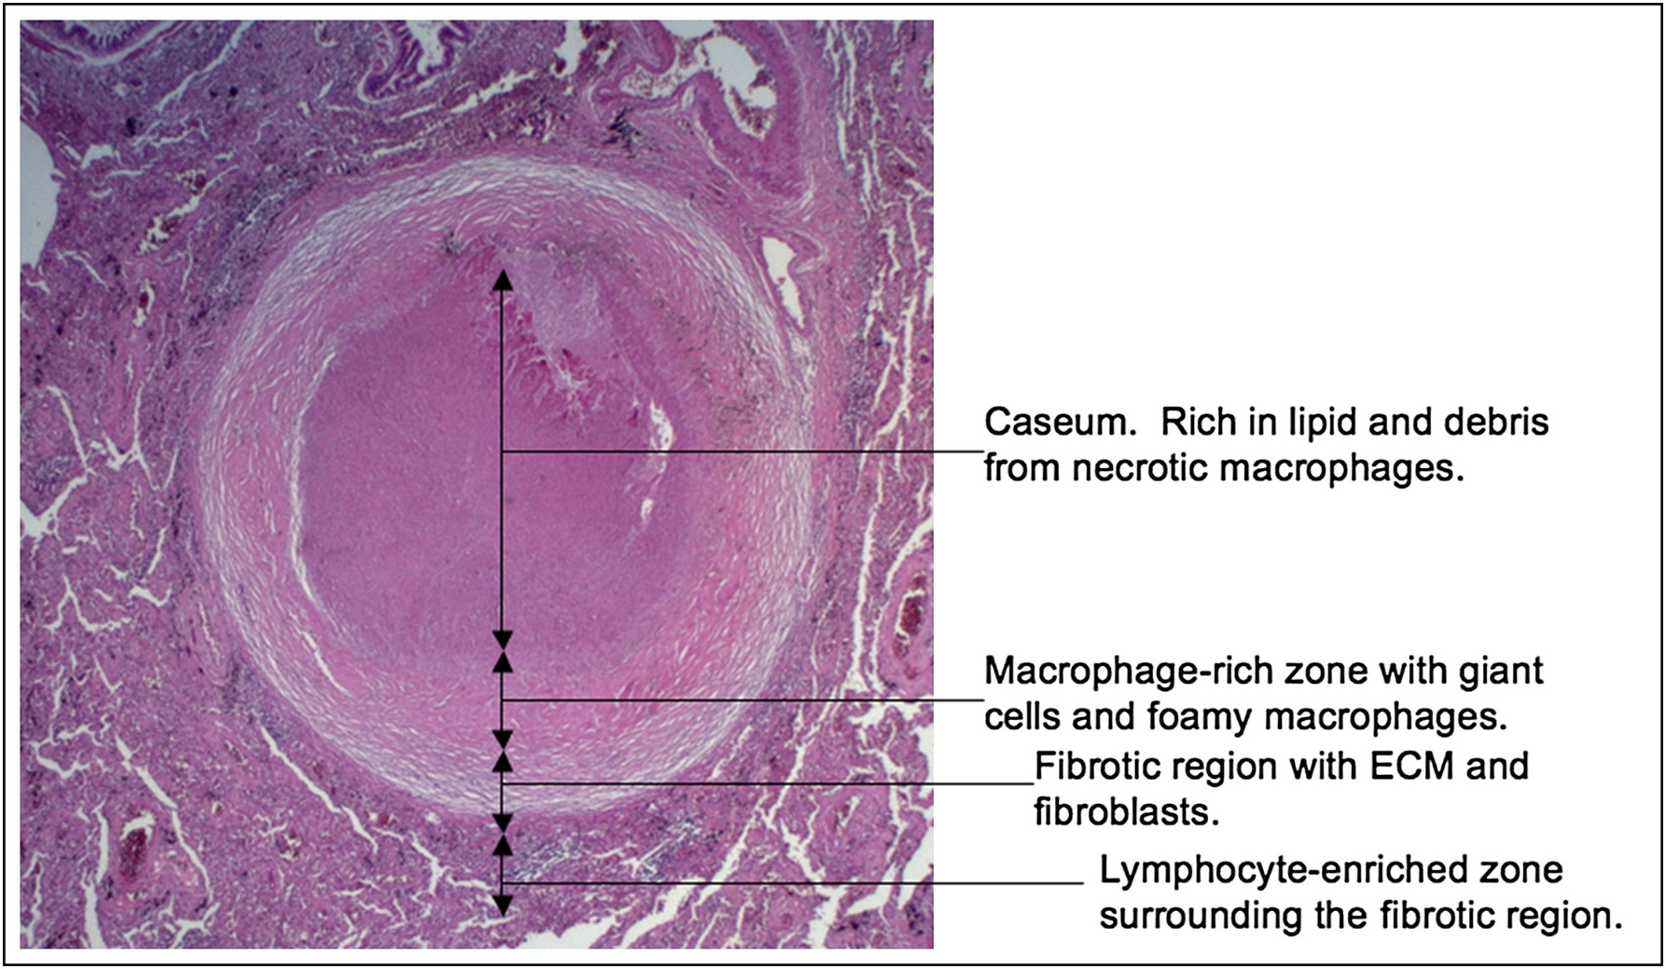
Mtb & the Granuloma: a lifelong relationship
Russell et al Cell Host Microbe 8: 68-76 (2010)

Slide 19
The Mtb Granuloma: the standoff
Original paradigm: wall off Mtb
Current paradigm: dynamic structure. Mtb exploits macrophages via ESX1 -specific necrosis, cell-cell spread, & recruitment
Caseum & lipids: complicated host-pathogen interface
T cell
Mφ
Hypoxia: induces Mtb transcriptional program & persistence mechanisms
Primary vs Post-Primary Granuloma Structure & Function Differ
Davis Cell 2009, Pagan CHM 2015, Galagan, Sherman Nature 2013, Hunter Tuberc 2016, Cohen Ann Rev Immun 2022

Slide 20
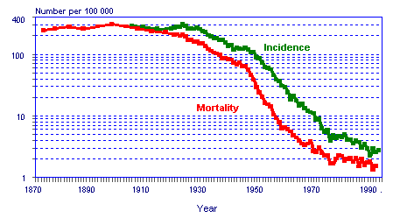
TB Treatment: The Drug & Rx Course Timeline
5000 BC to 1943:
Public health measures and improved living conditions critical components of TB control
Drug Availability
1943
1963
2000s
2012
2014
2016
2019
2021
1943 streptomycin
1952 isoniazid
1954 PZA
1962 ethambutol
1963 rifampicin
Moxifloxacin
levofloxacin (repurpose)
Linezolid
(repurpose)
Failure to shorten to 4m
REMox
OFLOTUB
RIFAQUIN
MDR shorten
Bangladesh
Includes
Clofazamine (repurpose)
STREAM
(BPaL MDR shortening RCT)
TBTC31
Rifapentine shortening to 4m works
2PHZM/2PHM
Bedaquiline
Delamanid
Pretomanid
Can Host Directed Therapies add benefit?

Slide 21
HDTs & Macrophages
Binding & uptake
Phagosome
Lipid Metabolism
Eicosanoids,
inflammation, & cell death
5. Effector Function: autophagy
Hawn et al MMBR 2014

Slide 22
HDTs & IMMUNOPATHOLOGY
Neutrophils, Anti-Fibrotics, & MMPs

Slide 23
Outcomes
1°: safety and tolerability up until day 210
2°:
SCC D56
FEV1 & FVC D56,180,540
Phase 2, open-label RCT
N=200 (40 per arm)
South Africa
CC-11050
Everolimus
Auranofin
Ergocalciferol
Placebo
Wallis et al Lancet Resp Med 2021

Slide 24
Everolimus
Activating Autophagy: An Mtb Killing Strategy
Everolimus
Rapamycin
Nitazoxanide
Gefitinib
Fluoxetine
SMERs
Verapamil
cAMP
mTORC
AMPK
Metformin
AMPK
ULK1
PI3K-complex
initiation
elongation
Tat-beclin
Lithium
Valproate
Haloperidol
degradation

Slide 25
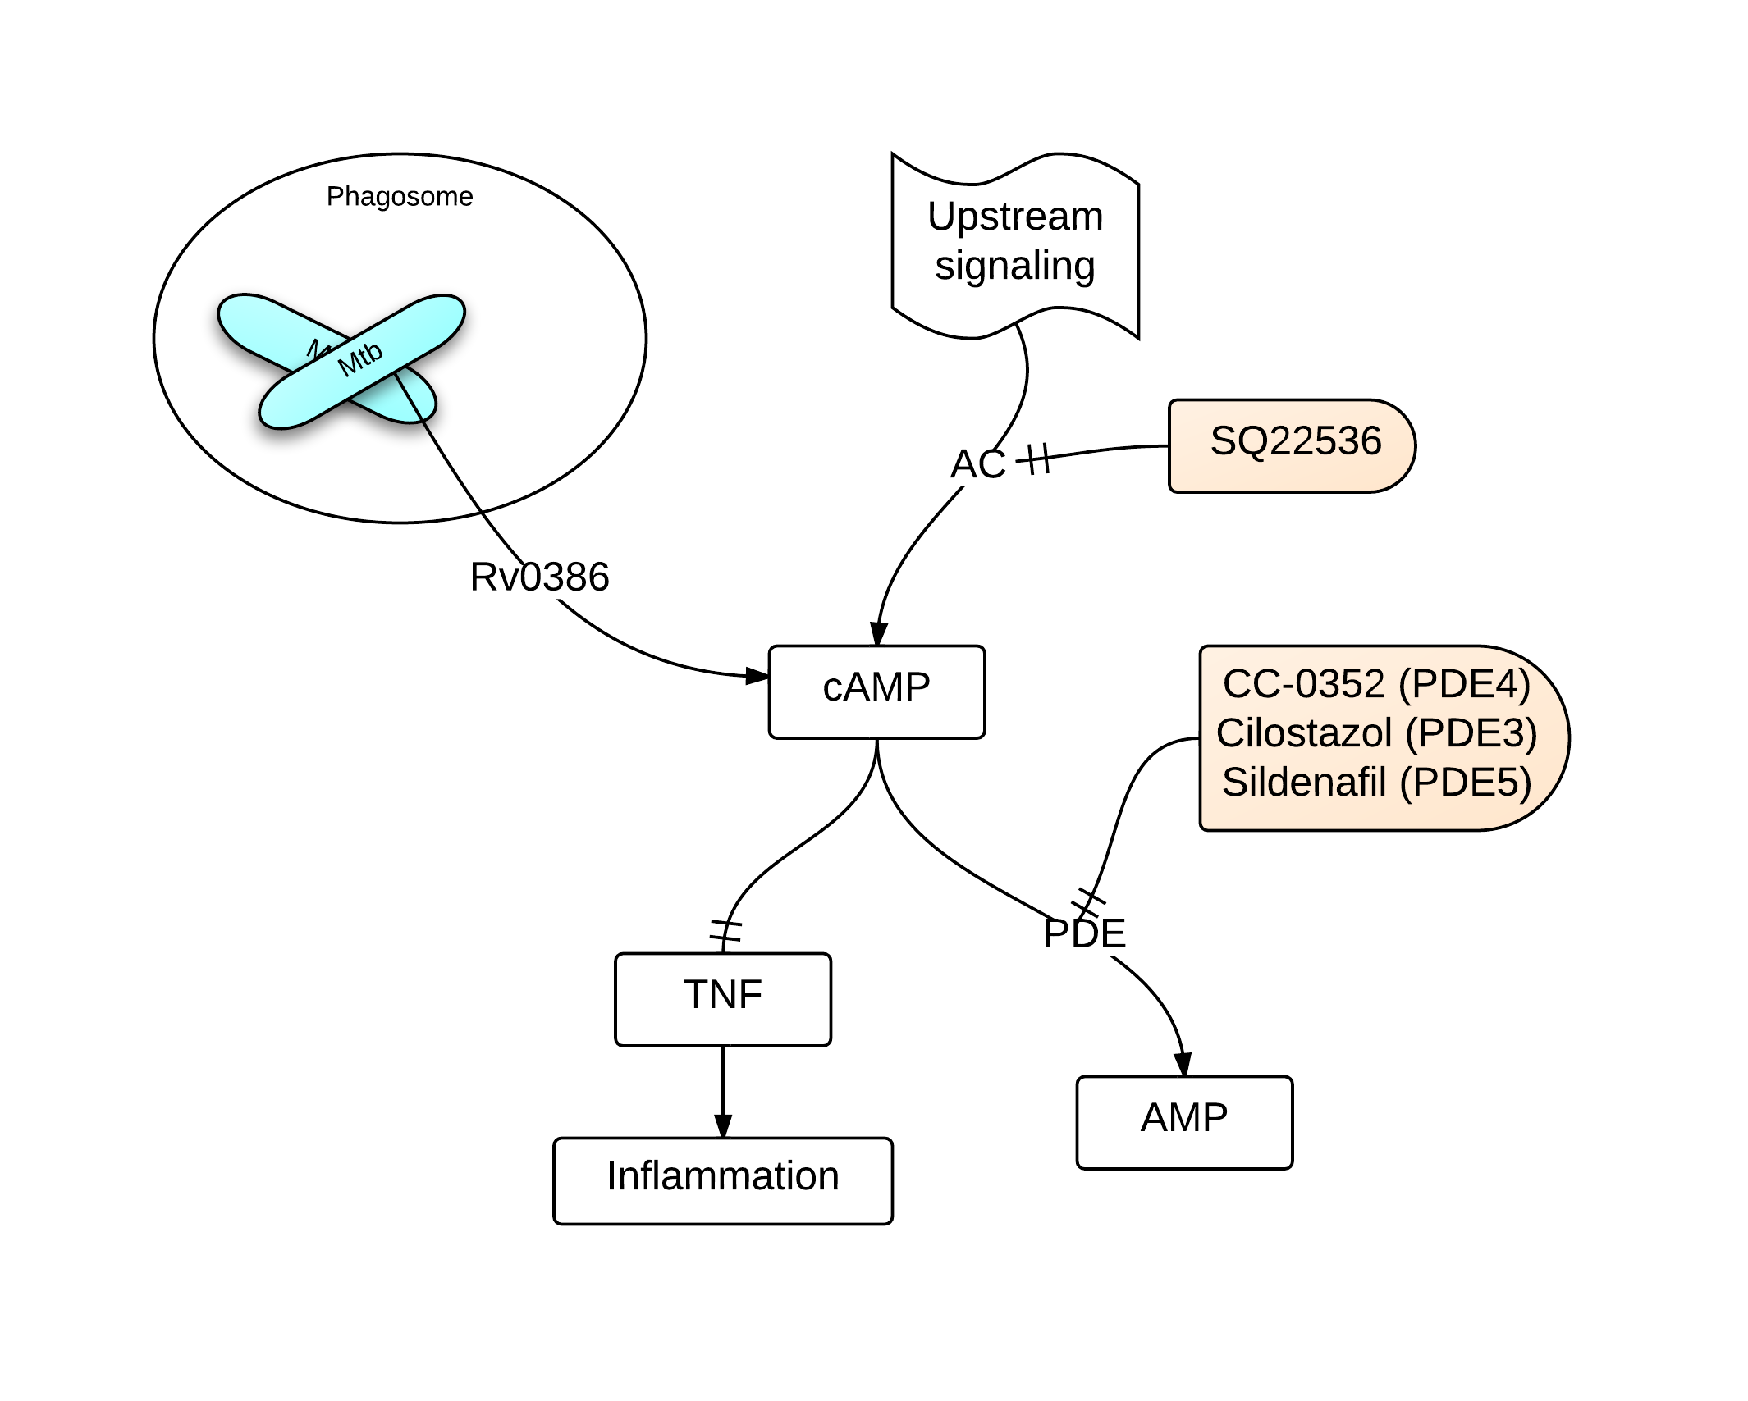
CC-11050
TNF, cAMP, & PDEi pathway
CC-11050 (PDE4)
Bacterial Effect:
cAMP & ↑MTb growth
Host Effect
cAMP & ↓TNF
PDEi
↑ cAMP & ↓TNF
2 possible benefits
1. MTB grows & can be killed
2. ↓ Host pathology

Slide 26
CC-11050 and everolimus arms with improved FEV1 at D180
Two HDTs with:
Macrophage mechanistic rationale
Clinical benefit on lung pathology

Slide 27
Lung Cavity Volume
JCI 2021

Slide 28
TB HDTs & Phase II RCTs
Common features of study design:
Phase 2, Standard ATT +/- HDT,
1° outcomes: safety & tolerability, some dose finding
2° outcomes: many include 2m SCC & lung function
Drug (trial name) | Target | Sample size per arm | Result/Status | PIs of RCT & earlier development of drug/concept
Vitamin D | Multiple | 12-190 | 7 RCTs, mostly negative | Many
Auranofin | Anti-inflammatory & bacterial | 40 | No effect | Wallis, Churchyard
Everolimus (4 months) | mTOR inhibitor, activates Autophagy | 40 | Improved FEV1 at D180 | Wallis, Churchyard, plus several in conceptual phase
CC-1050 (4 months) | PDE4i | 40 | Improved FEV1 at D180 | Wallis, Churchyard, Kaplan
Doxycycline (14 days) | MMPs + more | 15 | Reduced pulmonary cavity volume | Miow, Elkington, Friedland, Ong
Meformin (METHOD) | AMPK, autophagy |  | Begins 2021 | Kornfeld, Singhal, Wallis, Churchyard
Pravastatin (StAT-TB) | Lipid metabolism, autophagy, ? T cells | 40 | Dose finding & safety | Karakousis, Chaisson, Martinson
Rosuvastatin (ROSETTA) | Same as above | 154 |  | Paton
Imatinib | Myelopoiesis | 72 | Dose finding & safety | Kalman, Waller

Slide 29
TB Innate Immunity & HDT Summary
>70k Mtb-human macrophage evolutionary relationship & stand-off
2. Mtb exploits immune response to its advantage including effects on:
macrophages (multiple mechanisms),
granulomas (recruit cells to replicate),
neutrophils (enhanced replication) &
DCs (inhibit MHCII)
3. Cure for TB may be elusive and require more than anti-microbial drugs
4. HDTs—the pre-clinical and early clinical data is promising (CC-11050, everolimus, doxycycline) with unexpected mechanisms

Slide 30
Extra Slides

Slide 31
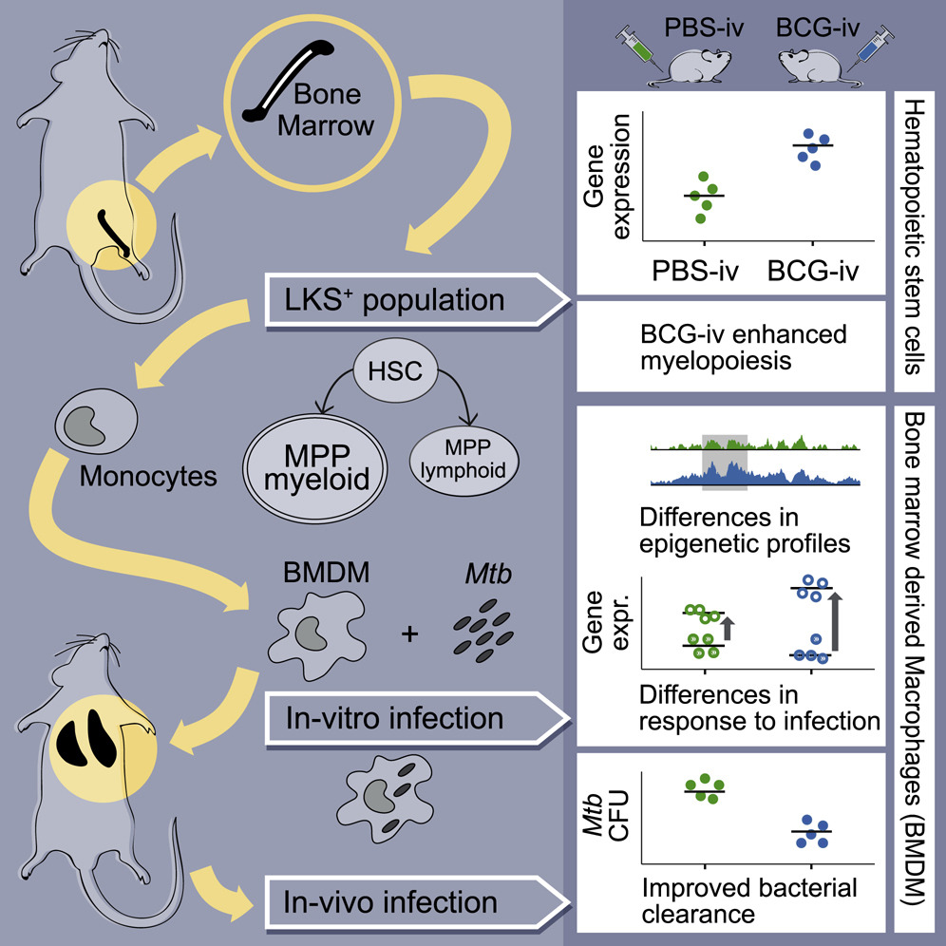
Trained Immunity
Murine Studies
BCG vaccination induces protection mediated by HSCs & myeloid lineage
Possible epigenetic mechanism of “innate memory”
Kaufmann et al Cell 2018, Cell 2020

