Slide 1
Disease modeling for TB
Stewart Chang (stewart.chang@gatesfoundation.org)
Institute for Disease Modeling
Bill & Melinda Gates Foundation

Slide 2
Why should you care about TB disease modeling?
If you’re a… | And you’re… | You may be asking…
Graduate student | Deciding whether to pursue TB research | Will TB continue to be a public health problem when I finish my degree?
TB researcher | Writing a grant | What potential impact will my research have (e.g., if made into a diagnostic)?
TB control program officer | Conducting case-finding | How did the national program set targets for case-finding?
Modeling can help answer all these questions!

Slide 3
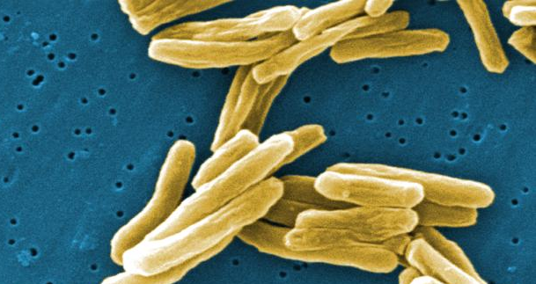
What do we mean by disease model?
By “disease model” we mean dynamical models to predict future trends in TB
Example: If we introduce a new TB vaccine in country X, how will the TB epidemic change?
Models can also refer to… | Used by… | For more information
Disease (transmission) models | WHO, funders | Dye 2015 book
Cost-effectiveness models | WHO, funders | Auguste 2016 review
Geospatial/hotspot models | NGOs, programs | Shaweno 2018 review
Drug metabolism PK/PD models | Drug companies | Fors 2020 paper
Host immune response models | Scientists | Kirschner 2017 review
Microbial evolution models | Scientists | Pecerska 2017 paper
Population-scale models
Host-scale models

Slide 4
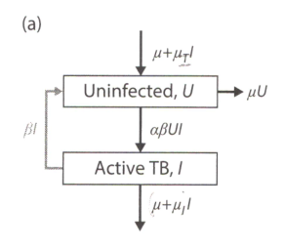
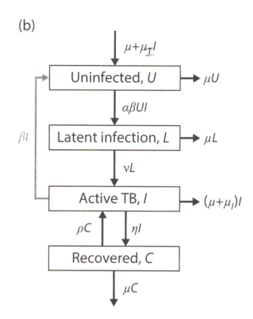
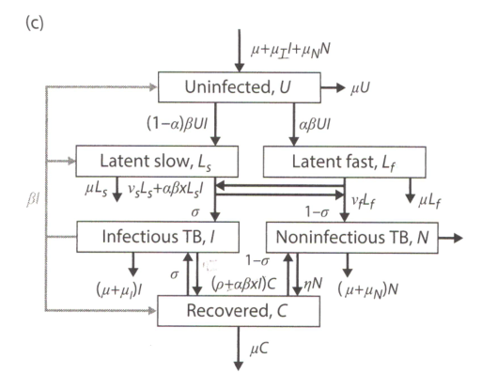
How does disease modeling work?
Start with natural history: How many states do we assume exist in TB disease?
Parameter
State variable
Dye 2015

Slide 5
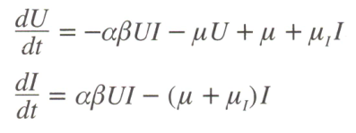
How does disease modeling work?
Start with natural history: How many states do we assume exist in TB disease?
Parameter
State variable
Dye 2015
Convert into equations or code
For (a) above
Change in state variable over time

Slide 6
How does disease modeling work?
Start with natural history: How many states do we assume exist in TB disease?
Parameter
State variable
Dye 2015
Convert into equations or code
Assign numbers to parameters, run model on computer
For (a) above
Duration of untreated TB = 2 years
Case-fatality rate of untreated TB = 50%
Implies mortality : incidence : prevalence = 1 : 2 : 4 ratio
For example, if 0.1% mortality g 2 x 0.1% = 0.2% incidence
Famous “Styblo Rule” from pre-treatment era
Change in state variable over time

Slide 7
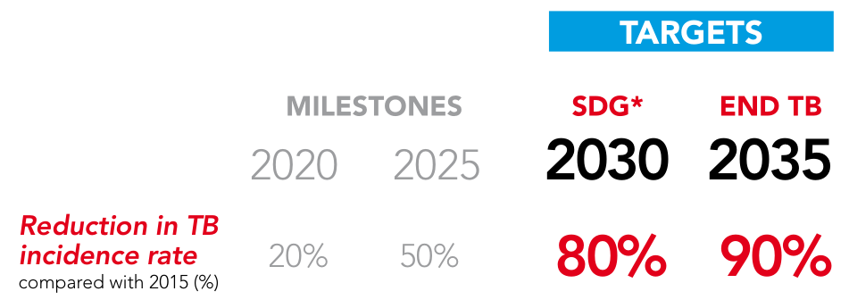
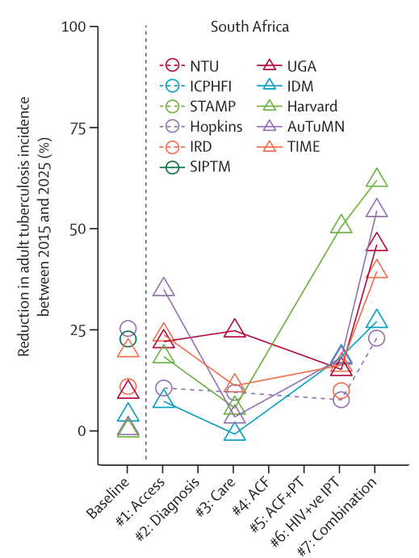
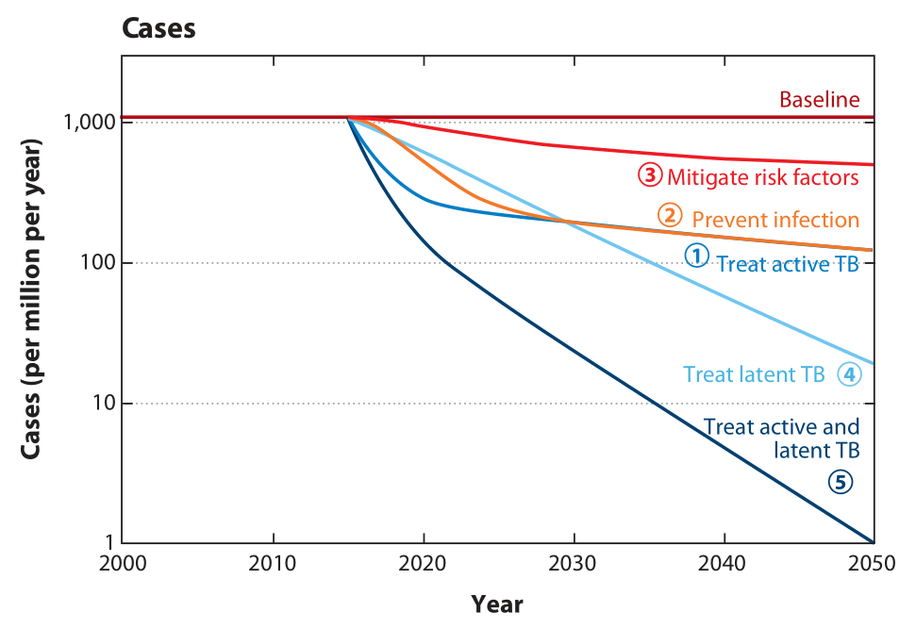
Example of high-level disease model applications
TB global targets based on model showing impact if programs scaled up
Modeling groups (including ours) evaluated if targets were feasible, e.g., 50% reduction by 2025
A few groups thought >50% reduction possible in SA
Dye 2013
Houben 2016

Slide 8
Example of high-level disease model applications
TB global targets based on model showing impact if programs scaled up
For participants:
How achievable do you think the TB targets are for your country?
What other factors would you consider important if you were trying to predict TB in your country?
Dye 2013

Slide 9
Research example: What impact will new test have?
Start with natural history (untreated TB) patient flow:
Infection rate β I
Fast rate (months⁻¹)
Latent infection, fast progressor
f %
Infected (active TB)
Uninfected
Latent infection, slow progressor
( 1 – f )%
Slow rate (years⁻¹)
Mortality rate
Self-cure rate
Death
For participants: Which state would TB testing and treatment affect?

Slide 10
Research example: What impact will new test have?
Start with natural history (untreated TB) patient flow:
Infection rate β I
Fast rate (months⁻¹)
Latent infection, fast progressor
f %
Infected (active TB)
Uninfected
Latent infection, slow progressor
( 1 – f )%
Slow rate (years⁻¹)
Mortality rate
Self-cure rate
Death
For participants: Which state would TB testing and treatment affect?

Slide 11
Add testing and treatment, take Infected and return to Uninfected:
Care-seeking rate
Sensitivity of test d %
Treatment success rate
Infected (active TB)
Treatment
Uninfected
False neg ( 1 – d )%
Treatment failure rate

Slide 12
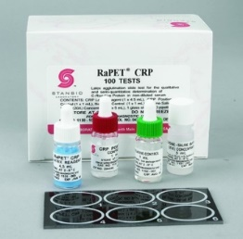
New diagnostics such as CRP, LAM may allow TB screening at HIV clinics in South Africa g what impact would this have?
South Africa: > 10 million HIV tests annually
C-reactive protein (CRP)
Rule-out test (blood)
2 mins
Lipoarabinomannan (LAM)
High specificity (urine)
25 mins
HIV clinic-based TB screening algorithm
HIV Testing
+/-
CRP
+
LAM
+
Confirmatory PCR then initiate TB treatment
-
-
Seek PCR testing based on symptoms
Brad Wagner, collab Paul Drain

Slide 13
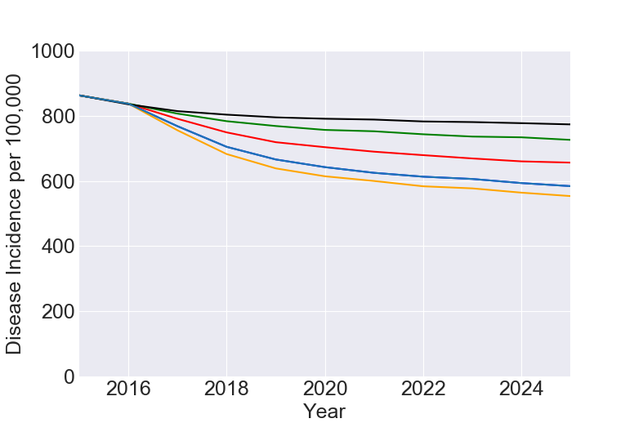
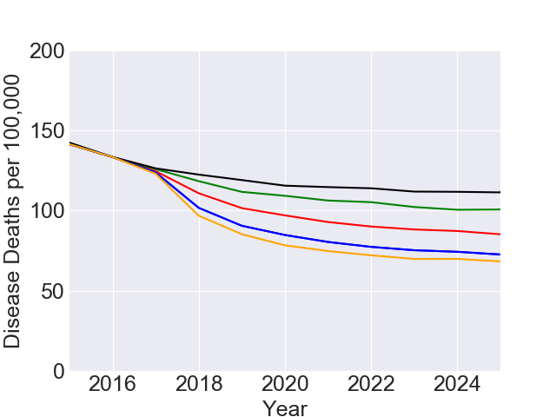
Would TB screening at HIV clinics allow SA to reach targets?
We modeled different test sensitivity scenarios in our South Africa TB model:
TB incidence
Predict tests would decrease incidence by approx. 25% by 2025
LAM test platform | Sens in HIV-neg | Sens in HIV-pos
Baseline | - | -
Alere (LAM) | 0.1 | 0.3
2nd-gen LAM | 0.3 | 0.5
2nd-gen LAM | 0.5 | 0.8
2nd-gen LAM | 0.8 | 0.8
By itself, CRP + LAM-based screening likely insufficient to reach 2025 milestones
TB mortality
Brad Wagner, collab Paul Drain

Slide 14
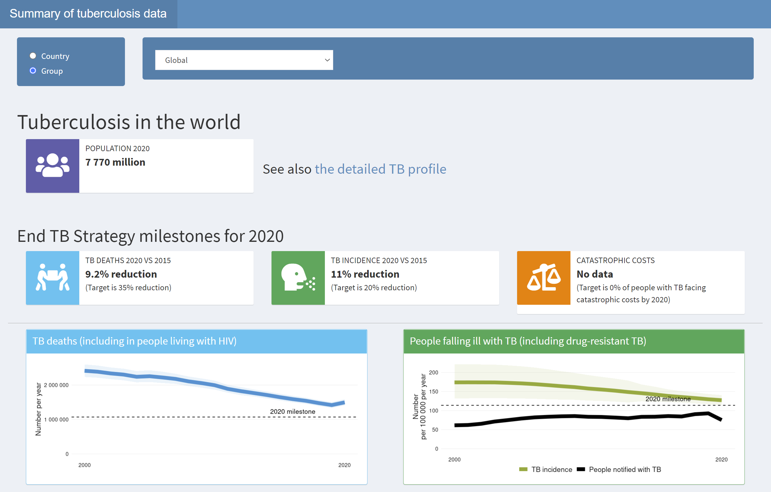
Homework 1: Check progress to 2020 milestones
https://worldhealthorg.shinyapps.io/TBrief/ (or Google “global tb data”)
Search by country
Check progress vs. 2020 milestones

Slide 15
Homework 2: Check projections toward 2030 milestones
https://www.gatesfoundation.org/goalkeepers/report/2022-report/ (or Google “goalkeepers 2022”)
Search by country
See model projections vs. 2030 milestones
Do the projections seem reasonable to you?
What factors would you include?

Slide 16
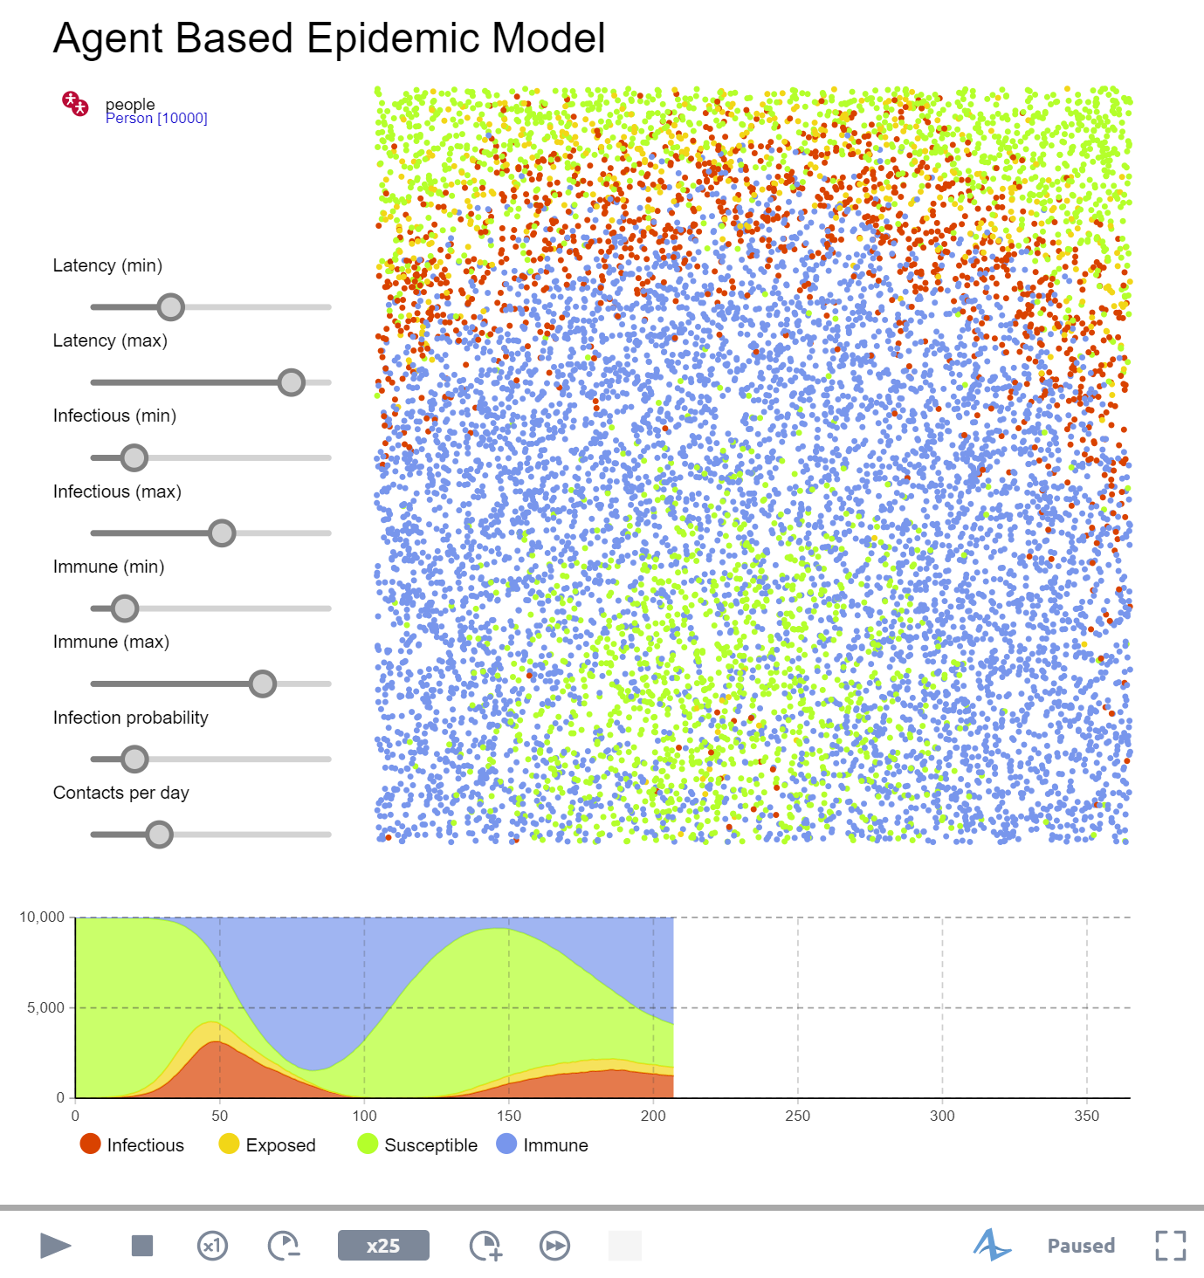
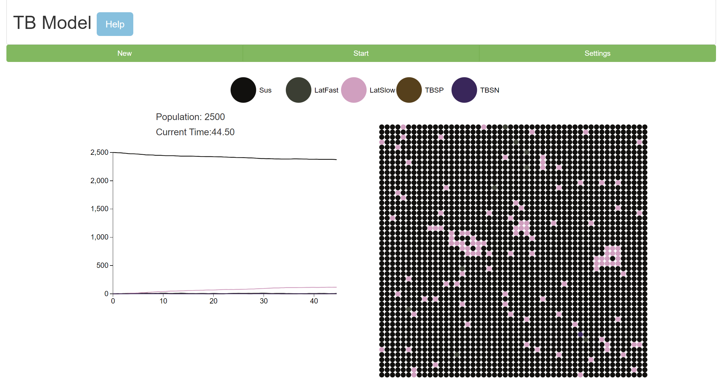
Homework 3: Try out a few disease models online
AnyLogic (generic disease): https://cloud.anylogic.com/model/6362c090-dfba-49c1-b071-e48d520cbec9
Chu-Chang Ku’s web app (TB): https://picapica314.herokuapp.com/runner-TB
What questions are they trying to answer?
How would you adapt them to your country of interest?

Slide 17
Summary
TB modeling provides a framework to think about:
TB natural history
Country-level policies
Targets for TB control
Allows us to simulate how we can try to control or eliminate TB:
For example, how we should use new tests like urine LAM test
Modeling is becoming more accessible, something everyone can try
Check out the “Homework” links, feel free to connect with me

