Slide 1
Back to the Future with BCG
Chetan Seshadri, M.D.
Associate Professor
University of Washington – Seattle, USA
Advanced TB Research Training Course
Session 1 – Immunology and Vaccines
September 12th, 2022

Slide 2
Disclosures
No financial conflicts of interest
Funding

Slide 3
The Vaccine Playbook
SARS-CoV-2
Rappouli and Aderem Nature 2011

Slide 4
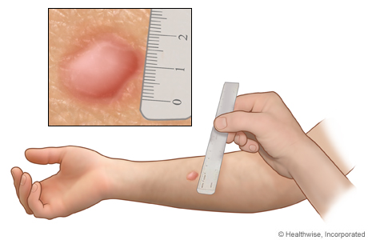
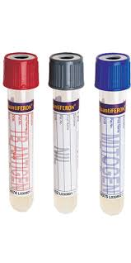
Active TB - The Tip of the Iceberg
Active TB
9 million
Tuberculin Skin
Test (TST)
Latent TB
2300 million?
www.webmd.com
Interferon Gamma
Release Assay (IGRA)
www.laboratoryalliance.com

Slide 5
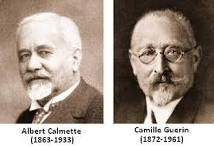
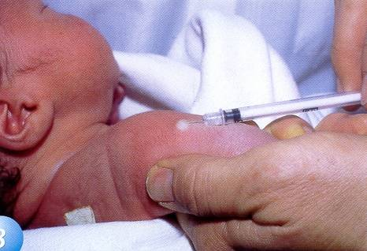
A Brief History of BCG
Attenuated strain of Mycobacterium bovis.
Shown to be effective in safe and effective in animals.
1921 – 1st infant receives oral BCG as a preventive vaccine in Paris.
Still the standard of care worldwide – over 1 billion doses administered 100 years later!
Slide courtesy of Tom Scriba

Slide 6
BCG Prevents TB Disease…Sometimes
Effective in preventing disseminated TB, deaths due to TB, and all cause mortality in infants.
Inconsistent efficacy against pulmonary TB in adults
Infants don’t spread TB, so the current strategy will never stem the epidemic!
Potential explanations
Serial passage over 90 years
Variation by strain
Exposure to environmental mycobacteria
Can BCG prevent M.tb infection?
Indiamart.com

Slide 7
H4:IC31
Sanofi Pasteur
Completed Phase I
990 South African adolescents
HIV-uninfected, IGRA-negative
Randomized to BCG, H4:IC31, or placebo (1:1:1)
Serial IGRA q6 months over 2 years
1º Outcome: Initial IGRA conversion
2º Outcome: Sustained IGRA conversion
gograph.com
BCG
Statens Serum Institut
Supported by
observational studies
Indiamart.com
Nemes et al. NEJM 2018

Slide 8
Initial
Sustained
Initial IGRA Conversion (Efficacy)
H4:IC31: 9.4% (p=0.63)
BCG: 20.1% (p=0.29)
Sustained IGRA Conversion (Efficacy)
H4:IC31: 30.5% (p=0.16)
BCG: 45.4% (p=0.03)
BCG revaccination prevents sustained IGRA conversion among adolescents.
Is this a surrogate for stable M.tb infection (vs. exposure)?
IFN-γ (IU/ml)
IGRA conversion (month)
Does prevention of infection translate to prevention of disease?
Nemes et al. NEJM 2018

Slide 9
BCG REVAX
Randomized, placebo controlled, Phase IIb study of BCG for prevention of sustained infection with M.tb (ClinicalTrials.gov NCT04152161)
1820 participants
Primary Outcome: sustained IGRA conversion (3 months and 6 months)
Secondary Outcome: sustained, durable IGRA conversion (36 and 48 months)
Estimated Primary Completion Date: April 2023
Estimated Study Completion Date: January 2026

Slide 10
Immune Correlates Program
Objective: Identify immune responses induced by BCG and associated with protection against M.tb infection (sustained IGRA conversion)
Nemes et al. Vaccine Insights, in press

Slide 11
BCG Prevents Respiratory Tract Infections
Nemes et al.
ACTIVATE
 | RTI Indicence | P-value
BCG | 2.1% | --
H4:IC31 | 9.4% | <0.001
Placebo | 7.9% | <0.001
Nemes et al. NEJM 2018
Giamarellos-Bourboulis et al. Cell 2020

Slide 12
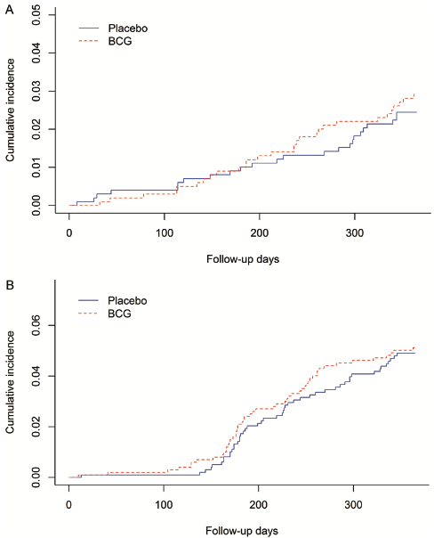
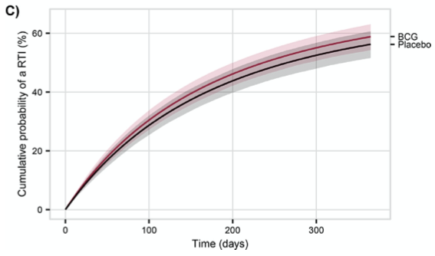
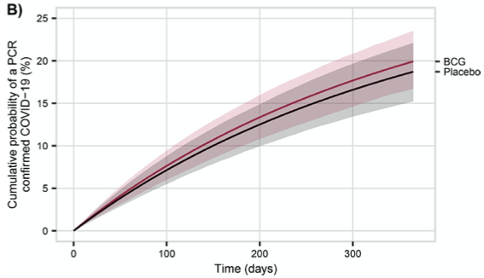
Can BCG Prevent COVID-19?
Older European Adults
South African Healthcare Workers
Respiratory Tract Infections
(Clinical)
SARS-CoV-2
(PCR)
Moorlag et al. CID. 2022
Upton et al. EclinicalMedicine 2022

Slide 13
Intravenous BCG protects against M.tb infection
T cells
Macs
Darrah et al. Nature 2020; Sharpe et al. Tuberculosis 2016; Barclay WR et al. Infect Immun 1971

Slide 14
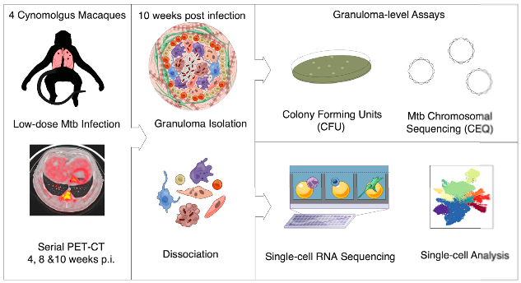
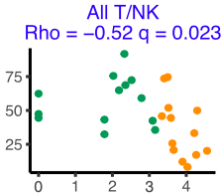
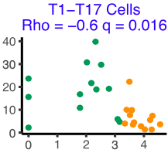
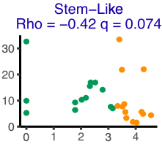
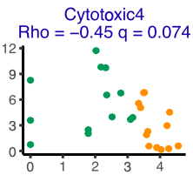
T cells associated with low-burden granulomas
Abundance
Abundance
CFU
CFU
Abundance
Abundance
CFU
CFU
Gideon, Hughes, Wadsworth et al. Immunity 2022

Slide 15
LAM IgM is a correlate of IV BCG induced protection
Irvine E. et al. Nature Immunology 2021

Slide 16
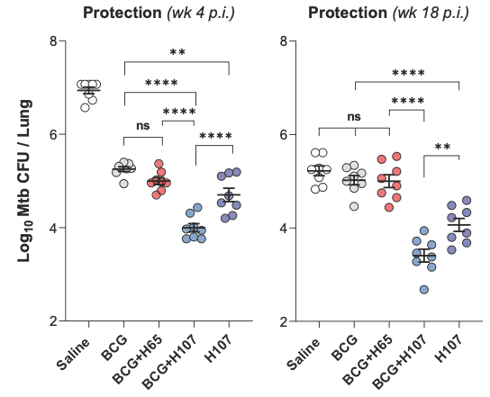
Co-administration of BCG and subunit vaccine
H107 is a polyvalent subunit vaccine containing eight antigens expressed in M.tb but not in BCG.
Mechanism of protection
Less differentiated (more durable?) CD4 T cells
Increased production of IL-17
Reciprocal co-adjuvant effect (BCG boost H107 and vice versa
Woodward et al. Nat Comm 2021

Slide 17
T cells also recognize non-peptide antigens
CD8
T-cell
γδ
T-cell
Metabolite-
specific T-cell
Lipid-specific
T-cell
MHC-I
BTN3A1
MR1
CD1
TB
TB
TB
TB
Donor-unrestricted T cells (DURTs) leverage conserved modes of antigen presentation (not MHC)
Van Rhijn & Moody, J Immunology 2015
Notes:
Trend towards increased clonality in LTBIs
No overall difference in clone sharing between groups (Jaccard index – proportion of unique rearrangements shared between all pairs of subjects)
RSTRs have the lowest JS divergence. This indicates that LTBIs have highly unique repertoires, even from each other.

Slide 18
DURTs are expanded after IV BCG in NHP
(Metabolite)
(Lipid)
Darrah et al. Nature 2020

Slide 19
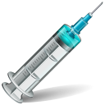
The Effect of BCG on DURTs in Humans
Early
BCG
0
10
Delayed
BCG
0
10
Delayed
Early
Delayed
Early
Delayed
Early
Delayed
Early
Gela et al. EBioMedicine. 2022

Slide 20
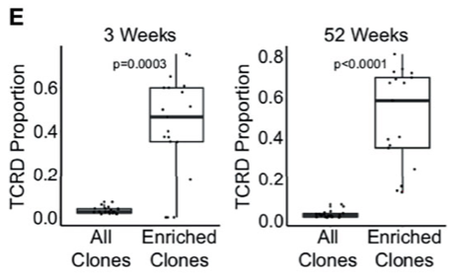
TCR-δ clonotypes are durably expanded after BCG
James et al. Frontiers Immunol 2022.

Slide 21
Take Home Points and Questions
Intradermal BCG prevents M.tb infection in IGRA(-) adolescents.
Confirmatory trial (BCG REVAX) ongoing. Will this translate to a reduction in TB disease?
Opportunity to identify immune correlates of protection to facilitate immuno-bridging studies
Intravenous BCG prevents M.tb disease in macaques.
Model system to dissect protective immune mechanisms (T cells, antibodies, trained immunity)
Pre-existing LAM IgM and T1-T17 cells are correlates of protection
A tractable clinical strategy? (The malaria experience)
γδ T cells are expanded after IV BCG in macaques and intradermal BCG in humans. Do they have a role in mediating protection?

Slide 22
Questions?
Acknowledgements
Elisa Nemes
Jordan McCrary
Paul Drain
https://seshadrilab.weebly.com
Post-doctoral applications welcome!

Slide 23
TEMPLATE

