Slide 1
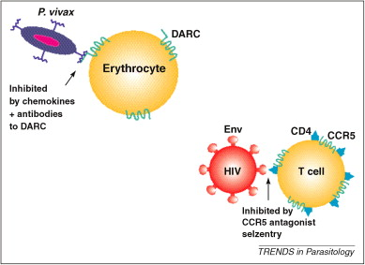

Resister Populations and Mtb Transmission: measuring resistance to incident Mtb infection
Jason Simmons, MD/PhD
Acting Assistant Professor, Division of Allergy and Infectious Diseases
University of Washington Department of Medicine
Advanced TB Research Course
September 15, 2022
DOI: (10.1016/j.pt.2010.03.010)
Notes:
Thanks for the introduction. In the laboratories of Tom Hawn and Chetan Seshadri, who each presented on the first day of the course, we’ve been interested in better defining the immune responses in humans who apparently naturally resist infection with Mycobacterium tuberculosis. As is the case with other pathogens like P.vivax malaria and HIV where some humans genetically encode resistance mechanisms to infection, our early hypothesis was that Mtb resisters employ mechanisms to more efficiently clear the bacterium upon exposure, and we could gain rich insight both into Mtb-host interactions and potentially identify therapeutic targets.

Slide 2
Outline
Defining incident infection
Historical and epidemiologic evidence of ‘resister’ populations
Contemporary Mtb resistance studies
  Genetics
  Immunology
Summary and gaps in knowledge
Notes:
This talk falls in the session of Mtb transmission and aerobiology, which is relevant because studying resistance mechanisms requires high-transmission settings, and we will discuss both historical and contemporary examples. It is also an opportunity to further discuss Mtb diagnostics that we use to establish incident Mtb infection and the limitations of these diagnostics.

Slide 3
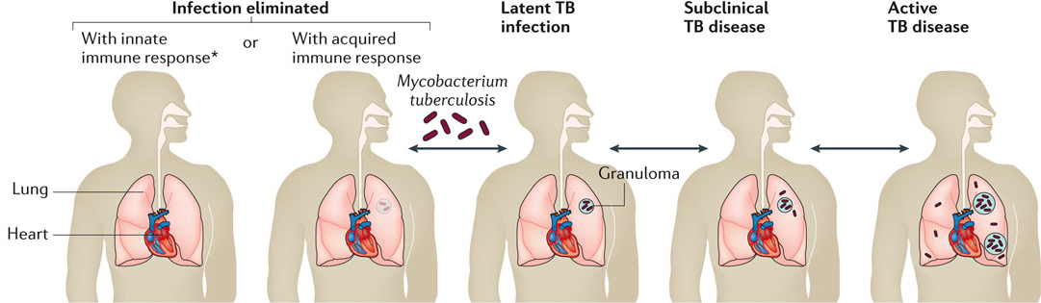
1. Defining Mtb infection
+ Immune sensitization (+IGRA/+TST)
Pai, M. et al. (2016) Tuberculosis; Nat. Rev. Dis. Primers
Notes:
How do we define or identify incident Mtb infection? Three basic outcomes upon exposure to aerosolized Mtb are possible which include the establishment of infection and progression to clinical symptoms and disease, establishment of infection that is contained by an effective immune response, or failure to establish infection potentially by its early clearance by an effective immune response.
Since the burden of bacteria is extremely low, it is essentially impossible with our existing tools to directly identify the bacteria in asymptomatic patients who are containing the bacterial infection. So, we rely on the tuberculin skin test and/or the IGRA. A positive TST or IGRA in the absence of symptoms or radiographic signs of TB disease is what is clinically termed ‘latent tuberculosis infection.’ But it is important to acknowledge that this test is really a measure of immune sensitization and it is possibly some proportion of individuals who test positive may actually have cleared the infection, particularly since modeling suggests up to ¼ of the world meets criteria of ‘latent infection’ based on immune sensitization. Furthermore, among individuals who test negative, it is not immediately clear whether they have resisted infection or simply were not adequately exposed.

Slide 4
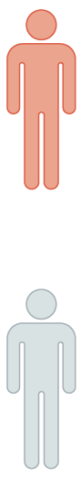
1. Defining Mtb resistance
LTBI
(TBInd)
+ TST and/or +IFNγ release assay (IGRA)
(may demonstrate incident infection)
“Resister”
(RSTR)
High Mtb exposure
Negative LTBI testing (TST and IGRA)
Stability of phenotype
  (longitudinal sampling)
Simmons et al. 2018, Nat Rev Imm
Behr et al. 2021, AJRCCM
Notes:
TBInd = TB Infected no disease

Slide 5
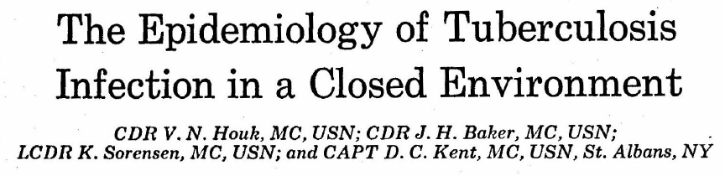
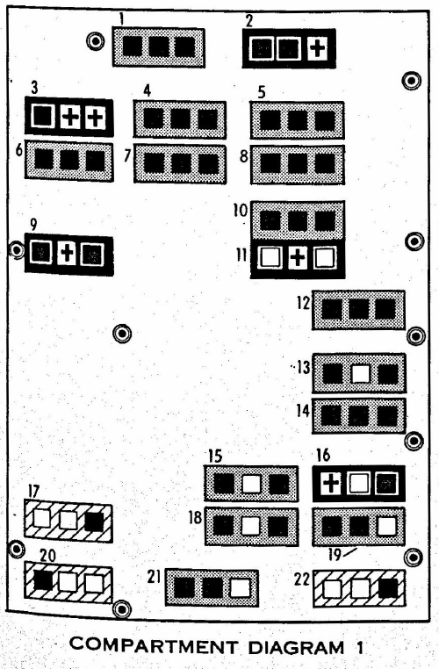


2. Historical Mtb resistance studies
TST –
TST +
Active TB
The seven individuals in this same compartment who had been on board a substantial time and who remained uninfected must have had a real, natural immunity to the infection. None of these individuals had skin test sensitivity to mycobacteria other than Mycobacterium tuberculosis… Therefore, a naturally occurring immunity seems a more likely explanation than protection from a previous so-called atypical infection
Notes:
350 member crew. Sailor developed symptoms after having known conversion neg->pos PPD
6 mo symptoms before repeat CXR 5 cm cavity
All other crew had PPDs obtained 6 mo prior, and diagrams indicate those “at risk” (PPD neg)
Of 308 crew at risk:
7 active TB including index case and 6 of these shared a berthing compartment
Of 66 at risk individuals in this compartment, 47 converted their skin test
Of the 13 remaining, 6 had only been aboard <4 weeks and most ultimately converted (4/6).
7 individuals with exposure for >6 months never converted.

Slide 6
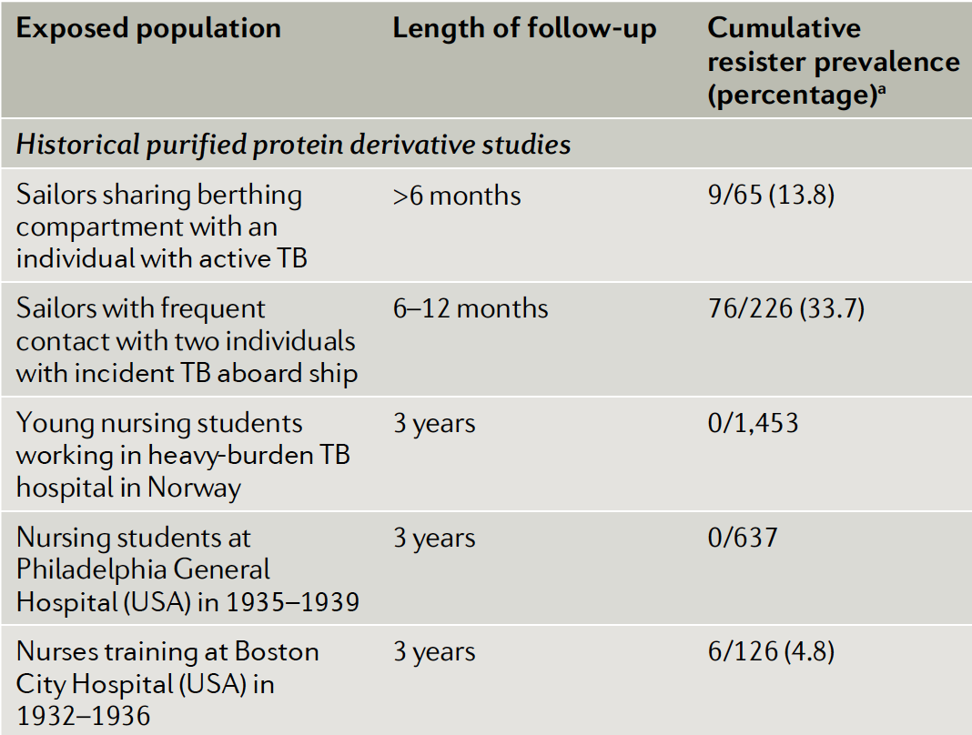
2. Historical Mtb resistance studies
RSTR prevalence 0-35%
  Exposure intensity
    Infectivity of index case
    Proximity of index case
    Ventilation
  Exposure frequency and duration
  Host factors (genetics, immune status)
  Microbiologic factors (strain infectivity)
  Resistance not absolute (Heimbeck 1938)
Simmons et al. 2018, Nat Rev Imm

Slide 7
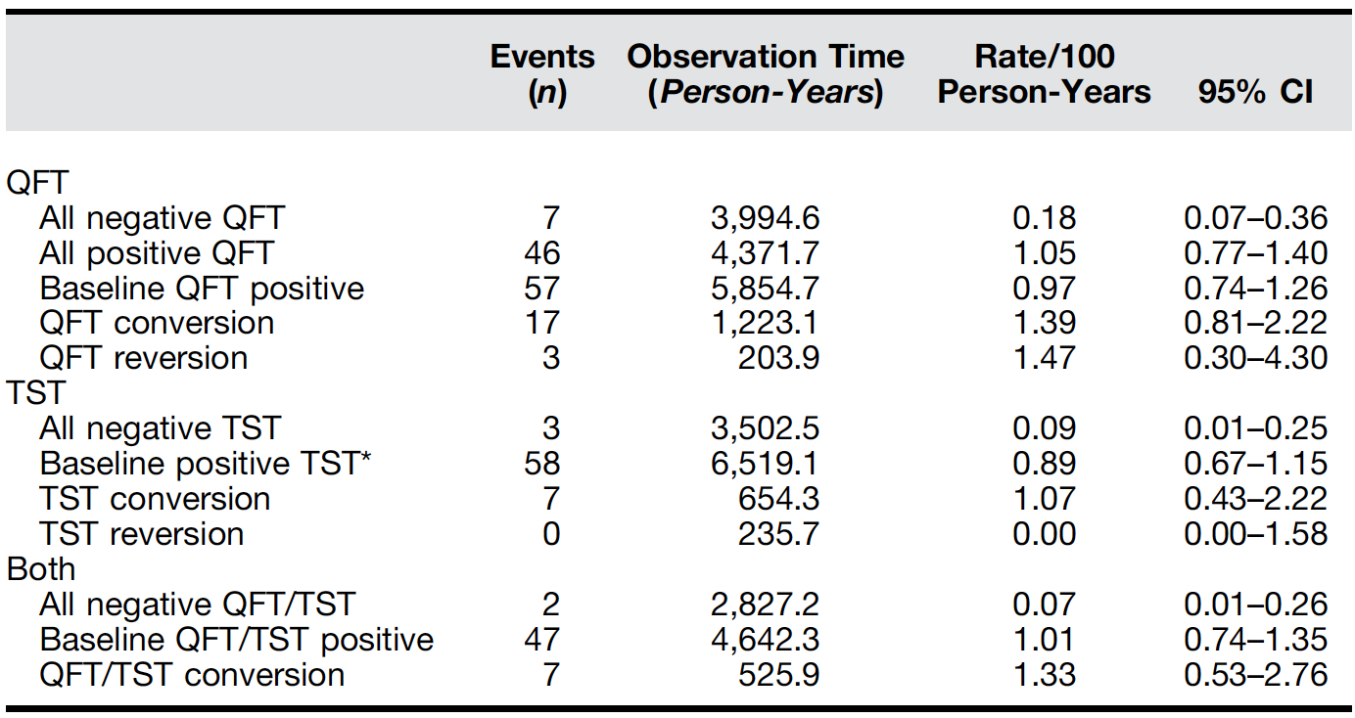
Contribution of LTBI toward resistance
+TST/IGRA
Exposure
Progression to TB
-TST/IGRA
IRR = ~10 – 14 (baseline IGRA+/IGRA-)
Andrews et al. 2015 AJRCCM
Notes:
Data are from high-risk adolescents in high-endemic area (SA), follow-up was over 2 years.
It is true that incidence of TB disease is higher among those with positive IGRA results, particularly those who convert from negative to positive, the comparison made in this study design likely reflects whether each group has been Mtb exposed or not. If you are

Slide 8
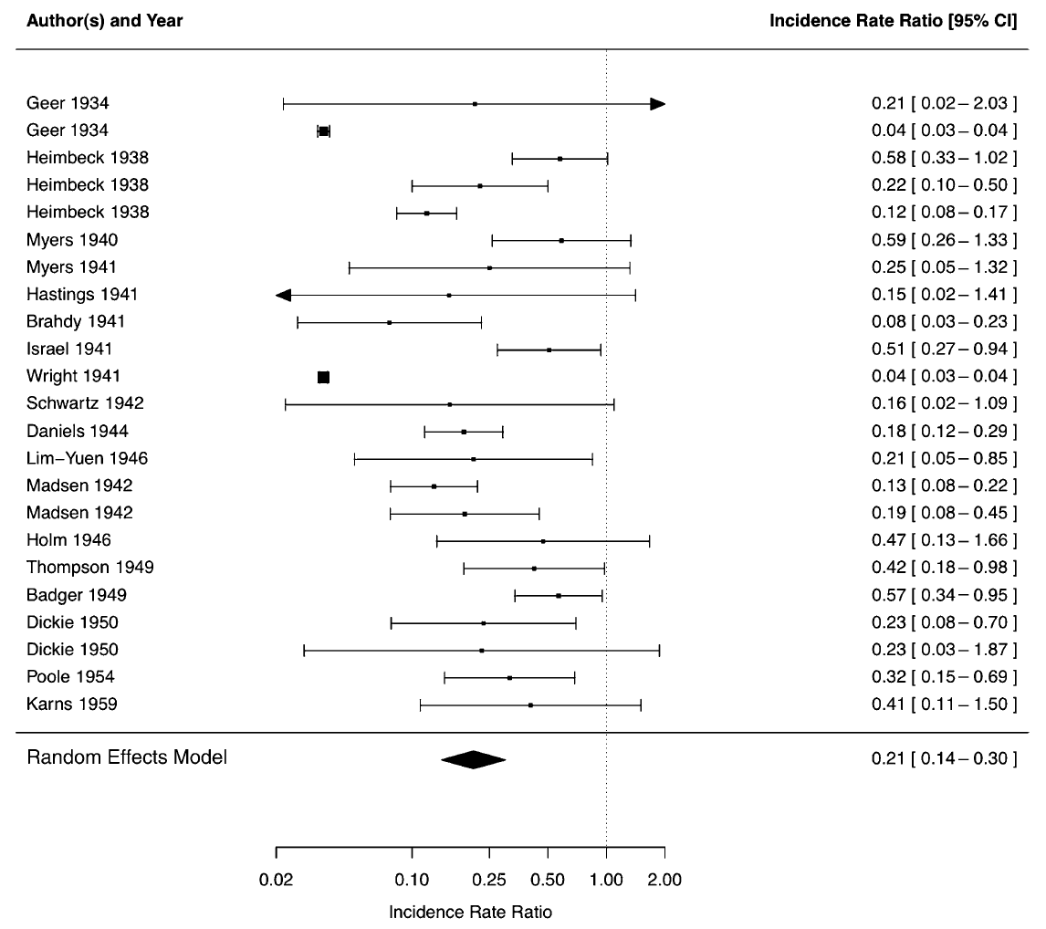
Contribution of LTBI toward resistance
+TST
Progression to TB
-TST
Exposure
LTBI may provide protective effect following re-infection
adjusted IRR 0.21 (0.14 – 0.30) = 79% protection
Andrews et al. 2012 CID
Notes:
These data really represent risk of TB progression as a function of previous exposure. We can instead restrict an analysis on how LTBI infection may impact risk of TB progression when individuals enter into a high transmission setting and face repeated Mtb exposures or re-infection. Jason Andrews made an extraordinary observation by looking retrospectively at many cohorts enrolled in the pre-antibiotic era, several of which we discussed earlier that included nursing students, medical students and TB sanitorium workers who underwent TST testing upon employment and then serially after they entered high-transmission settings.

Slide 9
2. Historical Mtb resistance studies
Summary
Study in high transmission settings and adequate follow-up duration required
Defining Mtb resistance requires the surrogate of immune sensitization, NOT infection
Prevalence estimates vary widely (exposure, host, microbiologic variables).
  Best estimates are likely 5– 10% (and resistance not absolute).
LTBI may provide protective effect in settings of intense, repeated exposures

Slide 10
3. Contemporary RSTR studies: Genetics
Susceptibility to Mtb disease
  Lubeck Disaster
  Twin Studies
  IFNg/IL12 axis (MSMD, Hawn lecture)
  Candidate gene associations: TLR 1/2, IL1b, VDR, MHCII…
Susceptibility to Mtb infection (TST/IGRA conversion)
  Heritability of TST and IGRA as quantitative traits (twin, contact tracing)
  Candidate gene association studies
  GWAS and linkage
Fox et al. 2016 PLoS Path
Kallman et al. 1942 Am Rev Tuberc
Comstock 1978 Am Rev Resp Dis
Abel et al. 2018 Lancet Inf Dis
Notes:
A genetic basis for susceptibility to Mtb disease has long been suspected. Kevin Urdahl reviewed animal models where susceptibility alleles have cleanly been described (SST).
Lubeck: 1929 – 1930 (Germany) 251 neonates were exposed to BCG with contamination of live/virulent Mtb and 72 died. Variability in clinical outcome linked to infective dose but even accounting for this, outcomes varied from death to mild disease.
Twin studies: Higher concordance of TB in monozygotic as compared to dizygotic twins with comparable environemental/social exposures. This included the Prophit study data.
Kids with rare monogenic disorders, both inherited and spontaneous mutations, in a variety of IFNg/IL12 signaling components seem to be at increased risk for both NTM and severe Mtb disease (won’t go into details). Many candidate gene association studies have also identified loci in a variety of immune pathways but little consistency across cohorts has been found.
With specific respect to genetic regulation of Mtb infection, several approaches have been reported. The heritability of TST and IGRA responses as quantitative traits (meaning the mm induration or amount of IFNg secretion) has been measured in a variety of study designs with a wide range of results (39 – 92%).

Slide 11
3. Contemporary RSTR studies: Genetics
Locus | Response | Population | Design | Correlate | Ref
TST1 (chr:11p14) | TST + (binary) | South Africa families French families | Genome-wide linkage | BCG/IFNγ-induced TNF (TNF1 locus); High TNF ~TST-neg negative. | Cobat et al. 2009 J Ex Med Cobat et al. 2015 JID Cobat et al. 2013 CID
TST2 (chr:5p15) | TST induration (continuous) | South Africa families | Genome-wide linkage | SLC6A3 locus | Cobat et al. 2009 J Ex Med
Chr: 2q21-24 5p13-5q22 | Persistent TST- (PTST-) | Uganda household contacts | Genome-wide linkage | Chr2 locus (GTDC1 and ZEB2) Chr5 locus overlaps with TST2 | Stein et al. 2008 PLoS One Igo et al. 2019 Genes Imm
Chr: 5q31.1 | PTST- (binary and continuous) (HIV-positive) | Uganda and Tanzania | GWAS | Near IL9 locus. Haplotype with missense IL9 variant stronger. Above loci replicated (Chr2, 5, 11) | Sobota et al. 2017 PLoS Genetics
Notes:
TNF1 locus genetically indistinguishable from TST1 suggests that resistance to TST conversion may involve the TNF pathway.
ZEB2 may modulate HDAC2 activity, and HDACs have been associated with PTST-. GTDC1 involved in lipid metabolism and body mass regulation.

Slide 12
3. Contemporary RSTR studies: Immunology
Site | Design, f/u | Findings | Reference
Gambia | HHC, conversion of TST/IGRA TST (3 month) IGRA (6 month) | TST non-converters had whole blood B cell and type 1 IFN signatures | Weiner et al. CID 2020 Medawar et al. Imm. Inflamm. Dis. 2019
Indonesia | HHC, conversion of IGRA between 2 (baseline) and 14 weeks | IGRA non-converters had higher initial monocyte/granulocyte populations (resolved @ 14wks) | Verrall, Schneider et al. JID 2019 Verrall, Alisjahbana et al. JID 2019
Haiti | HHC, cross-sectional (but IGRA- contacts followed 6 mo) | Higher CD8+ MAIT cells have higher CD25 and granzyme B, lower IFNγ | Vorkas et al. JCI Insight 2019
Notes:
Gambia:Whole blood transcriptional, metabolite and IgG/IgA reactivity to Mtb proteome array
B cell gene set signature in TST non-converters
Type 1 IFN antiviral signature in QFT non-converters
Indonesia: Highly-exposed HHC with negative baseline IGRA that was measured again at 14 weeks (317 of 490 remained IGRA negative). Flow cytometry at 2 and 14 weeks indicated non-converters had a decrease in various monocyte and granulocyte populations between weeks 2-14 whereas the convertersmaintained stable populations.
Haiti - Exposed, IGRA- contacts had
higher MAIT CD25 and granzyme B
lower CD69 and IFNγ

Slide 13
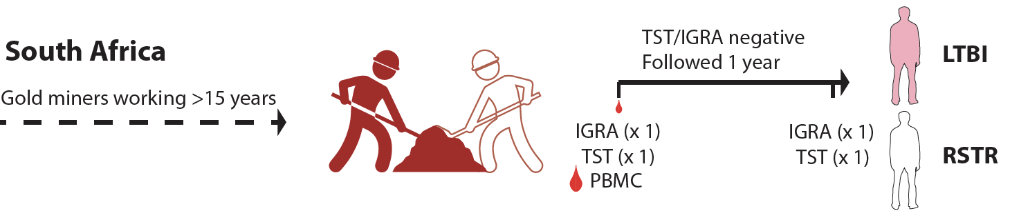
3. Contemporary RSTR studies: Immunology
Uganda HHC (KCHC Study, Kampala, Uganda)
2002 – 2012
Kampala, Uganda
2562 HHCs
Baseline
322 converters
TST/IGRA negative
737 (28.8%)
TST -
TST
f/u 8-10 years
“Resister”
(RSTR)
254 (10.7%)
(PTST-)
0
24 mo.
Probability that a 40yo miner (PPD = 0mm) is a RSTR is 93%,
versus 22% (general community)
Wallis et al. 2016 Front Microb
G. Churchyard
R. Wallace
Ntshiqa et al. 2021 Gates Open Res
Notes:
Indonesia: Highly-exposed HHC with negative baseline IGRA that was measured again at 14 weeks (317 of 490 remained IGRA negative). Flow cytometry at 2 and 14 weeks indicated non-converters had a decrease in various monocyte and granulocyte populations between weeks 2-14 whereas the convertersmaintained stable populations.

Slide 14
3. Contemporary RSTR studies: Immunology
Macrophage transcription
response to fatty acids
Simmons et al. 2021 JCI
Notes:
Indonesia: Highly-exposed HHC with negative baseline IGRA that was measured again at 14 weeks (317 of 490 remained IGRA negative). Flow cytometry at 2 and 14 weeks indicated non-converters had a decrease in various monocyte and granulocyte populations between weeks 2-14 whereas the convertersmaintained stable populations.

Slide 15
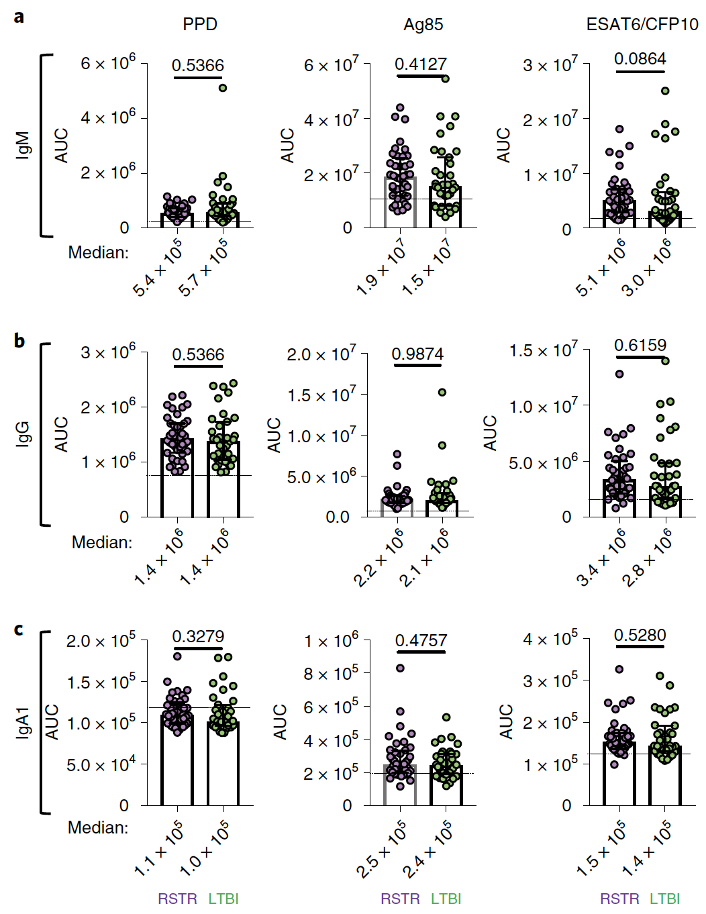
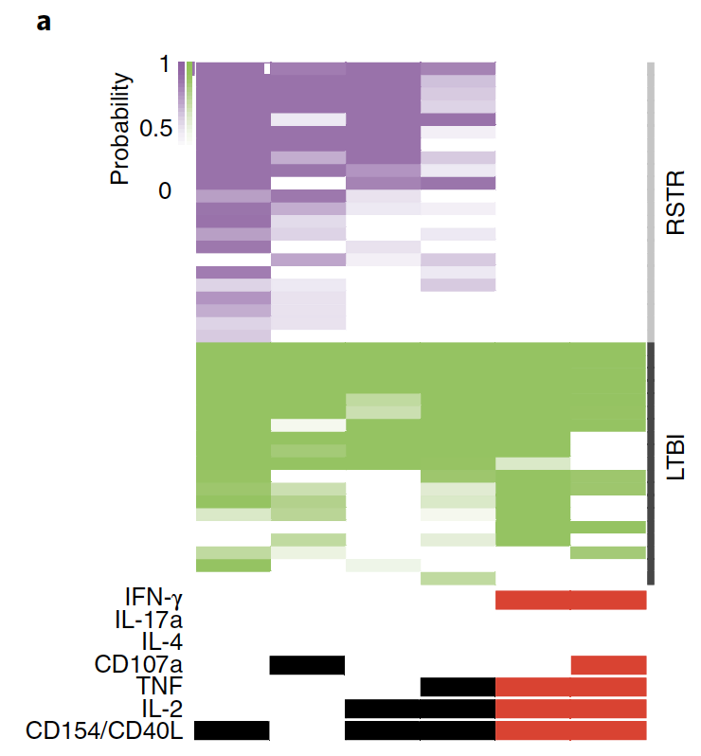
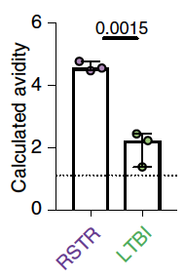
3. Contemporary RSTR studies: Immunology
Uganda HHC (KCHC Study, Kampala, Uganda)
ESAT6 + CFP10
RSTR subjects are Mtb exposed
Antigen-specific T cell responses
  IFNγ-independent T cell responses
  Lower polyfunctionality scores
Antigen-specific antibody responses
  Total levels equivalent to LTBI (ex PPD IgG1)
RSTRs have qualitatively different Ab
Higher PPD avidity
Lu et al. 2019 Nat Med
Notes:
Indonesia: Highly-exposed HHC with negative baseline IGRA that was measured again at 14 weeks (317 of 490 remained IGRA negative). Flow cytometry at 2 and 14 weeks indicated non-converters had a decrease in various monocyte and granulocyte populations between weeks 2-14 whereas the convertersmaintained stable populations.

Slide 16
3. Contemporary RSTR studies:
Summary
Resistance to TST/IGRA conversion has genetic links (TST1/TNFeQTL, TST2)
RSTR cohorts have immunologic evidence of Mtb exposure
  RSTRs have IFNγ-independent T cell responses
  RSTR PPD-specific Ab have higher avidity
Immunometabolic and fatty acid transcriptional programs associate with RSTR transcriptomes.
Notes:
Stringently defined RSTR populations have immunologic evidence of Mtb exposure despite testing negative for traditionally defined LTBI
Innate cellular and adaptive phenotypes have been ascribed to RSTR, little consistency

Slide 17
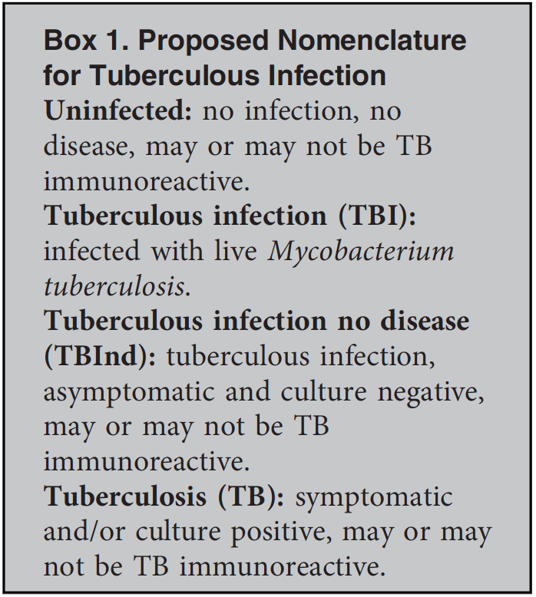
4. Current Gaps and Future Studies
Microbiologic diagnostics or host biomarkers that distinguish infected and uninfected subjects with ‘LTBI’
Rates of TB progression among RSTR and traditional LTBI
Defining ‘early clearance’ host pathways
Advances will yield
  Host-directed therapy targets
  Vaccines trial tools
    Immune correlates of protection
    Selection of uninfected participants
  Prioritization for TPT
  Monitoring of treatment response
Behr et al. 2021 ARJCCM

Slide 18

Questions?
If UW faculty/personnel,
please scan to evaluate me!
Course: Advanced TB Research Course
Resister Populations and Mtb Transmission

