Slide 1
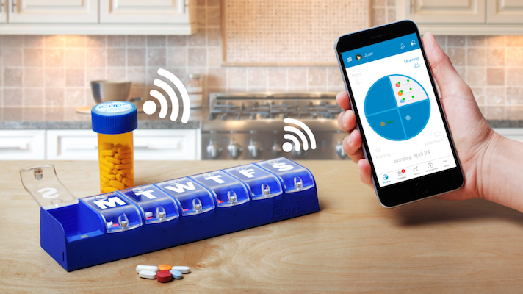

Using Mobile Health Technologies for TB
Sarah Iribarren, PhD
Biobehavioral Nursing and Health Informatics
University of Washington
sjiribar@uw.edu
University of Washington Advanced TB Research Training Course
September 16, 2022

Slide 2

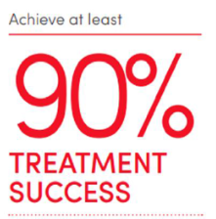
Session Overview
Using Mobile/Digital Health Technologies for TB
Why mobile or digital health technologies for TB?
What does it include? Landscape
How effective is it? Research
Future potential next steps

Slide 3

Why Mobile/Digital Health for TB?
Potential to transform TB care
Many challenges to TB treatment
Historically TB programs have used Directly Observed Therapy (DOT)
Call to accelerate TB innovations
COVID-19 pandemic accelerated need for remote support

Slide 4


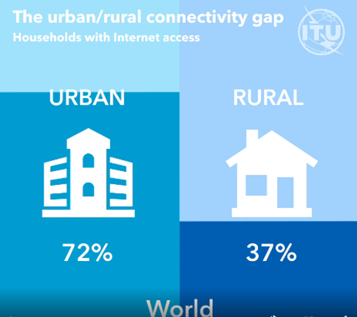
Why Mobile/Digital Health for TB?
Drivers for Digital Technologies
Advances in mobile technologies
High access to mobile phones
Broad mobile network coverage
  ~63% of the world’s population online
  Urban/Rural Internet access gap
International Telecommunication Union, 2021 Fact sheet

Slide 5

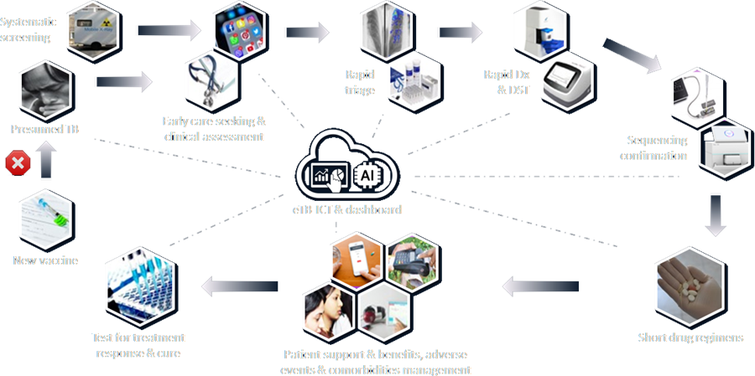


What does digital health for TB include? Landscape
https://www.reimaginingtbcare.org/

Slide 6
Digital Adherence Technologies Definition
definition:
“Tools designed to support people with TB with taking their medications. Compared to traditional directly observed therapy (DOT), the tools allow for people to take their medications at a place and time that is convenient to them, while remaining connected to their health care provider. For health care providers, DATs can facilitate the identification of high-risk patients who may need additional in-person support.”

Slide 7
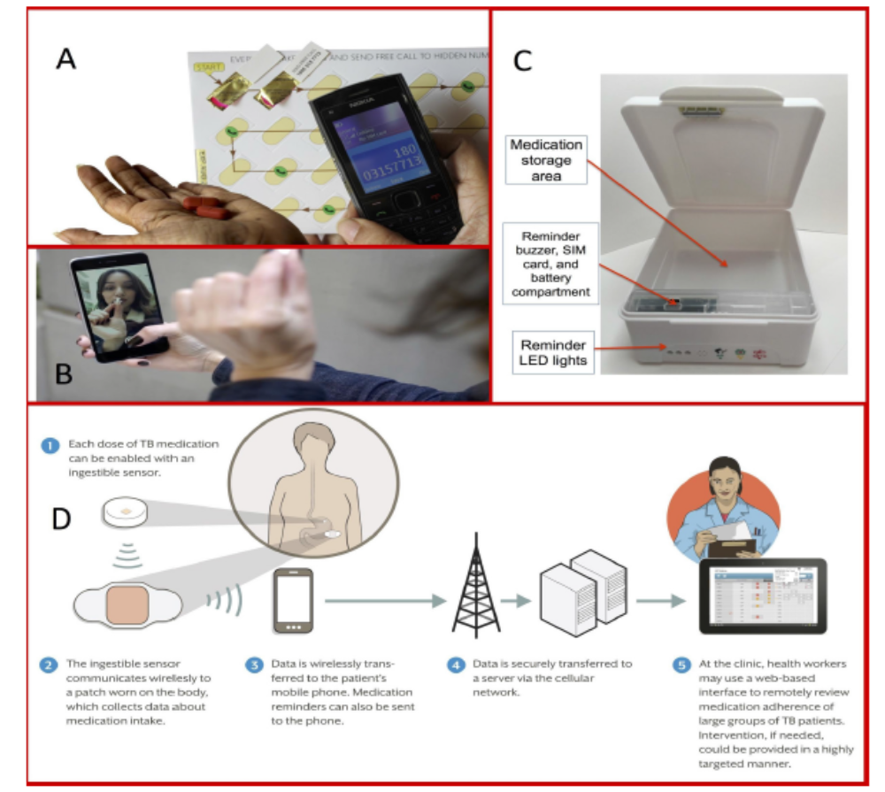
Digital Adherence Technologies Landscape
Digital record of objective or subjective medication intake
Medication sleeves
Smart pill boxes
Video-supported treatment
Sensors
Drug metabolite tests
SMS
Subbaraman et. al. BMJ Global Health, 2018

Slide 8
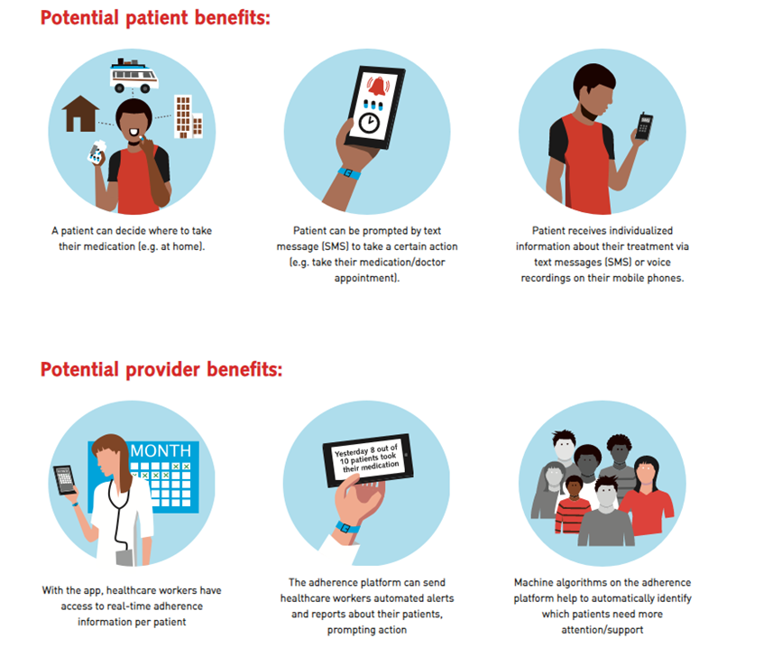
Digital Adherence Technologies Benefits

Slide 9
Digital Adherence Technologies Weaknesses
Accuracy of the monitoring technologies – SMS, opening/closing box a proxy
Video – requires internet, smartphones and secure data and video transfer
Technology fatigue – Extra steps for patients to report
  Varied levels of engagement
  May be underreporting or over reporting
  Health care providers have competing priorities
Costs – smart pill box ~$53 USD
Level of integration into healthcare systems
Ethical concerns - Stigmatization and intrusiveness of monitoring technologies

Slide 10
Ethical framework
Balance of individual and public good – respect patient autonomy
Ethical issues need to be considered in planning, implementing, and evaluating programs
DiStefano et al. Global Health: Science and Practice, 2016

Slide 11


How effective are Digital Health Technologies for TB?
Systematic review of 16 RCTs
  3 Video Directly Observed Therapy (VDOT)
  1 Video Observed Therapy (VOT)
  1 ingestible sensor
  1 phone call reminders
  2 medication monitor boxes
  8 SMS text message reminders
Outcomes: treatment completion, treatment adherence, missed dose, noncompleted rate, cure rate and smear conversion
DHT interventions promising
Variable effects regarding effect direction and the extent of improving TB medication adherence and clinical outcomes.
Developing DHT interventions with personalized feedback is required to have a consistent and beneficial effect on medication adherence and outcomes
Ridoh et al. Digital Health Technologies to Improve Medication Adherence and Treatment Outcomes in Patients With Tuberculosis: Systematic Review of Randomized Controlled Trials
J Med Internet Res 2022;24(2):e33062, doi: 10.2196/33062PMID: 35195534

Slide 12
How effective is it? Research
SMS
Systematic Review and Meta-Analysis
8 studies (total of 5680 patients) included in meta-analysis
SMS showed modest effect in improving TB treatment success
Gashu et al. BMC Infectious Diseases 2020

Slide 13
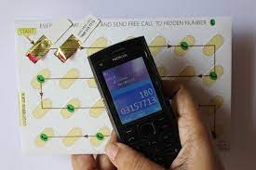
How effective is it? Research
Medication sleeves – 99DOTS
Multisite Cohort study of 650 Indian patients
urine isoniazid test collected at unannounced home visits
Alternative measures missed detecting at least 30% of people who were nonadherent by urine testing
  Alternative measures: 99DOT patient-reported doses, last missed dose question, pill estimate, 4-day recall
Subbaraman et al. 2021 Measuring Tuberculosis Medication Adherence: A Comparison of Multiple Approaches in Relation to Urine Isoniazid Metabolite Testing Within a Cohort Study in India. Open Forum Infectious Diseases. https://doi.org/10.1093/ofid/ofab532

Slide 14


Ongoing Research –
Expected to enroll ~70,000 drug-sensitive TB patients across 5 countries
  Ethiopia, Philippines, South Africa, Tanzania, and Ukraine
2019-2022
3 DATs: smart pillbox, VOT, 99DOTS
https://www.digitaladherence.org/the-ascent-project/

Slide 15
Future potential next steps
Understand and address barriers to scale of effective and quality digital health interventions
Unite digital health efforts
Consider combining DATs or offering a range of DATs
Integrate these technologies into existing systems
Further explore the use of accompanying drug metabolite testing
Stay tuned to new evidence – more and better evidence still needed
My bias: digital tools are not the solution – but rather a way to connect with, engage, and empower individuals where they are and provide tailored care when it is needed

Slide 16
Question to you: How might digital health technologies meet the needs of those you serve?
Thank you
Questions?
Sarah Iribarren: sjiribar@uw.edu

