Slide 1
IMPLEMENTATION SCIENCE FOR TB
Bryan J. Weiner, Ph.D.
Department of Global Health
University of Washington
September 16, 2022
Notes:
Hello, I am Bryan Weiner. I am a Professor in the Departments of Global Health and Health Systems and Population Health at the University of Washington. In the next few minutes, I am going to give you a high-level overview and introduction to implementation science for tuberculosis.

Slide 2
IMPLEMENTATON SCIENCE MADE SIMPLE
What is implementation research and how does it differ from effectiveness research?
Examples:
Training, audit and feedback, opinion leaders clinical reminders, decision support, task shifting
% clinicians delivering EBP, % patients receiving EBP, guideline adherence, competence
Notes:
So, what is implementation science? The US National Institutes of Health defines implementation science (or implementation research) as the scientific study of methods to promote the integration of research findings and evidence-based interventions into healthcare practice and policy.
That definition works for me, but it often generates blank stares when I use it to describe implementation science to people outside my field. So, let me break it down in simpler terms and compare implementation research with effectiveness research.
Implementation research starts with evidence-based interventions. These interventions could be programs, practices, principles, products, pills, or policies. We call these the 7 Ps. What’s important is that these interventions should have some evidence supporting them. Let’s call the evidence-based intervention the thing that we want to see implemented.
When we do effectiveness research, we evaluate whether the thing works. The primary research question is: does the thing improve health outcomes?
When we do implementation research, we study how best to help people and places do the thing. If effectiveness research answers the “what” question, what things should we do to improve health outcomes, then implementation research answers the “how” question, how to do get the thing done, how do we get it integrated into routine practice.
Implementation strategies are the stuff that we do to try to help people and places do the thing. We can do all kinds of stuff to help people do the thing. [ADVANCE] We can use training to help them do the thing. We could use audit and feedback to do the thing. We could enlist the help of opinion leaders to do the thing. And so on.
The main outcomes in effectiveness research are health outcomes. Does the thing improve health? The main outcomes in implementation research focus on how much or how well people and places do the thing. Good examples of implementation outcomes include the percentage of clinicians delivering the thing, the percentage of eligible patients receiving thing, the extent to which clinicians are following the guideline for the thing, or even the skill with which clinicians deliver the thing.
In a sense, implementation research pick up where effectiveness research leave off. Once we have sufficient evidence to support doing the thing, we turn our attention to how to get the thing integrated into routine practice.

Slide 3
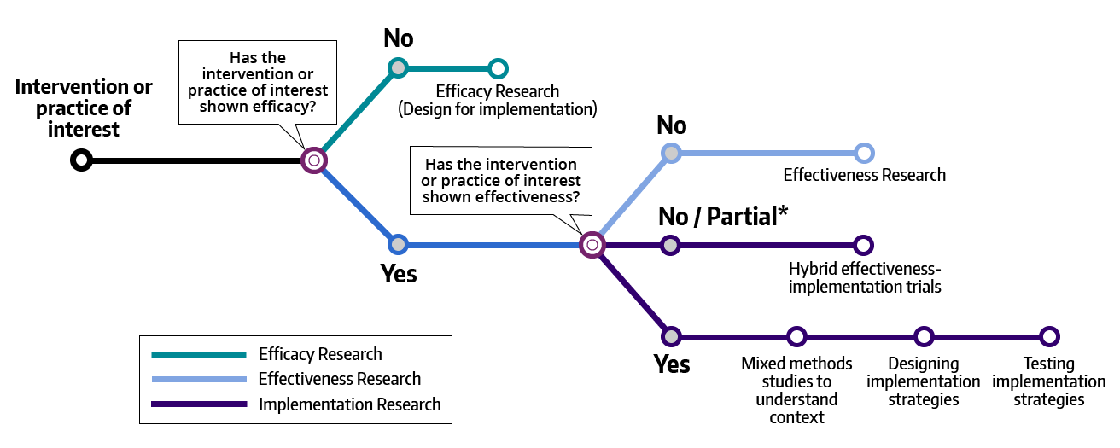
WHEN TO DO IMPLEMENTATION SCIENCE
“Hybrid designs blend design characteristics of effectiveness and implementation studies to generate timely uptake of desirable interventions, more effective implementation strategies, and more relevant information for future scale-up activities.”
Rabin & Brownson, Dissemination and Implementation Research in Health, 2018
Notes:
This “subway” map makes this point clearer.
If an intervention hasn’t demonstrated efficacy, then we need to do efficacy research, although even at this stage we should be thinking about implementation issues down the road.
If the intervention has demonstrated efficacy under controlled conditions, but not effectiveness under real-world conditions, then we need to do effectiveness research, perhaps through pragmatic trials.
If the intervention has demonstrated effectiveness under real-world conditions, then we can move onto implementation research. We can do formative implementation research to understand the context of implementation. For example, we can investigate the barriers and facilitators to implementing the intervention. We can then design and test implementation strategies, perhaps through implementation trials where the primary outcomes are how much and how well the intervention is delivered. There are many interventions backed by solid evidence. For these interventions, the priority is not evaluating whether the intervention works, but rather testing strategies or methods for getting it done in routine practice. For example, we don’t need more effectiveness trials of colorectal cancer screening tests. We know they work. The question now is, how do increase colorectal cancer screening rates, especially in safety-net settings where there are real disparities in screening rates.
If the intervention has not demonstrated effectiveness under real-work conditions, or the evidence is limited in quantity or scope, then we could conduct a hybrid effectiveness-implementation trial where we ask both a “what” and a “how” question in the same study. Hybrid trials blend design characteristics of effectiveness and implementation studies to generate timely uptake of desirable interventions, more effective implementation strategies, and more relevant information for future scale-up activities.

Slide 4
THREE TYPES OF HYBRID DESIGNS
Clinical efficacy research
Clinical effectiveness research
Implementation research
Improved public health outcomes
Hybrid Type 1
Primary: Effectiveness
Secondary: Implementation
Hybrid Type 3
Primary: Implementation
Secondary: Effectiveness
Primary aim: Determine effectiveness of an intervention
Secondary aim: Better understand context for implementation
Primary aim: Determine impact of an implementation strategy
Co-primary or secondary aim: Assess clinical outcomes associated with implementation
Hybrid Type 2
Equal focus on effectiveness and implementation
Primary aim: Determine effectiveness of an intervention
Co-primary or secondary aim: Determine feasibility and/or (potential) impact of an implementation strategy
Adapted from: Cully 2012 Implementation Science
Notes:
There are three types of hybrid effectiveness-implementation study designs. In a Hybrid 1 design, the primary aim is to determine the effectiveness of the intervention and the secondary aim is to better understand the context of implementation. This design looks and feels like an effectiveness study, but with a twist. We focus primarily on whether the thing works, but we also examine the barriers and facilitators to doing the thing or how acceptable, feasible, or appropriate the thing is from the perspective of clinicians or patients or both.
In a Hybrid 3 design, the primary aim is to determine the impact of an implementation strategy and the secondary aim is to assess health outcomes associated with implementing the intervention. This design looks and feels like an implementation study, but with a twist. We focus primarily on whether the implementation strategy increases how much or how well people or places do the thing, but we also look at whether the thing works as well when implemented this way as it did when tested in effectiveness research. We might do a Hybrid 3 for example, we want to implement a thing that has good evidence behind it, but we’re going to adapt the thing or implement it in settings or with patients that differ from those in the original effectiveness research. The more we stray from the evidence-base supporting the thing, the more we want to assess whether the thing still works.
In a Hybrid 2, the primary aims are two-fold: determine whether the thing works and figure out how to implement the thing.
In the next couple of slides, I will provide examples of Hybrid 2 and Hybrid 3 trials in TB. In the interests of time, am not going to illustrate Hybrid 1 trials in TB. I will simply note that these are pretty much like effectiveness trials with an implementation related aim in which we survey or interview providers and patients, and perhaps administrators about implementation-related issues.

Slide 5
HYBRID 2 EXAMPLE
The aims of the EXPEL-TB trial are to
Compare the completion of TB diagnostic evaluation at community health centers randomized to the intervention vs. routine TB diagnostic evaluation strategies
Identify the processes and contextual factors that influence implementation
Compare the costs and epidemiological impact of the intervention vs. routine TB diagnostic evaluation
Notes:
Here’s an example of a Hybrid 2 trial in TB.
In Uganda, routine TB diagnostic evaluation strategies (or standard of care) is a hub-and-spoke system that involves on-site sputum smear microscopy plus referral of sputum samples to Xpert testing sites.
However, studies have documented persistent challenges to the TB diagnostic evaluation process, including low utilization of Xpert, delays between sputum collection and return of Xpert results, and high rates of pre-treatment loss to follow-up for Xpert positive patients.
So, along comes this new technology, called GeneXpert Edge, which is a battery-operated, single-module device equipped with cooling fans and dust filters and operated using a touchscreen tablet. The exciting thing about GeneXpert Edge is that with it, you can detect TB in two hours. This is cool stuff and could really help address those persistent challenges that I just mentioned.
However, the key question is what is the optimal strategy for implementing this technology?
The implementation strategy they tested has three components:
Onsite molecular testing using GeneXpert Edge
Process re-design to facilitate same-day TB diagnosis and treatment. Basically, a standardized checklist was used to re-organize staff and patient workflow to address failure of patients to return after the initial health center visit
Performance feedback in the form of monthly report card that includes both site-specific TB diagnostic evaluation quality indicators as well as indicators averaged across all intervention sites.

Slide 6
TRIAL OUTCOMES FOR HYBRID 2 EXAMPLE
Outcome | Data
Reach | # and % completing Xpert testing
Effectiveness | Process outcomes (e.g., # and % diagnosed with and treated for TB within 14 days) Health and economic outcomes (e.g,. # and % who died within 6 months, ICER)
Adoption | % eligible sites able/willing to initiate implementation strategy component
Implementation | Fidelity (e.g., % tested by Xpert, % invalid, error, or indeterminate results) Acceptability (thematic output from health worker focus group discussions) Patient and health system costs (e.g., incremental patient cost per diagnostic evaluation) Modification of targeted implementation barriers Median scores on health worker knowledge, attitudes, self-efficacy Median scores for domains of patient satisfaction survey Thematic output from provider in-depth interviews
Notes:
Here you can see what makes a Hybrid 2 different from an effectiveness trial.
On the one hand, you have your effectiveness outcomes. In this study, the primary outcome is the number and percentage of patients diagnosed with and treated for TB within 14 days. Other health and economic outcomes include the number and percentage of patients who died within 6 months and the incremental cost-effectiveness ratio.
So, that’s how these investigators will answer the question: does the thing work? Does it improve health outcomes?
But check out the other outcomes of interest here. These are implementation outcomes, not health outcomes. They include reach. They include adoption. They include implementation. These outcomes capture how much and how well people and places do the thing, not whether the thing works.
And in a Hybrid 2 trial, we treat the effectiveness research question and the implementation research question as equally important. This as implications for study design, resource allocation, etc.

Slide 7
HYBRID 3 EXAMPLE
The aims of the 3HP Options trial are to
Compare the acceptance and completion of 3HP among PLHIV under three delivery strategies: DOT, SAT, or informed choice of DOT or SAT with support of decision aid
Identify process and contextual factors that influence acceptance and completion of 3HP under each Strategy
Estimate the costs and compare the cost-effectiveness of the three strategies for delivering 3HP.
Notes:
Here’s an example of a Hybrid 3 trial in TB.
Recently, a 3-month 12-dose regimen of weekly 3HP was recommended by the World Health Organization for the prevention of TB among people living with HIV on common antiretroviral therapy regimens.
RQ: what’s the best approach to delivering 3HP to PLHIV?
The aims of the 3HP Options trial are to (1) compare the acceptance and completion of 3HP among PLHIV under three delivery strategies (DOT, SAT, and informed choice of DOT or SAT with support of decision aid); (2) identify process and contextual factors that influence acceptance and completion of 3HP under each delivery strategy; and (3) estimate the costs and compare the cost-effectiveness of the three strategies for delivering 3HP.
The investigators describe this trial as a Type 3 hybrid study because the primary goal is to identify the optimal implementation strategy for delivering 3HP rather than its effectiveness.
Thus, the primary outcome reflects the reach and fidelity to the intervention; assessment of health outcomes, such as incident TB, adverse events, mortality, is a secondary aim.

Slide 8
WHAT ELSE CAN YOU DO WITH IMPLEMENTATION SCIENCE?
Notes:
We can do more with implementation science than test strategies for implementation evidence-based interventions in TB.
We can use implementation science frameworks to identify barriers and facilitators to active case finding strategies. This could be done in a formative research context, in which we use information about barriers and facilitators to guide the selection of implementation strategies. Or, this can be done in a summative evaluation context, in which we look post-implementation at the factors that led to greater or more successful implementation by some people or places than for others.
We can also use implementation science frameworks to design interventions and develop implementation strategies to improve case detection, for example, The behavioral change wheel is an implementation science framework that can be used to design behavioral interventions and implementation strategies that address the key determinants of the targeted behavior or behavior of interest, such as case detection.

Slide 9
WHAT ELSE CAN YOU DO WITH IMPLEMENTATION SCIENCE?
Notes:
We can use implementation science frameworks to identify the multilevel factors influencing health care workers’ and managers’ acceptance of HIV counseling and testing services among TB patients. Here we could use two implementation science frameworks together. We could use an evaluation framework, like Enola Proctor’s implementation outcomes framework, to assess acceptability (or acceptance) and a determinants framework like the Consolidated Framework for Implementation Research to investigator the patient- and delivery-level factors influencing acceptance.
A final example, we can use implementation science to evaluate the effect of implementation strategies that target health care workers on patient behavioral outcomes like treatment completion. Note in this study, the investigators also examined barriers and facilitators to implementation, scalability, and sustainability of the intervention in the outpatient TB care setting.

Slide 10
SO, WHAT DOES IMPLEMENTATION SCIENCE BRING TO THE TABLE?
Focus on implementation
Theories, models, and frameworks
Assessment tools
Implementation strategies
Methods
Notes:
Let me conclude by highlighting what implementation science brings to the table? What’s the value added for TB researchers?
First, and foremost, implementation science brings focused attention on implementation. It focuses on the “how” rather than the “what” – how do we help people and places do the “thing” with consistency and quality. This is important because interventions that don’t get used consistently or used well don’t improve health outcomes, no matter how effective they are.
Second, implementation science brings theories, models, and frameworks for investigating implementation related questions. We have lots of TMFs in implementation science. We have process models that describe or prescribe steps or activities for implementation, explanatory frameworks that identify the multilevel factors that influence implementation, and evaluation frameworks for assessing the success or effectiveness of implementation.
Third, implementation science brings assessment tools for investigating implementation context, implementation processes, and implementation outcomes. On the qualitative side, we have templates and tools for collecting and analyzing qualitative data, and increasingly we have reliable, valid, and brief measures for assessing implementation context, processes, and outcomes
Fourth, implementation science brings implementation strategies to the table. We have inventories of implementation strategies that can be matched to implementation barriers. We have guides and tools for designing implementation strategies. And we have a growing evidence base for selected strategies
Finally, implementation science brings some distinctive methods to the table. I have mentioned the hybrid effectiveness-implementation study designs, but we are also adapting or developing methods for rapid qualitative data analysis, approaches for matching implementation strategies to implementation barriers, research designs for optimizing implementation strategies before deployment and evaluation
I hope this brief overview and introduction to implementation science piques your interest. We need implementation science to help us move evidence-based interventions into routine practice. It complements the effectiveness research that we do. And the best news is that you don’t have to become an implementation scientist to incorporate implementation science into your effectiveness research. We have a growing cadre of implementation scientists interested in collaborating with effectiveness researchers to do hybrid trials and by doing so, helping to accelerate the translation of research into practice and ultimate better health outcomes.

Slide 11
SUPPLEMENTAL SLIDES ON THEORIES, MODELS, AND FRAMWORKS IN IMPLEMENTATION SCIENCE

Slide 12
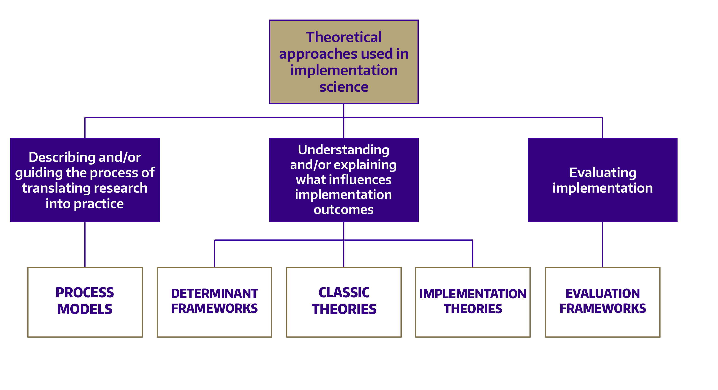
AN OVERVIEW OF IMPLEMENTATION SCIENCE FRAMEWORKS
Notes:
Let me conclude by highlighting what implementation science brings to the table? What’s the value added for TB researchers?
First, and foremost, implementations brings focused attention on implementation. It focuses on the “how” rather than the “what” – how do we help people and places do the “thing” with consistency and quality. This is important because effective interventions that don’t get used consistency or used well don’t improve health outcomes.
Second, implementation science brings theories, models, and frameworks for investigating implementation related questions. We have lots of TMFs in implementation science. We have process models that describe or prescribe steps or activities for implementation, explanatory frameworks that identify the multilevel factors that influence implementation, and evaluation frameworks for assessing the success or effectiveness of implementation.
Third, implementation science brings assessment tools for investigating implementation context, implementation processes, and implementation outcomes. On the qualitative side, we have templates and tools for collecting and analyzing qualitative data, and increasingly we have reliable, valid, and brief measures for assessing implementation context, processes, and outcomes
Fourth, implementation science brings implementation strategies to the table. We have inventories of implementation strategies that can be matched to implementation barriers. We have guides and tools for designing implementation strategies. And we have a growing evidence base for selected strategies
Finally, implementation science brings some distinctive methods to the table. I have mentioned the hybrid effectiveness-implementation study designs, but we are also adapting or developing methods for rapid qualitative data analysis, approaches for matching implementation strategies to implementation barriers, research designs for optimizing implementation strategies before deployment and evaluation
I hope this brief overview and introduction to implementation science piques your interest. We need implementation science to help us move evidence-based interventions into routine practice. It complements the effectiveness research that we do. And the best news is that you don’t have to become an implementation scientist to incorporate implementation science into your effectiveness research. We have a growing cadre of implementation scientists interested in collaborating with effectiveness researchers to do hybrid trials and by doing so, helping to accelerate the translation of research into practice and ultimate better health outcomes.

Slide 13
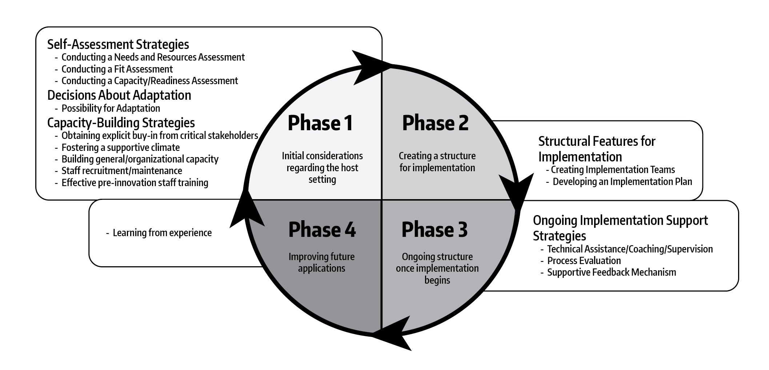
EXAMPLE: PROCESS MODEL
The Quality Implementation Framework

Slide 14
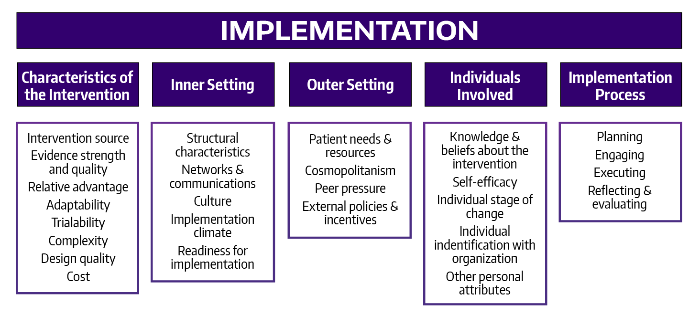
EXAMPLE: EXPLANATORY FRAMEWORK
Adapted from Damschroder et al 2009
The Consolidated Framework for Implementation Research
Notes:
Let me conclude by highlighting what implementation science brings to the table? What’s the value added for TB researchers?
First, and foremost, implementations brings focused attention on implementation. It focuses on the “how” rather than the “what” – how do we help people and places do the “thing” with consistency and quality. This is important because effective interventions that don’t get used consistency or used well don’t improve health outcomes.
Second, implementation science brings theories, models, and frameworks for investigating implementation related questions. We have lots of TMFs in implementation science. We have process models that describe or prescribe steps or activities for implementation, explanatory frameworks that identify the multilevel factors that influence implementation, and evaluation frameworks for assessing the success or effectiveness of implementation.
Third, implementation science brings assessment tools for investigating implementation context, implementation processes, and implementation outcomes. On the qualitative side, we have templates and tools for collecting and analyzing qualitative data, and increasingly we have reliable, valid, and brief measures for assessing implementation context, processes, and outcomes
Fourth, implementation science brings implementation strategies to the table. We have inventories of implementation strategies that can be matched to implementation barriers. We have guides and tools for designing implementation strategies. And we have a growing evidence base for selected strategies
Finally, implementation science brings some distinctive methods to the table. I have mentioned the hybrid effectiveness-implementation study designs, but we are also adapting or developing methods for rapid qualitative data analysis, approaches for matching implementation strategies to implementation barriers, research designs for optimizing implementation strategies before deployment and evaluation
I hope this brief overview and introduction to implementation science piques your interest. We need implementation science to help us move evidence-based interventions into routine practice. It complements the effectiveness research that we do. And the best news is that you don’t have to become an implementation scientist to incorporate implementation science into your effectiveness research. We have a growing cadre of implementation scientists interested in collaborating with effectiveness researchers to do hybrid trials and by doing so, helping to accelerate the translation of research into practice and ultimate better health outcomes.

Slide 15
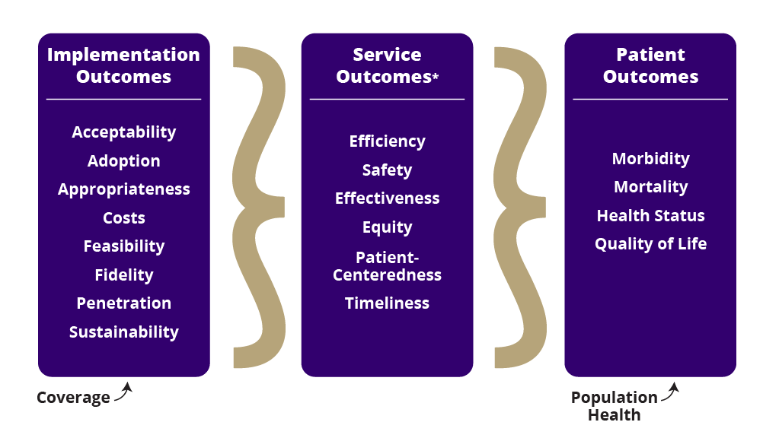
EXAMPLE: EVALUATION FRAMEWORK
Adapted from Proctor et al., 2011
Notes:
Let me conclude by highlighting what implementation science brings to the table? What’s the value added for TB researchers?
First, and foremost, implementations brings focused attention on implementation. It focuses on the “how” rather than the “what” – how do we help people and places do the “thing” with consistency and quality. This is important because effective interventions that don’t get used consistency or used well don’t improve health outcomes.
Second, implementation science brings theories, models, and frameworks for investigating implementation related questions. We have lots of TMFs in implementation science. We have process models that describe or prescribe steps or activities for implementation, explanatory frameworks that identify the multilevel factors that influence implementation, and evaluation frameworks for assessing the success or effectiveness of implementation.
Third, implementation science brings assessment tools for investigating implementation context, implementation processes, and implementation outcomes. On the qualitative side, we have templates and tools for collecting and analyzing qualitative data, and increasingly we have reliable, valid, and brief measures for assessing implementation context, processes, and outcomes
Fourth, implementation science brings implementation strategies to the table. We have inventories of implementation strategies that can be matched to implementation barriers. We have guides and tools for designing implementation strategies. And we have a growing evidence base for selected strategies
Finally, implementation science brings some distinctive methods to the table. I have mentioned the hybrid effectiveness-implementation study designs, but we are also adapting or developing methods for rapid qualitative data analysis, approaches for matching implementation strategies to implementation barriers, research designs for optimizing implementation strategies before deployment and evaluation
I hope this brief overview and introduction to implementation science piques your interest. We need implementation science to help us move evidence-based interventions into routine practice. It complements the effectiveness research that we do. And the best news is that you don’t have to become an implementation scientist to incorporate implementation science into your effectiveness research. We have a growing cadre of implementation scientists interested in collaborating with effectiveness researchers to do hybrid trials and by doing so, helping to accelerate the translation of research into practice and ultimate better health outcomes.

Slide 16
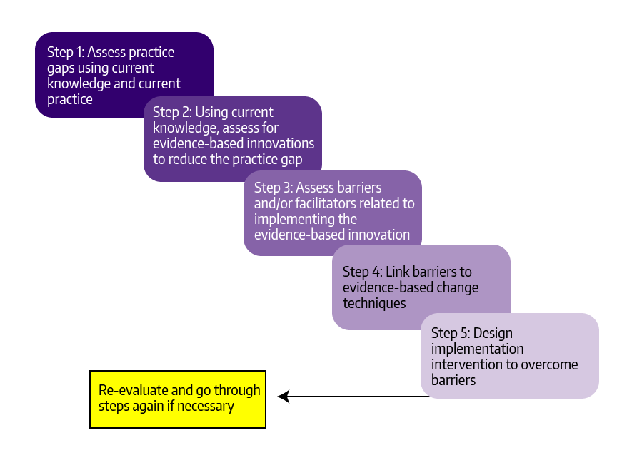
USING MULTIPLE IS FRAMEWORKS
Gap or variation analysis
Conduct literature review
Use determinants framework
Map strategies and behavior change techniques to determinants
Use evaluation framework
Use theory to inform implementation intervention
Notes:
Let me conclude by highlighting what implementation science brings to the table? What’s the value added for TB researchers?
First, and foremost, implementations brings focused attention on implementation. It focuses on the “how” rather than the “what” – how do we help people and places do the “thing” with consistency and quality. This is important because effective interventions that don’t get used consistency or used well don’t improve health outcomes.
Second, implementation science brings theories, models, and frameworks for investigating implementation related questions. We have lots of TMFs in implementation science. We have process models that describe or prescribe steps or activities for implementation, explanatory frameworks that identify the multilevel factors that influence implementation, and evaluation frameworks for assessing the success or effectiveness of implementation.
Third, implementation science brings assessment tools for investigating implementation context, implementation processes, and implementation outcomes. On the qualitative side, we have templates and tools for collecting and analyzing qualitative data, and increasingly we have reliable, valid, and brief measures for assessing implementation context, processes, and outcomes
Fourth, implementation science brings implementation strategies to the table. We have inventories of implementation strategies that can be matched to implementation barriers. We have guides and tools for designing implementation strategies. And we have a growing evidence base for selected strategies
Finally, implementation science brings some distinctive methods to the table. I have mentioned the hybrid effectiveness-implementation study designs, but we are also adapting or developing methods for rapid qualitative data analysis, approaches for matching implementation strategies to implementation barriers, research designs for optimizing implementation strategies before deployment and evaluation
I hope this brief overview and introduction to implementation science piques your interest. We need implementation science to help us move evidence-based interventions into routine practice. It complements the effectiveness research that we do. And the best news is that you don’t have to become an implementation scientist to incorporate implementation science into your effectiveness research. We have a growing cadre of implementation scientists interested in collaborating with effectiveness researchers to do hybrid trials and by doing so, helping to accelerate the translation of research into practice and ultimate better health outcomes.

