Slide 1

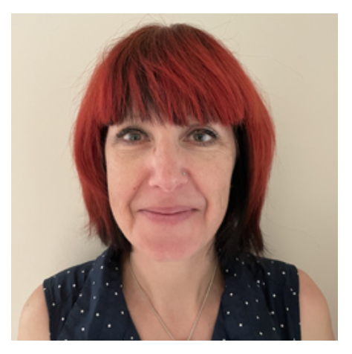
Drug Discovery for Tuberculosis

Slide 2
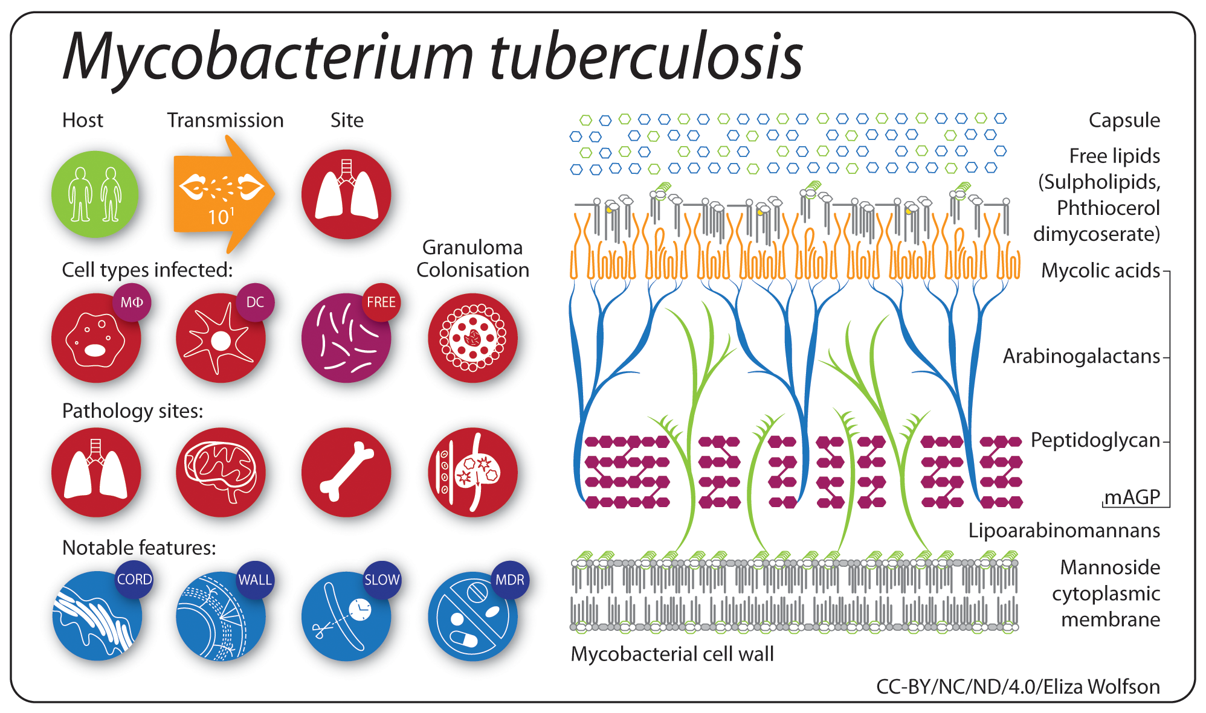
Microbe Profile: Mycobacterium tuberculosis: Humanity's deadly microbial foe.
S.V. Gordon and T. Parish. Microbiology (2018) 164:437-439

Slide 3
Drug Discovery and Development
Screen
Hit Assessment
Hit to Lead
Lead
Optimization
Clinical
Candidate
Clinical Trial
Phase I, II, III
3

Slide 4
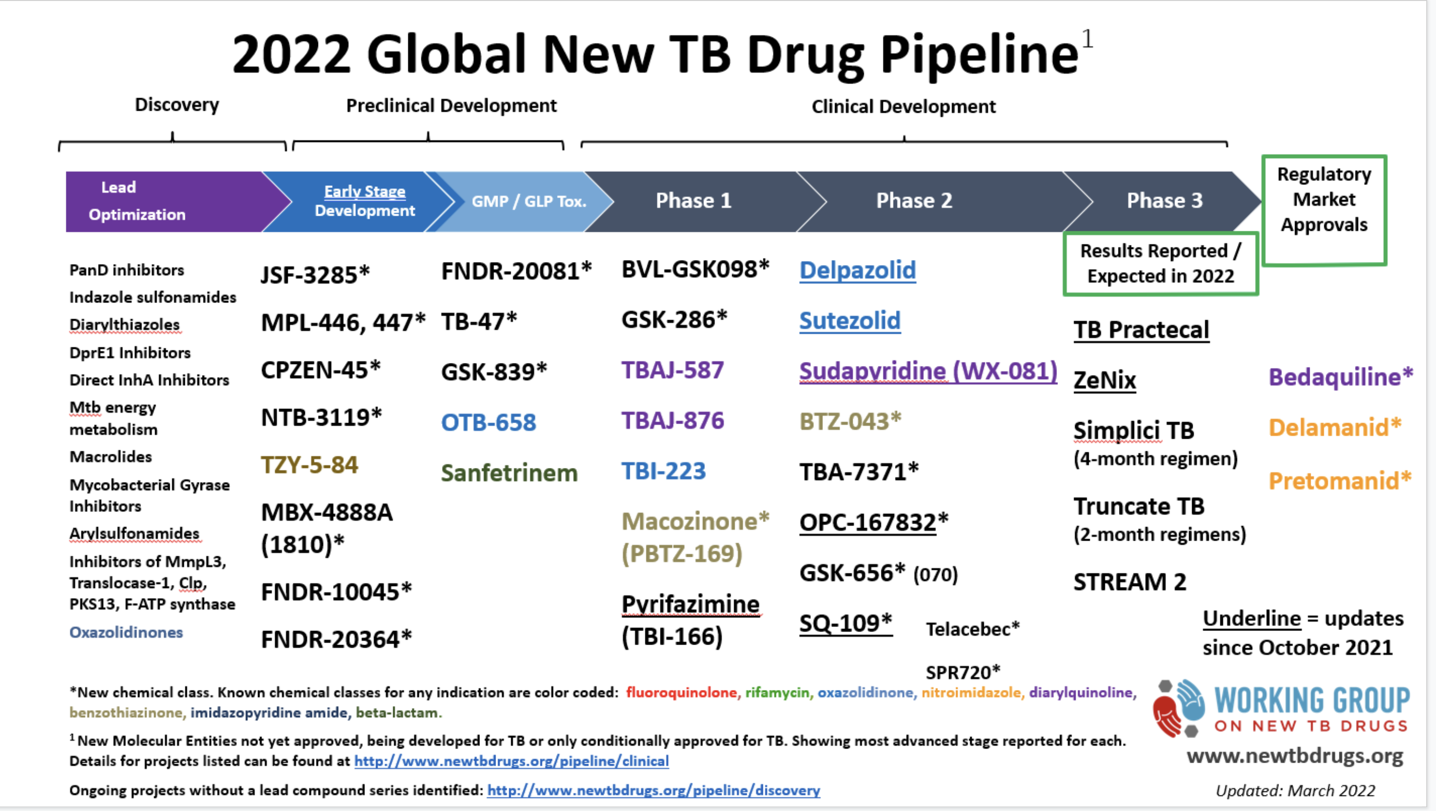

Slide 5
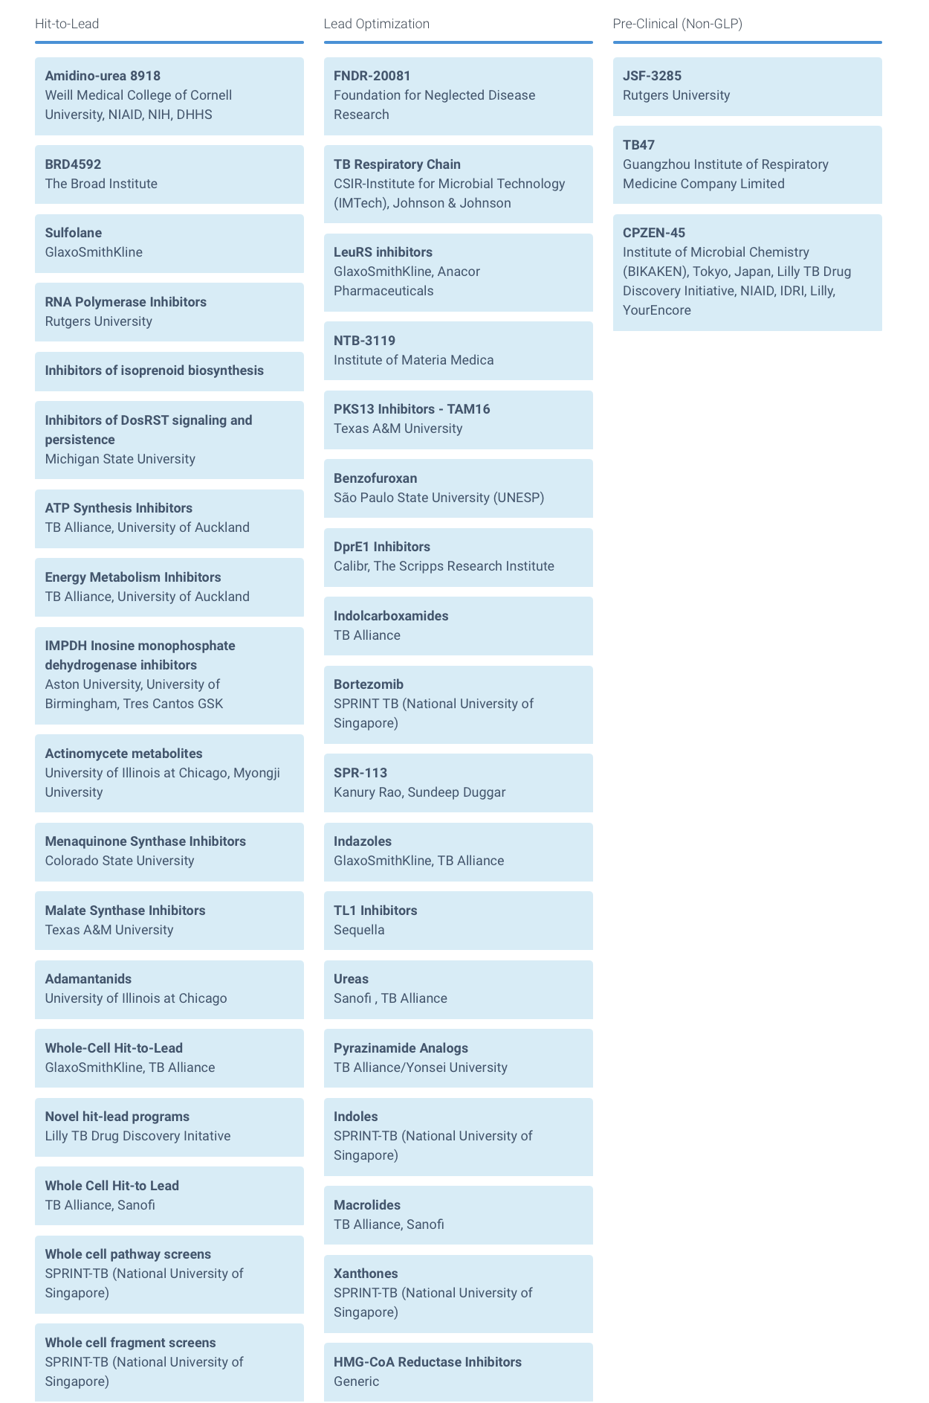
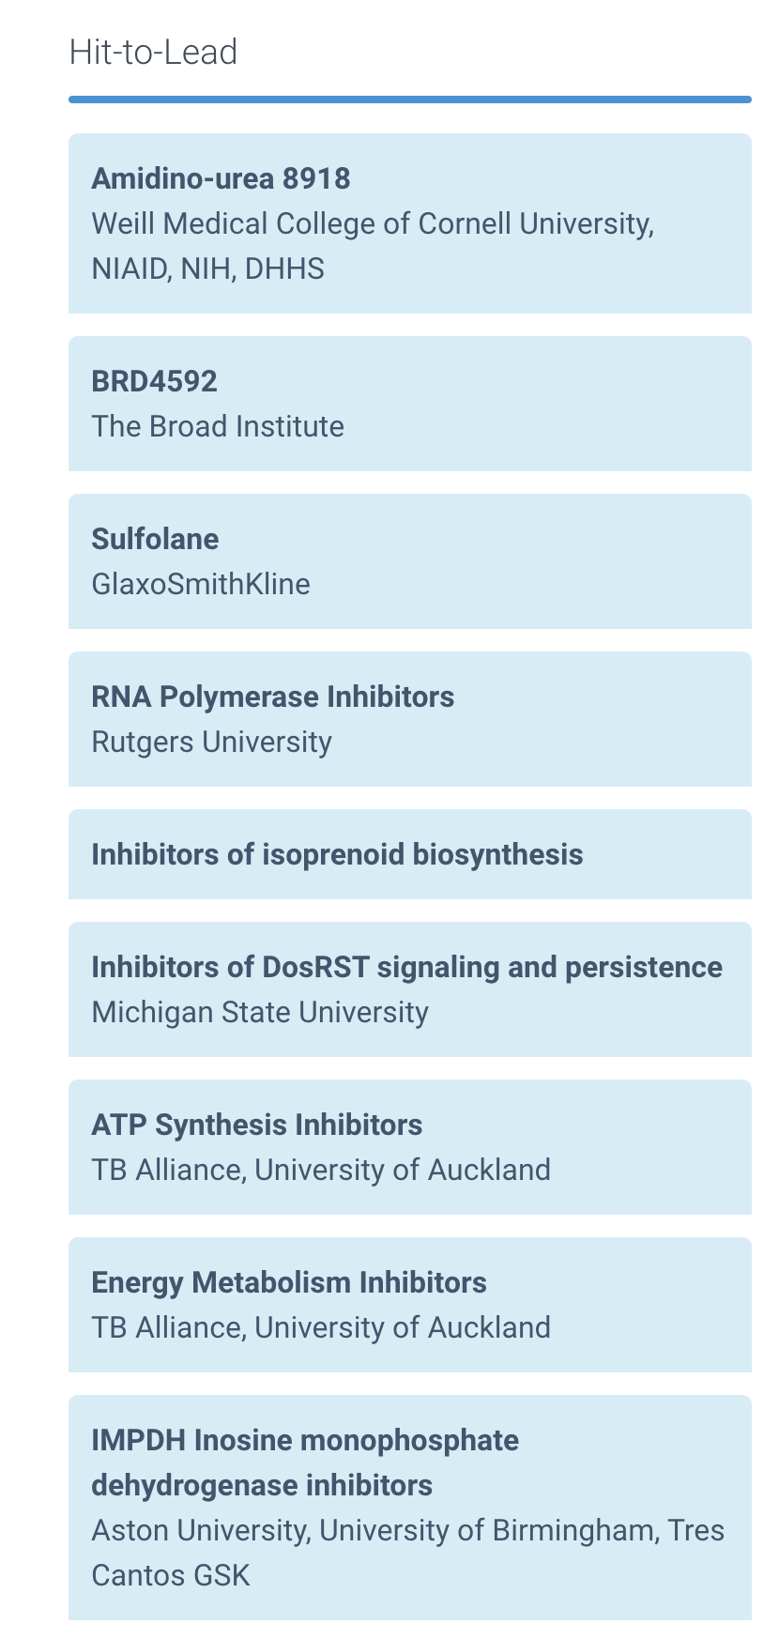
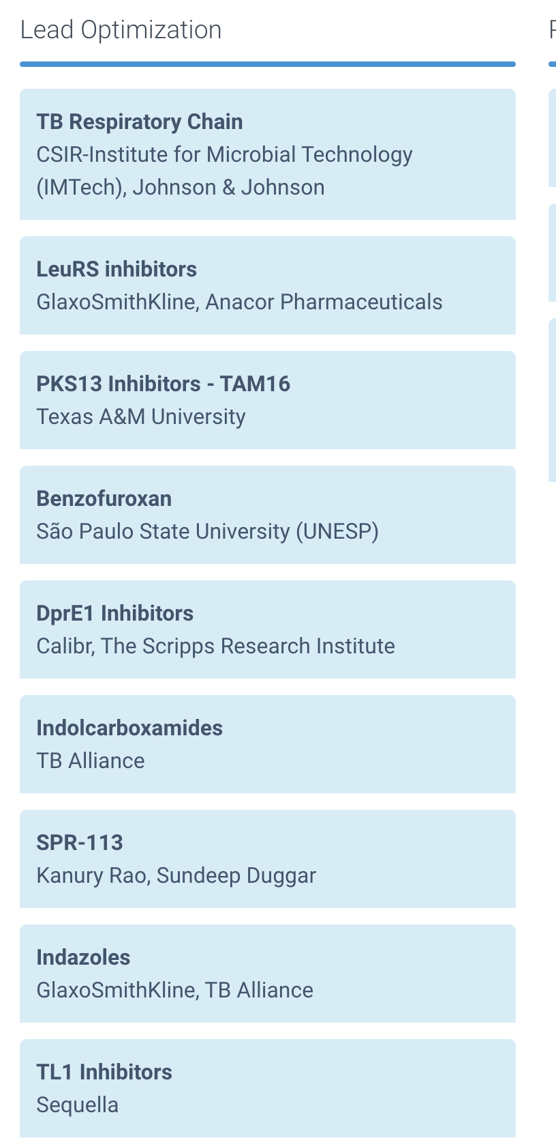
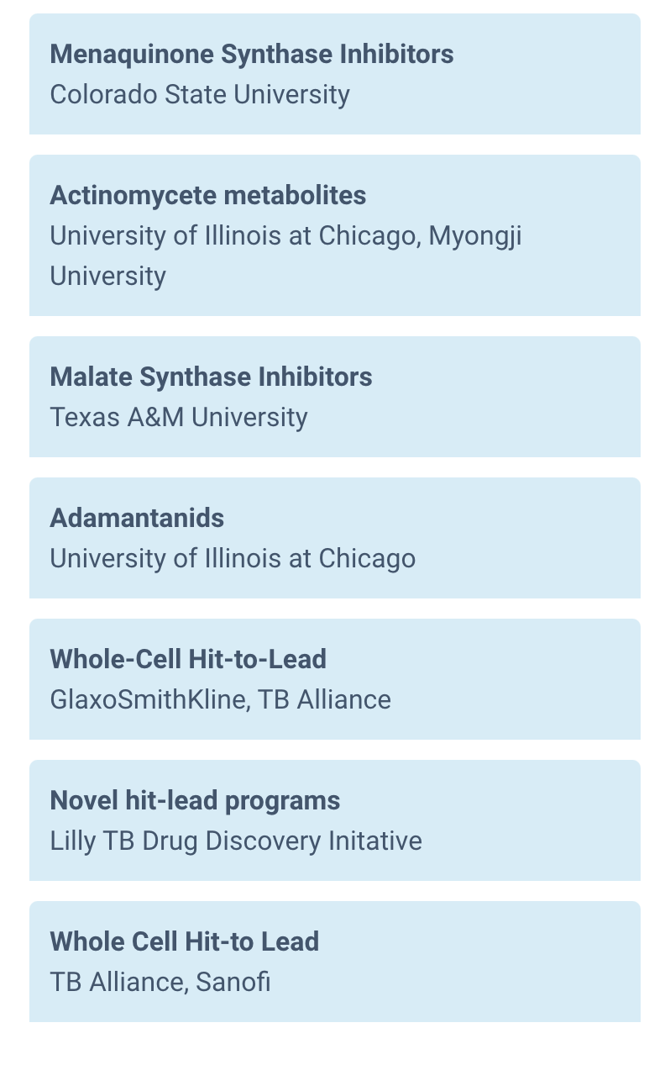
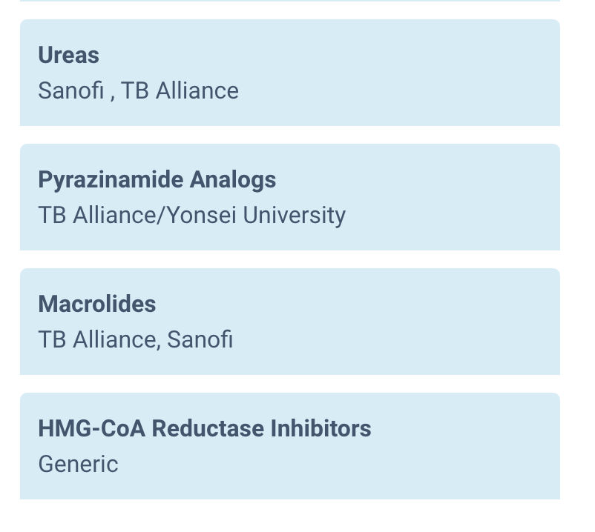

Slide 6
Drug Discovery and Development
Small molecule library
10,000 to 2,000,000
Screen
Hit Assessment
Hit to Lead
Lead
Optimization
Clinical
Candidate
Clinical Trial
Phase I, II, III
6

Slide 7
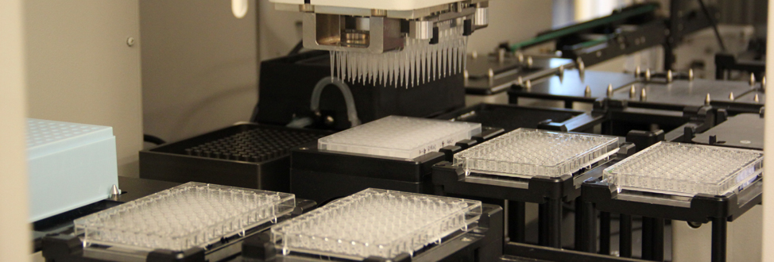
New ways to screen
Lead to treatment shortening
Relevant to aspect(s) of disease
Adaptable to high throughput
7

Slide 8
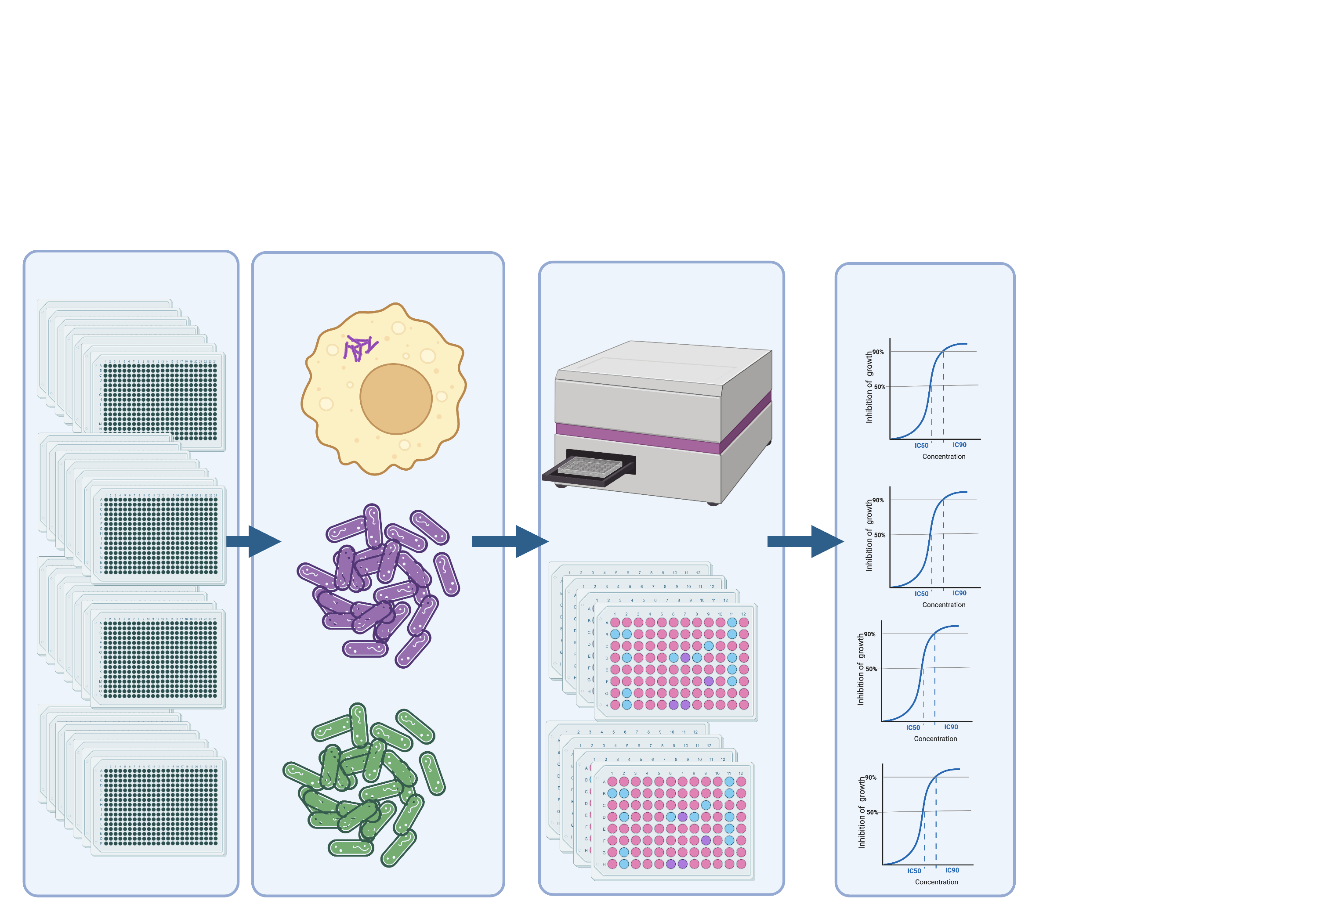
High throughput screens identify vulnerable targets
Created with BioRender.com

Slide 9
Replicating bacteria
      ̴ 200,000 compounds tested
384 well screen (20 µM, single point)
      ̴ 3,000 compounds tested (1.5 % hit rate)
MIC determination
      ̴ 1,000 compounds with MIC < 20 µM identified
Active compounds

Slide 10
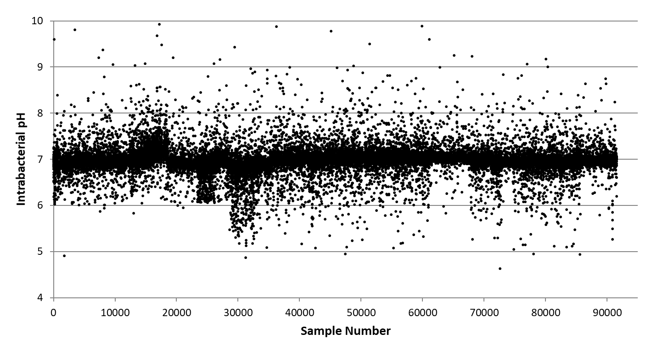
High throughput screen

Slide 11
Hit assessment
Screen
Hit Assessment
Hit to Lead
Lead
Optimization
Clinical
Candidate
Clinical Trial
Phase I, II, III
30-50 analogs
6 months
11

Slide 12
Hit-to-lead (lead generation)
Screen
Hit Assessment
Hit to Lead
Lead
Optimization
Clinical
Candidate
Clinical Trial
Phase I, II, III
100-400
analogs
1 year
12

Slide 13
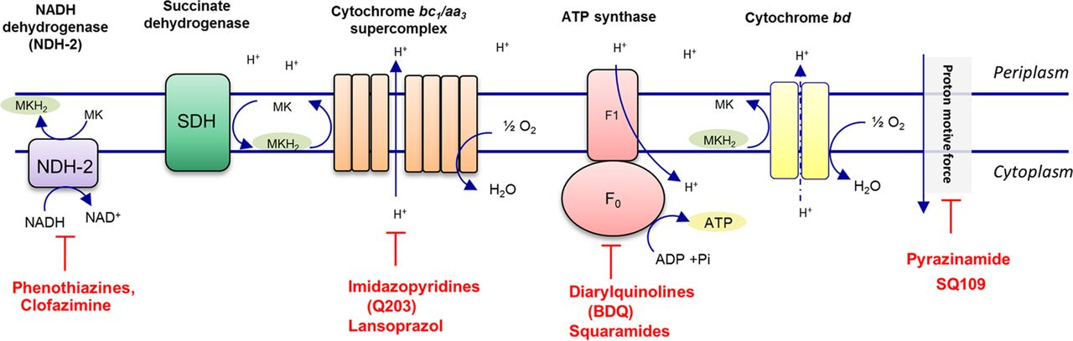
Mtb electron transport chain
13

Slide 14
Scaffolds targeting cytochrome bcc (QcrB)
Cleghorn et al. J Med Chem. 2018. 61:6592. Chandrasekera et al. J Med Chem. 2015. 58:7273.
Zuniga et al. Bioorg Med Chem. 2017. 25:3922. Ollinger at al. PLOS One. 2013. 8: e60531.
14

Slide 15
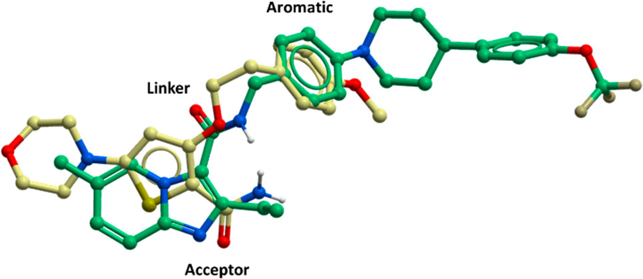
QcrB is the common target
Cleghorn et al. J Med Chem. 2018. 61:6592
15

Slide 16
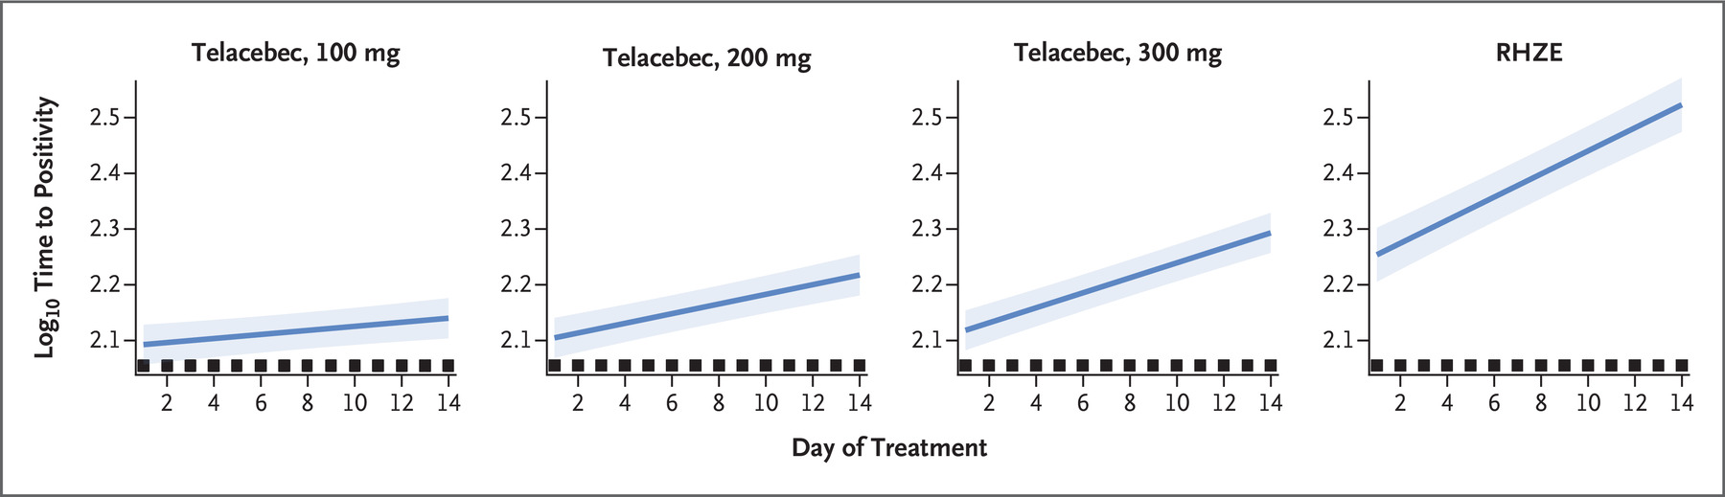
Telacebec (Q203) as clinical validation
16

Slide 17
Development of morpholino thiophenes
CONHMe, CONH2,
Weinreb amide is tolerated
Ketone tolerated
Phenyl replacement tolerated
Few other group tolerated to replace the morpholino group
Morpholine, pyridine and pyrazole groups most actives
Linkage/Spacer tolerated but less active
Activity strongly dependent on phenyl ethoxy group and substitution of the aryl ring
Meta, para more active than ortho
Shortening/elongating/constraining chain is not tolerated
Any other replacement of aryl group is inactive

Slide 18
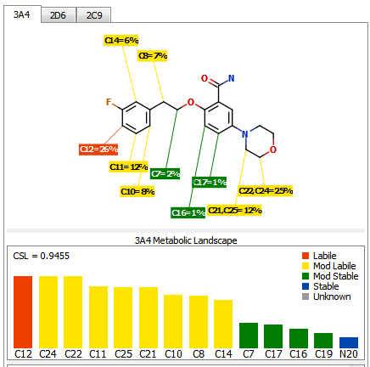
Drug-like properties
ADME = adsorption, distribution, metabolism, excretion
PK = pharmacokinetics
Multiple sites of P450 metabolism
Morpholine and N-methyl groups are predicted to be labile

Slide 19
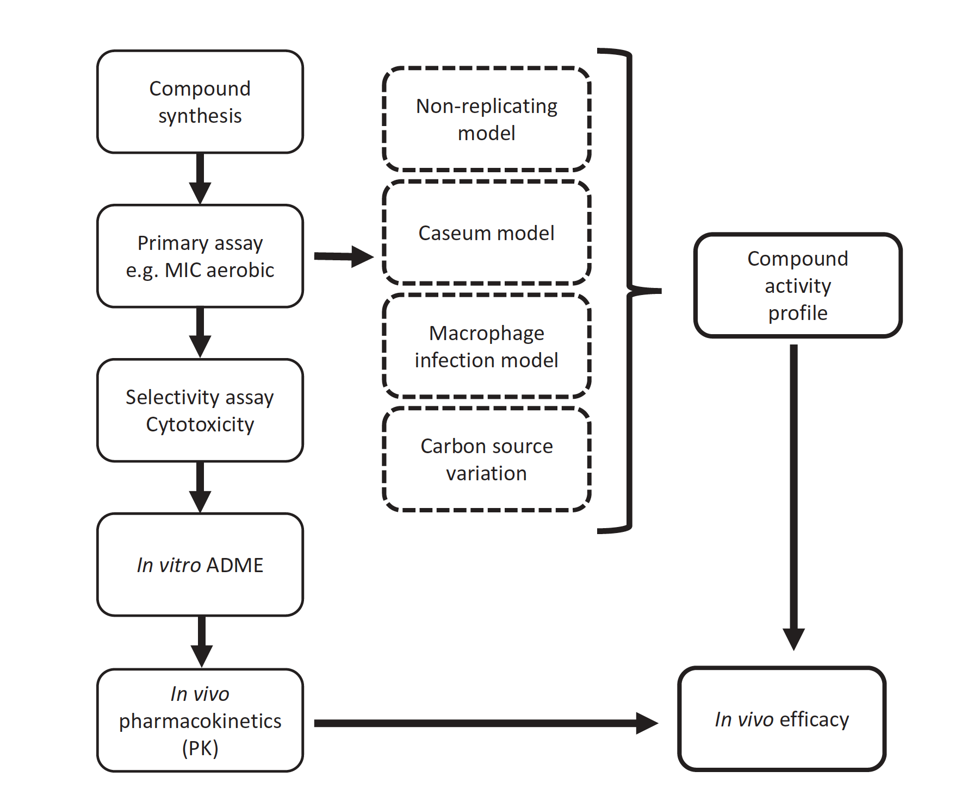
Progression of compounds “hit-to-lead”

Slide 20
Hit-to-Lead criteria
Assay | Criteria
MIC | < 5 µM
Selectivity index | >10
In vivo exposure | Acceptable
MIC shift for strains | <10X shift
In vivo | >1 log reduction in lung
hERG | IC₅₀ >5 µM; selectivity >50X

Slide 21
Drug Discovery and Development
Screen
Hit Assessment
Hit to Lead
Lead
Optimization
Clinical
Candidate
Clinical Trial
Phase I, II, III
80-250 analogs
1-2 year
21

Slide 22
Lead optimization
Assay | Criteria
MIC | < 0.5 µM
Selectivity | >500
In vivo exposure | Acceptable
MIC shift for strains | <5 X shift
In vivo | >1 log reduction in lung
hERG | no hERG
CYPs (P450s) | no induction
CYPs (P450s) | IC₅₀ >10µM
Photoactivity | None
Half life | > 2 h
Bioavailability | >30%
Remove liabilities
Focus on safety
Maintain antibacterial potency
Maintain druglike properties
In vivo activity

Slide 23

It takes a village

Slide 24
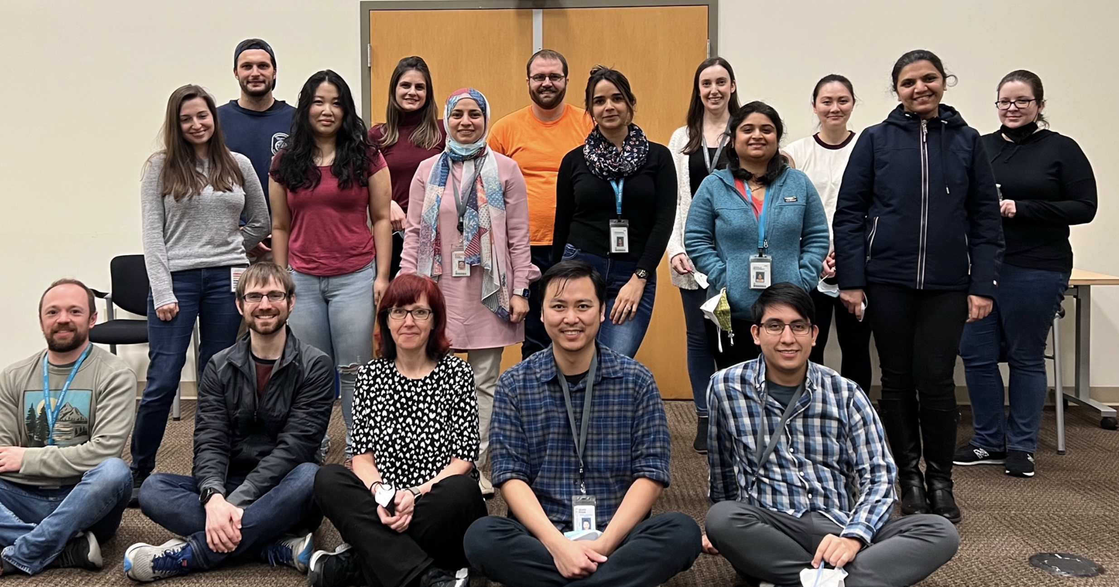



Acknowledgements
Personnel
Funding
Bill & Melinda Gates Foundation
NIAID/NIH
Department of Defense
Lilly TB Drug Discovery Initiative

Slide 25
SEATRAC
Basic Science Core
Tanya Parish
Kevin Urdahl
Seattle TB Research Advancement Center
Consultations to investigators wishing to establish new projects​
Basic safety training to cover work under BSL3 and ABSL3 conditions​
Advanced training in microbiological and immunological techniques​
​Access to a suite of assays to generate data for pilot studies.​
https://trtc.uw.edu/seatrac/faq

Slide 26
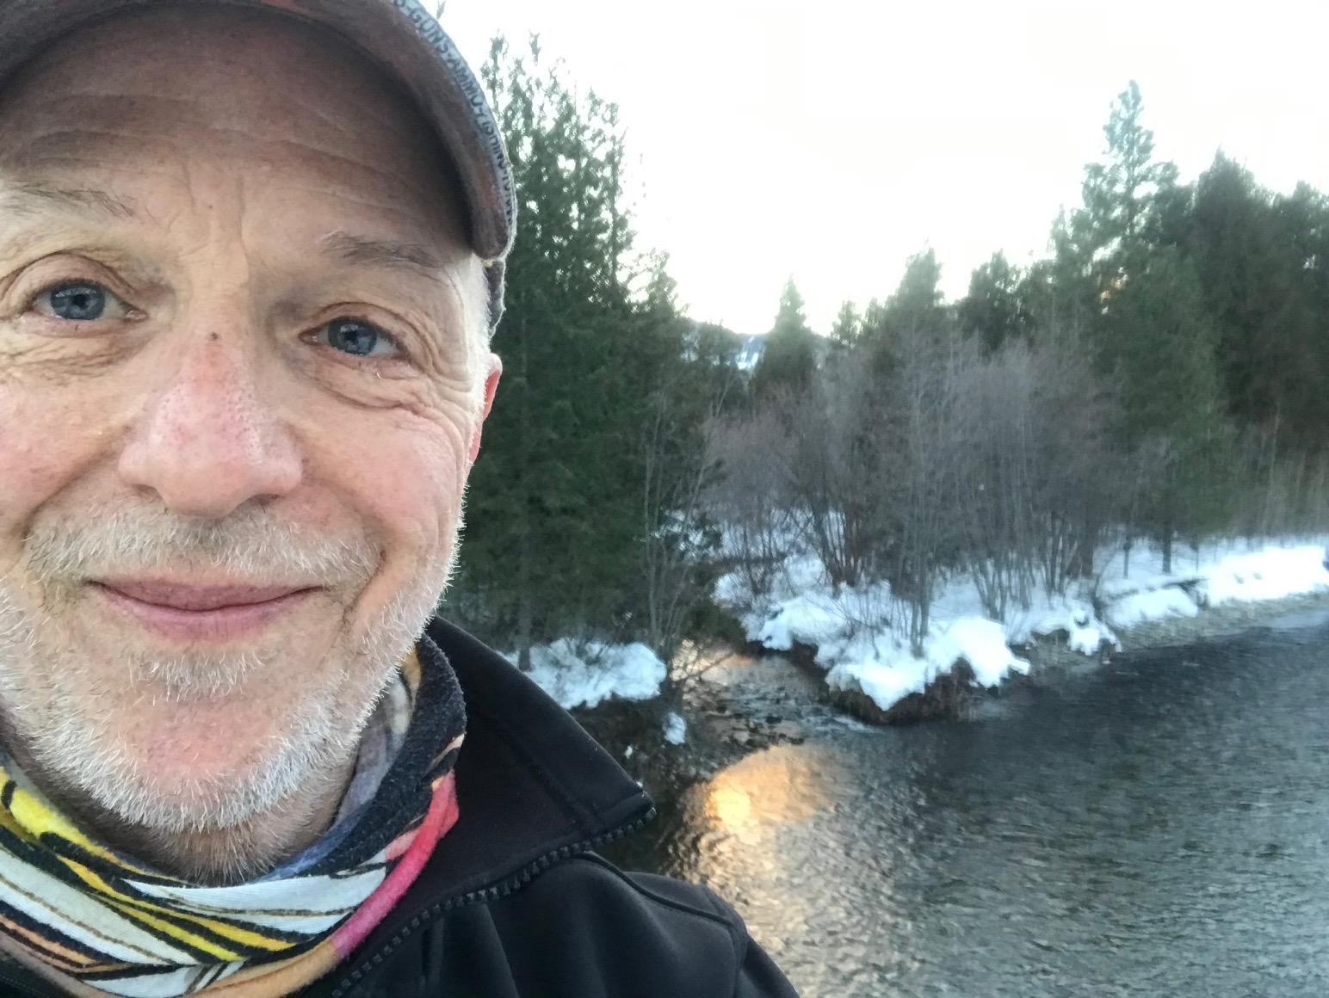
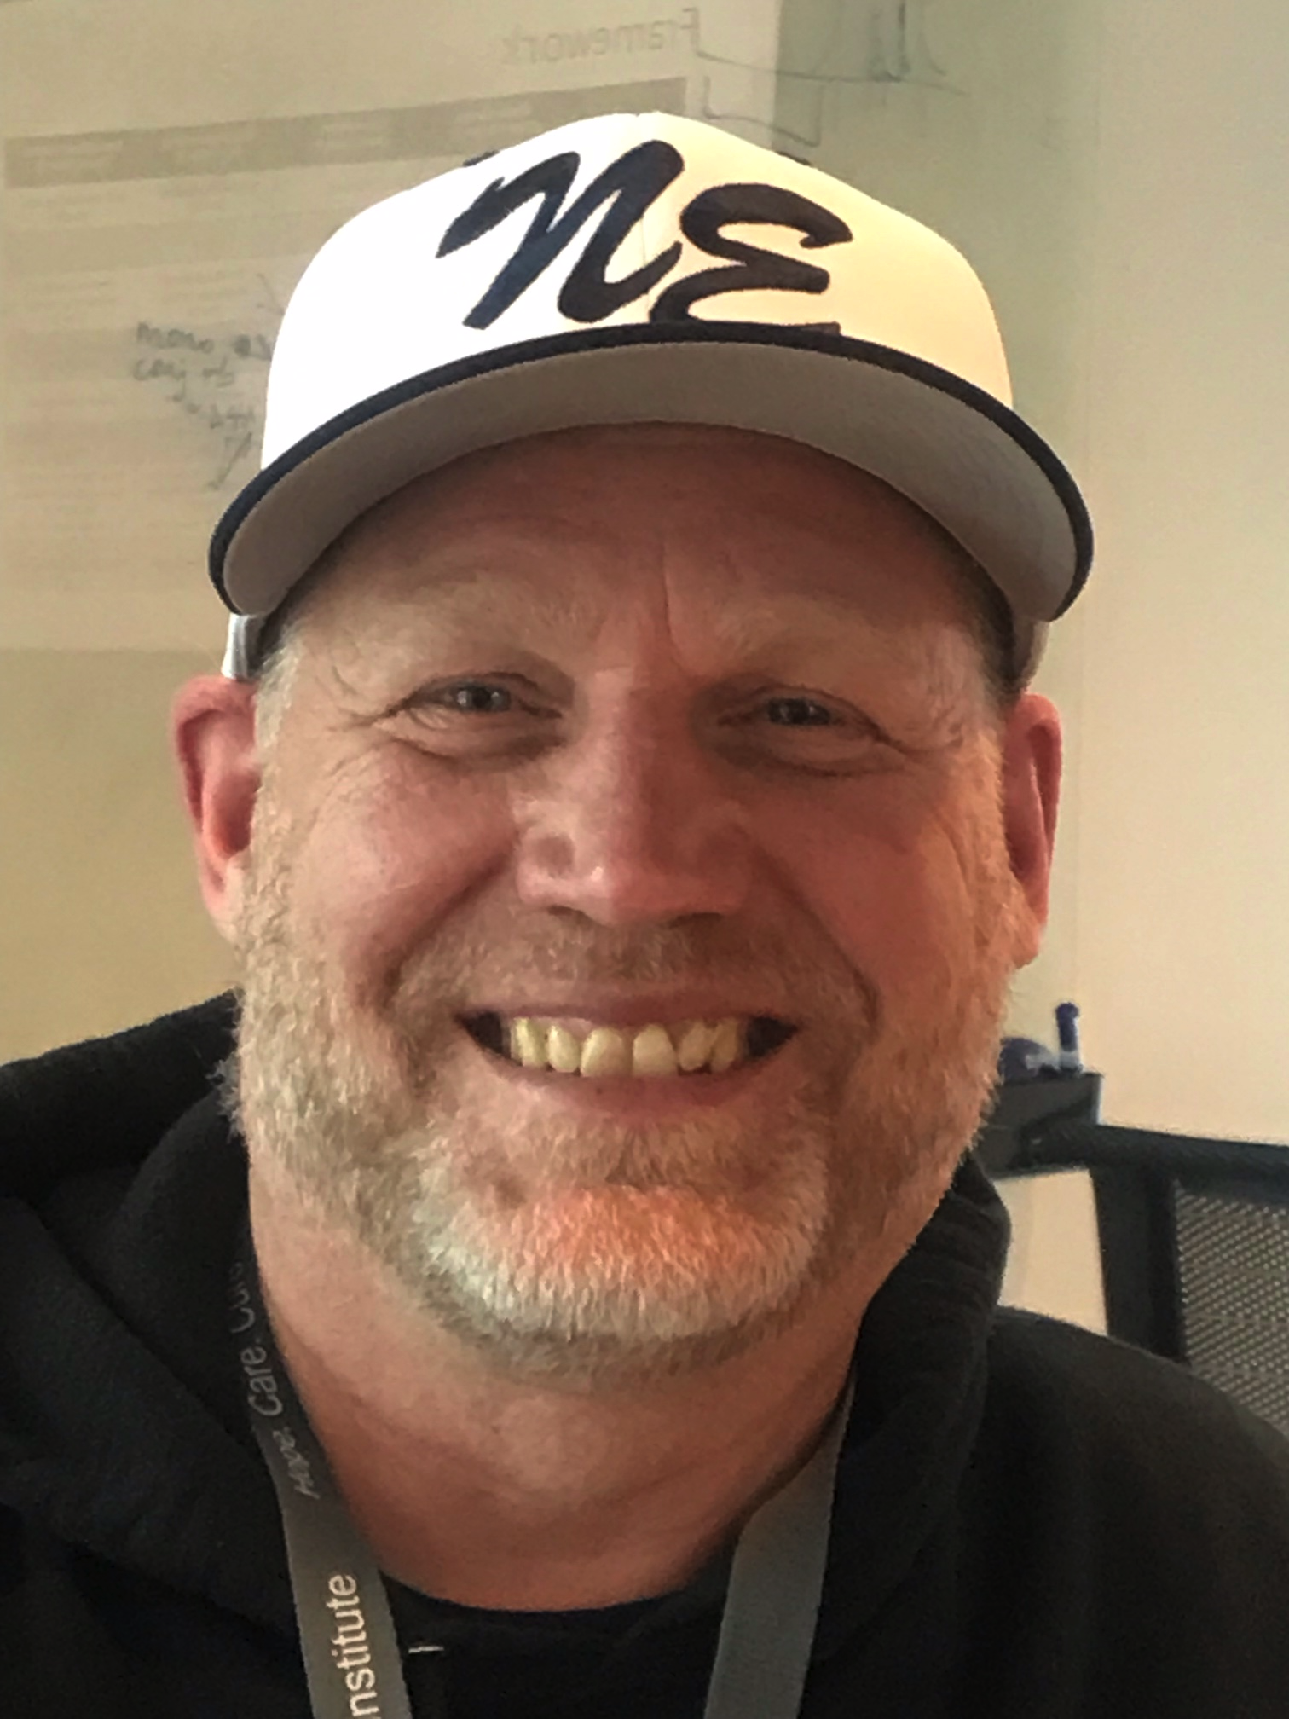
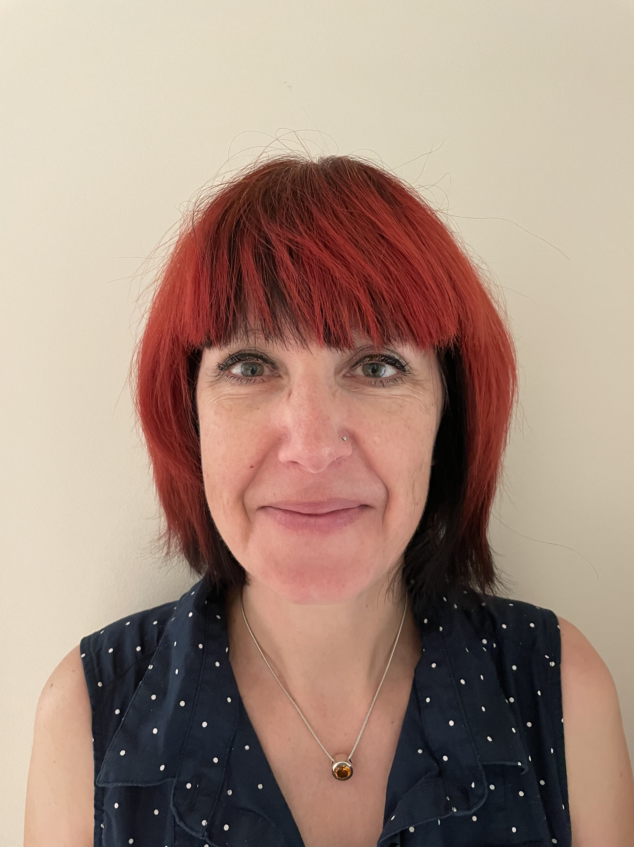
Three training centers
Tanya Parish
Seattle Children’s Research Institute
Kevin Urdahl
Seattle Children’s Research Institute
David Sherman
University of Washington

Slide 27
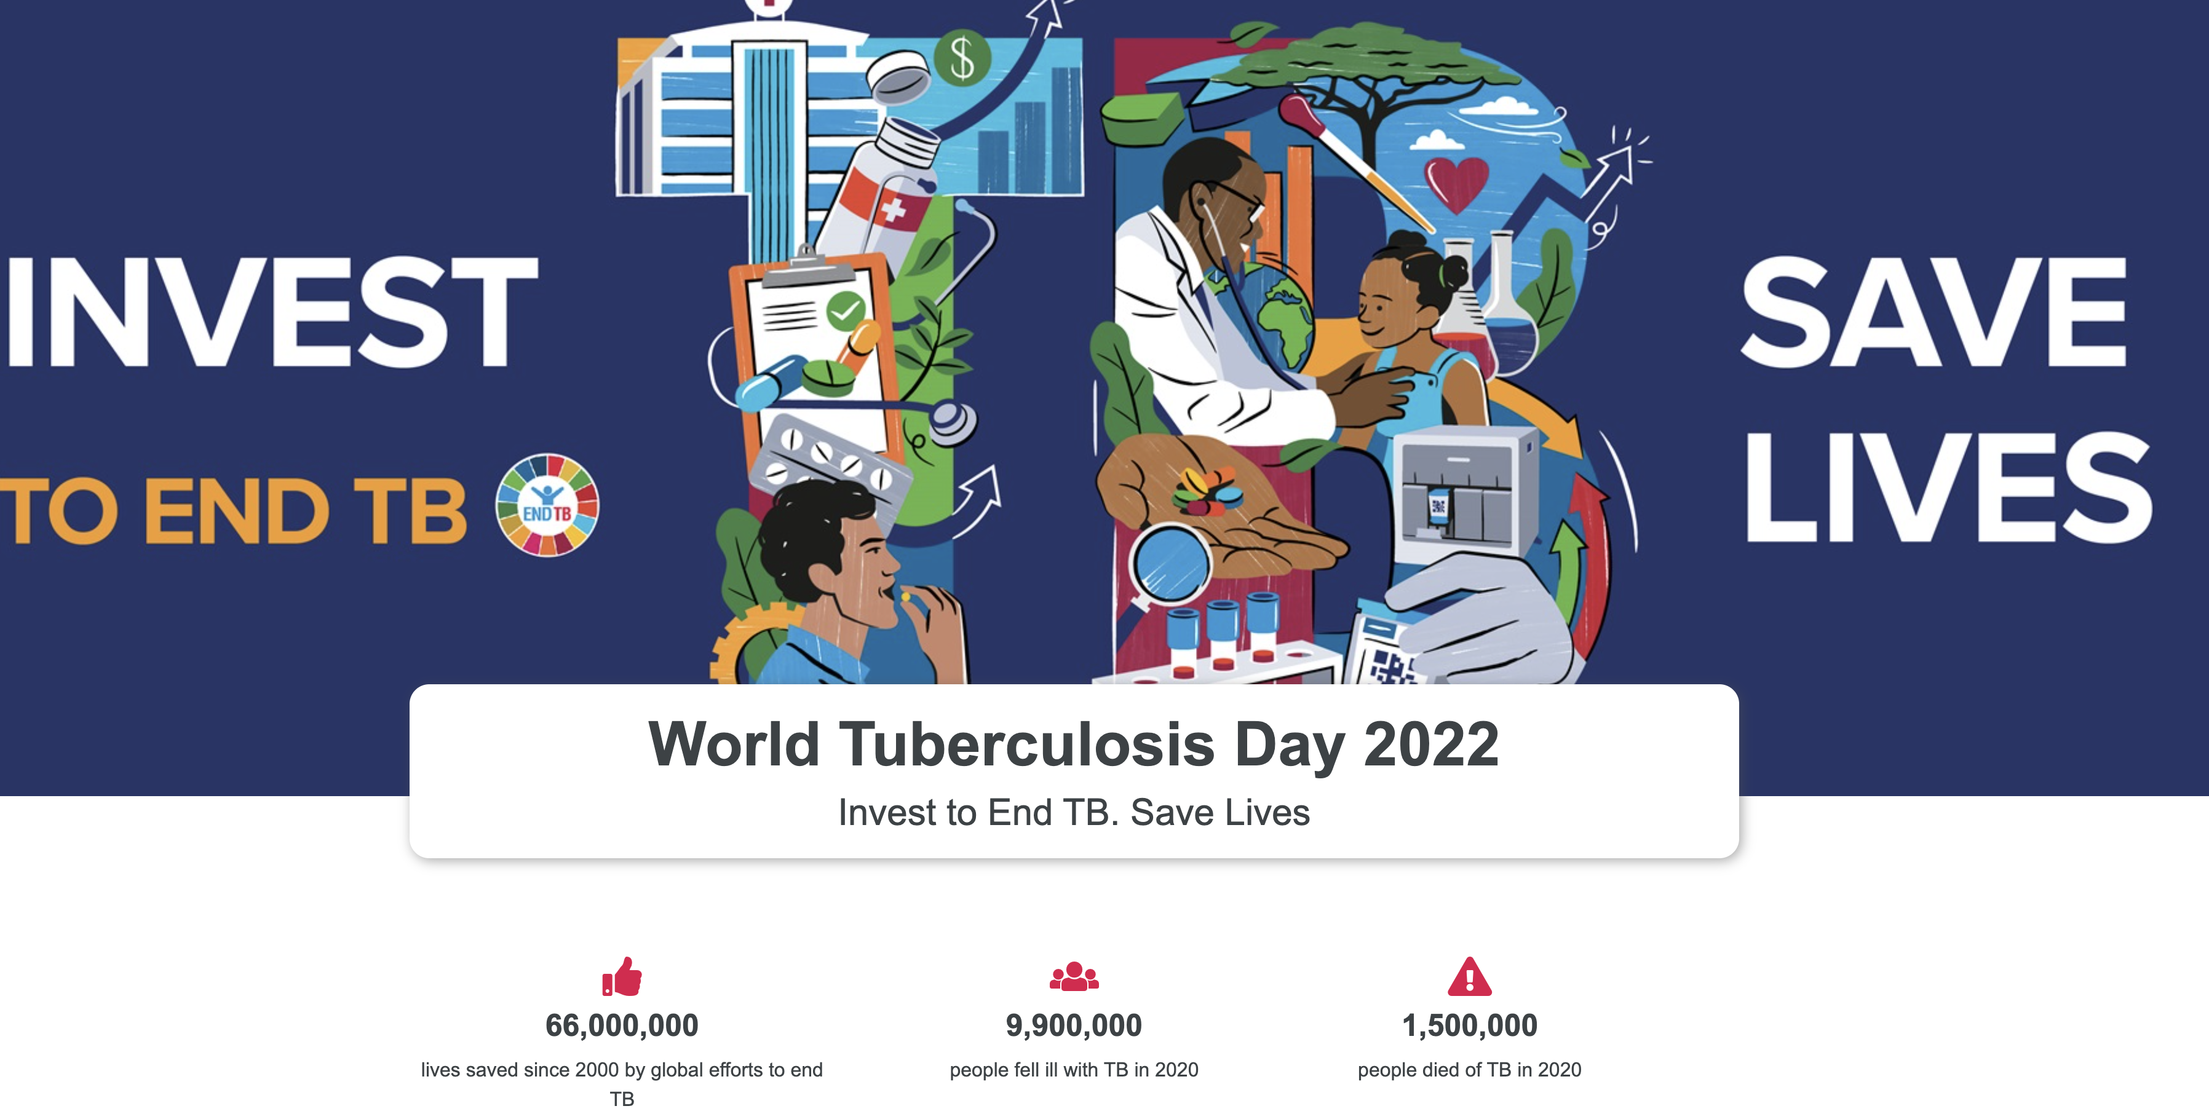
https://www.who.int/campaigns/world-tb-day/2022

