Slide 1
Immunity against TB:
Insights from Animal Models
Kevin Urdahl
Seattle Children’s Research Institute

Slide 2

Despite widespread BCG vaccination,
TB remains a major global problem

Slide 3
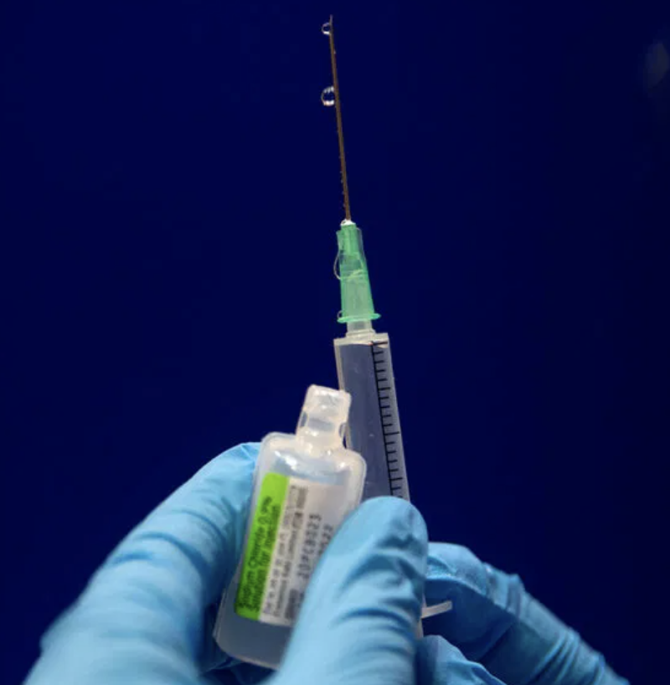
We need a better vaccine, but developing one has proven very difficult
Yet several effective COVID
vaccines were developed
in less than a year!

Slide 4
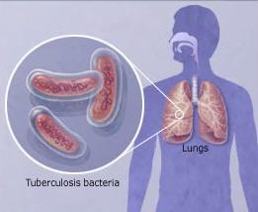
TB is a human disease

Slide 5
TB is a human disease
TB Immunity:
Established within the lung
Very early after aerosol infection

Slide 6
TB is a human disease
TB Immunity:
Established within the lung
Very early after aerosol infection

Slide 7
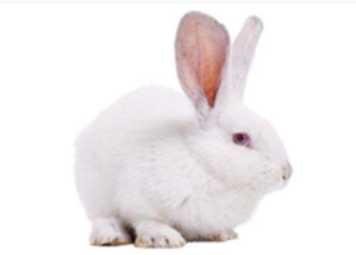
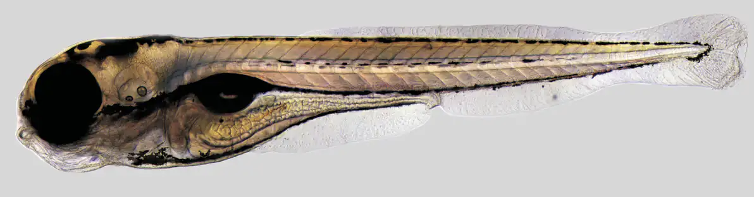
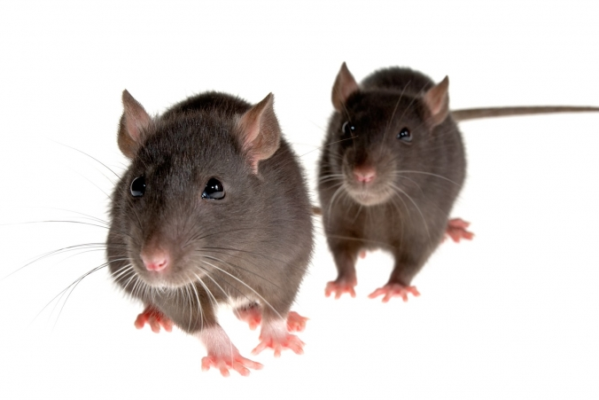
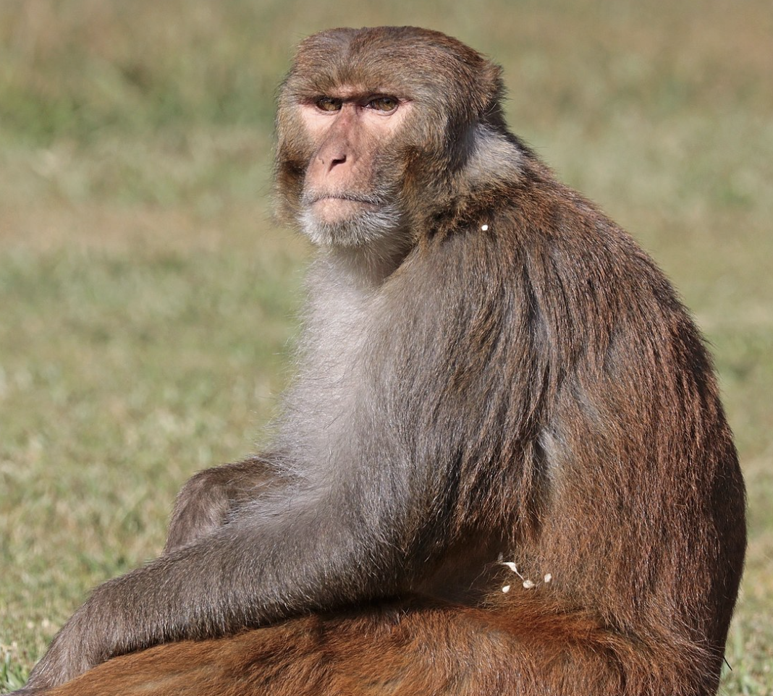
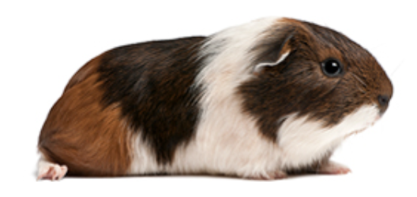
TB Animal Models
Zebrafish
Rabbits
Mice
Guinea pigs
Non-human primates

Slide 8
Studies in mice have identified several immune factors, later confirmed to be important in immunity against human TB
CD4 T cells
IFNγ/IL-12
TNF
Mice

Slide 9
Yet mouse and human TB are different in several important ways
90-95%
do not develop disease
(eradication or
paucibacillary infection)
CFU/Lung

Slide 10
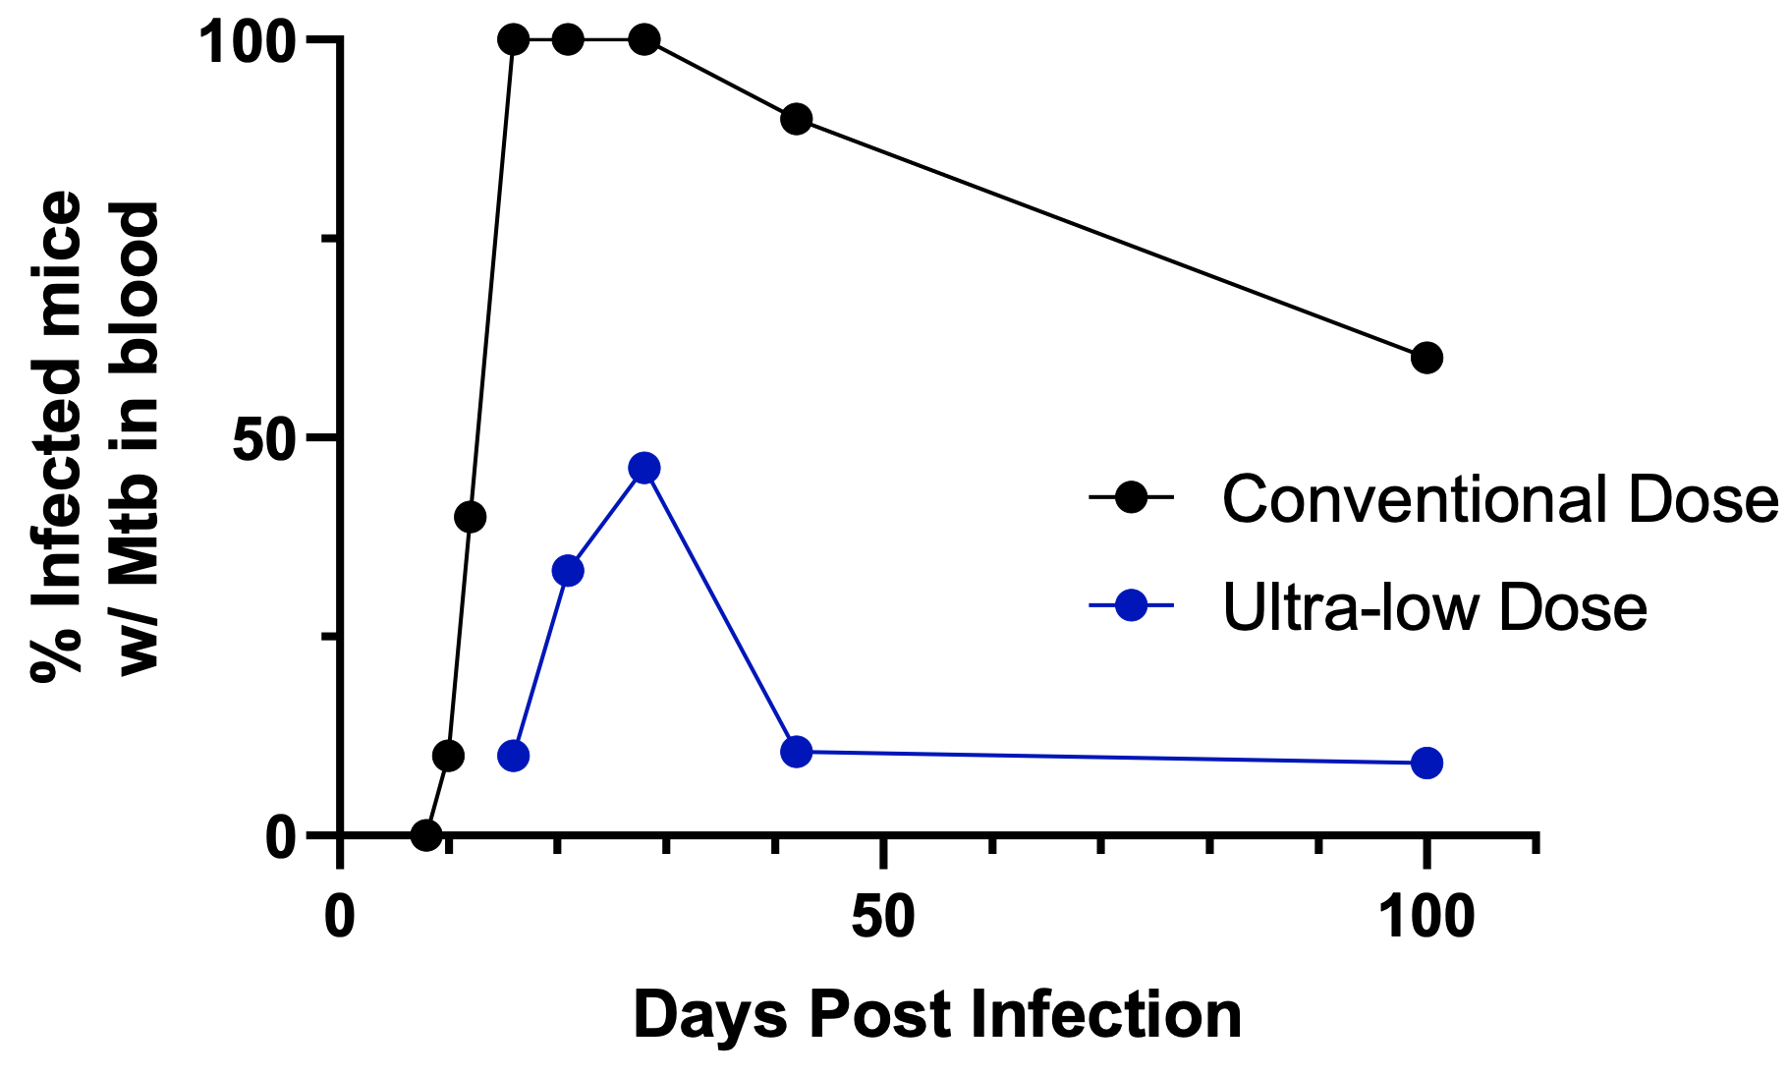
Conventional dose Mtb infection in mice results in persistent bacteremia
Lauren Cross, unpublished

Slide 11
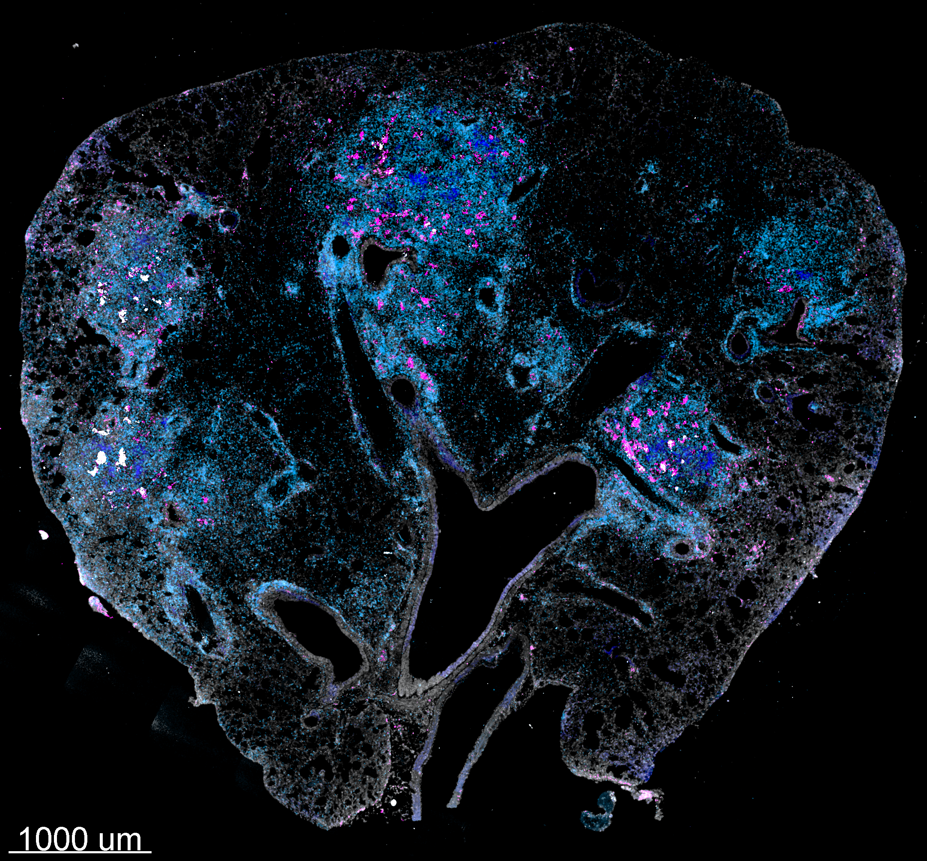
Mice infected with a conventional Mtb dose have poorly formed granulomas
CD3 CD11b B220 Mtb
Plumlee et al, Cell Host Microbe, 2021

Slide 12
Could some of the differences between mouse and human TB due be due to the infectious dose?
90-95%
do not develop disease
(eradication or
paucibacillary infection)
CFU/Lung
50-100 CFU
1-3 CFU

Slide 13
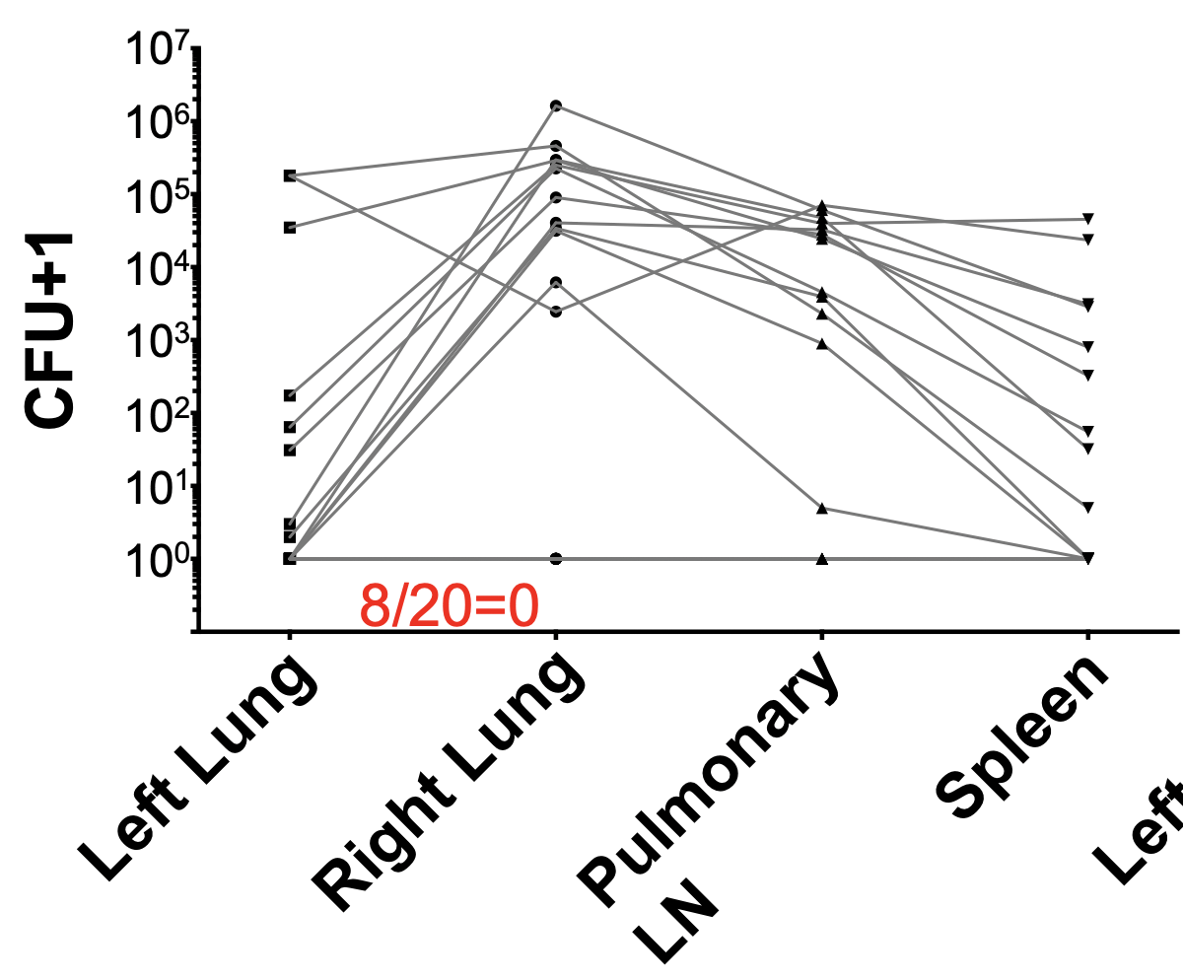
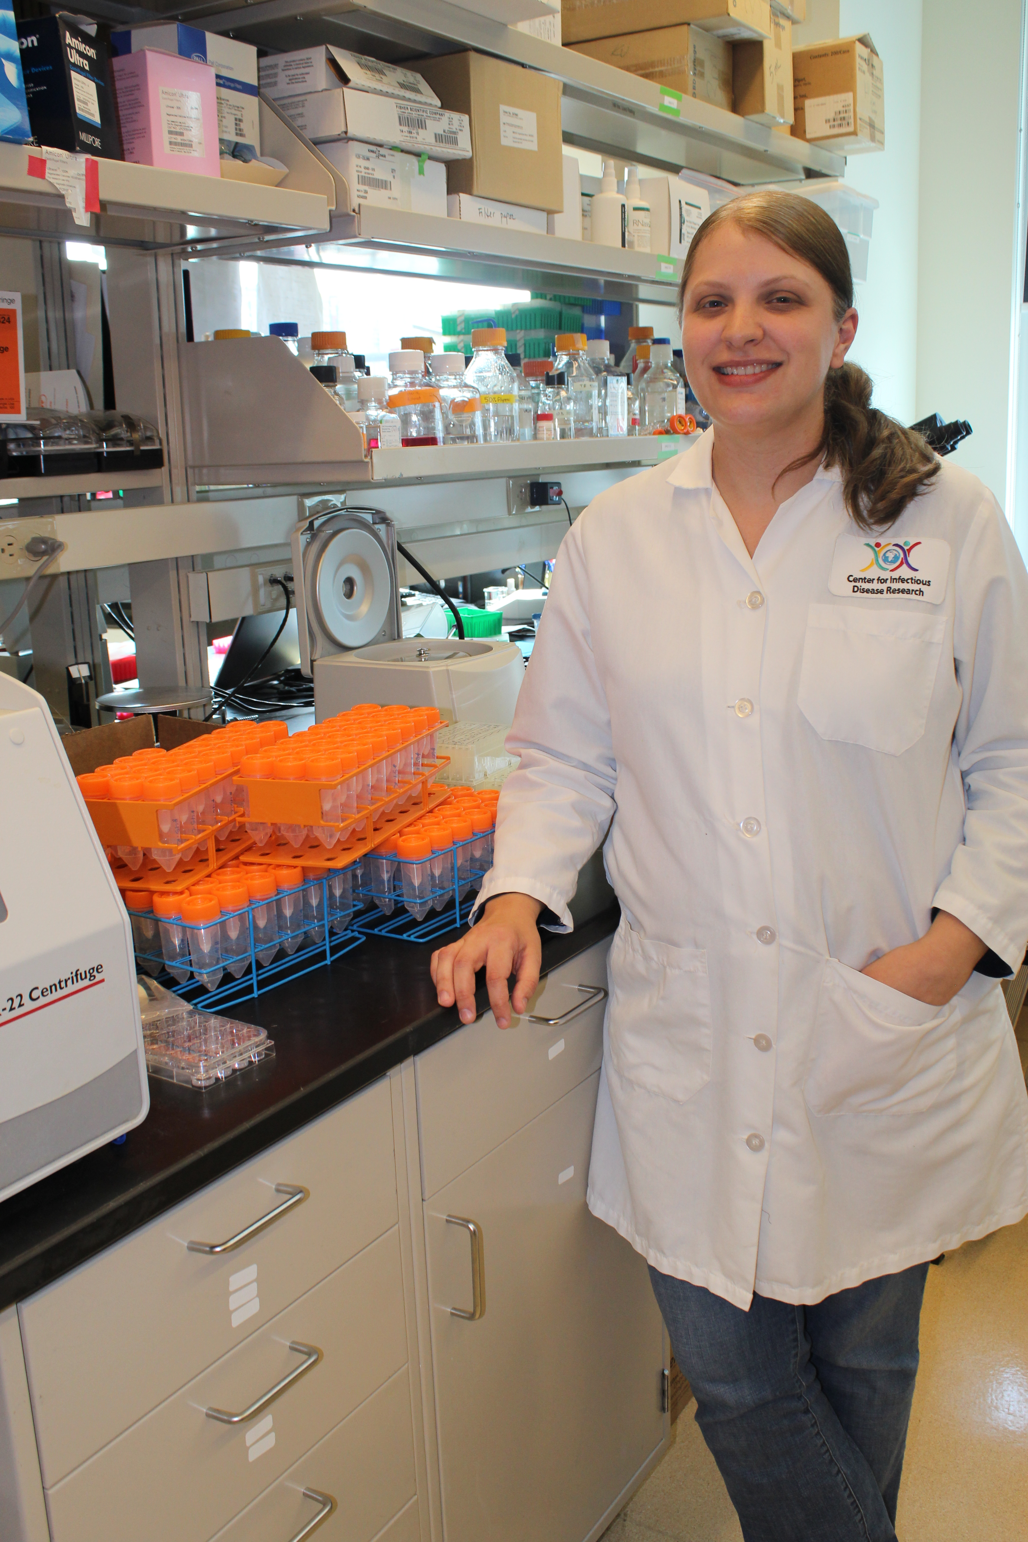

Ultra-low dose infection
Courtney Plumlee
Plumlee et al, Cell Host Microbe, 2021

Slide 14
ULD Mtb infection in mice results in transient bacteremia
Lauren Cross, unpublished

Slide 15
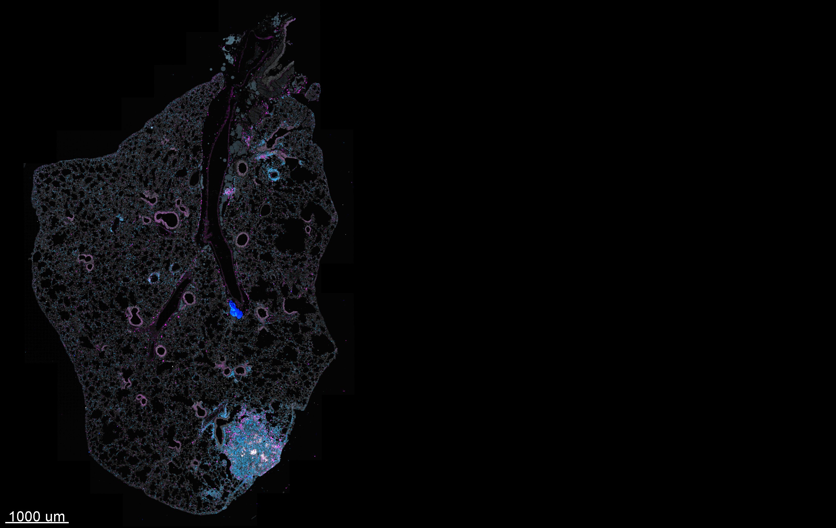
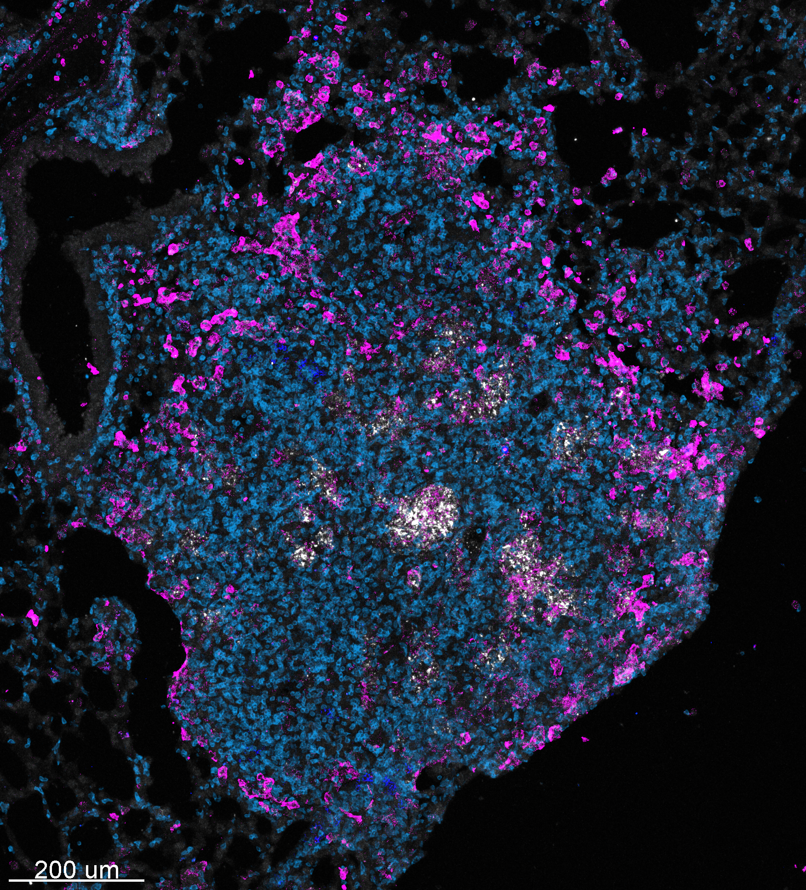
ULD Mtb infection results in a single, well-organized granuloma
CD3 CD11b B220 Mtb
Plumlee et al, Cell Host Microbe, 2021

Slide 16
TB vaccines in animal models

Slide 17
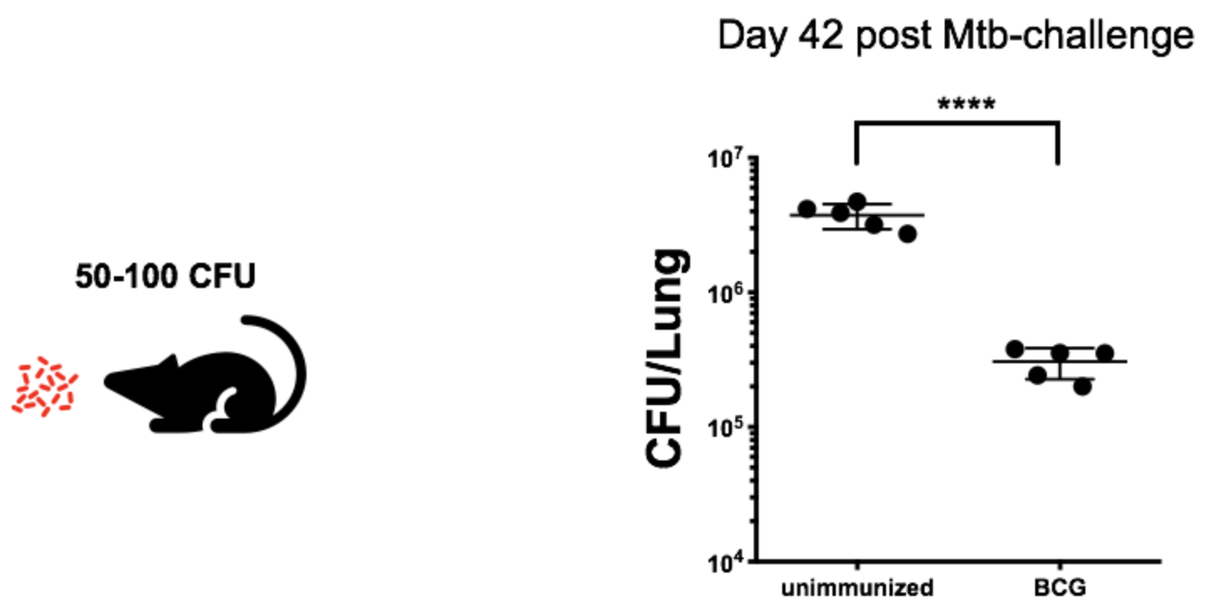
The “gold standard” for TB vaccines in animals
Courtney Plumlee

Slide 18
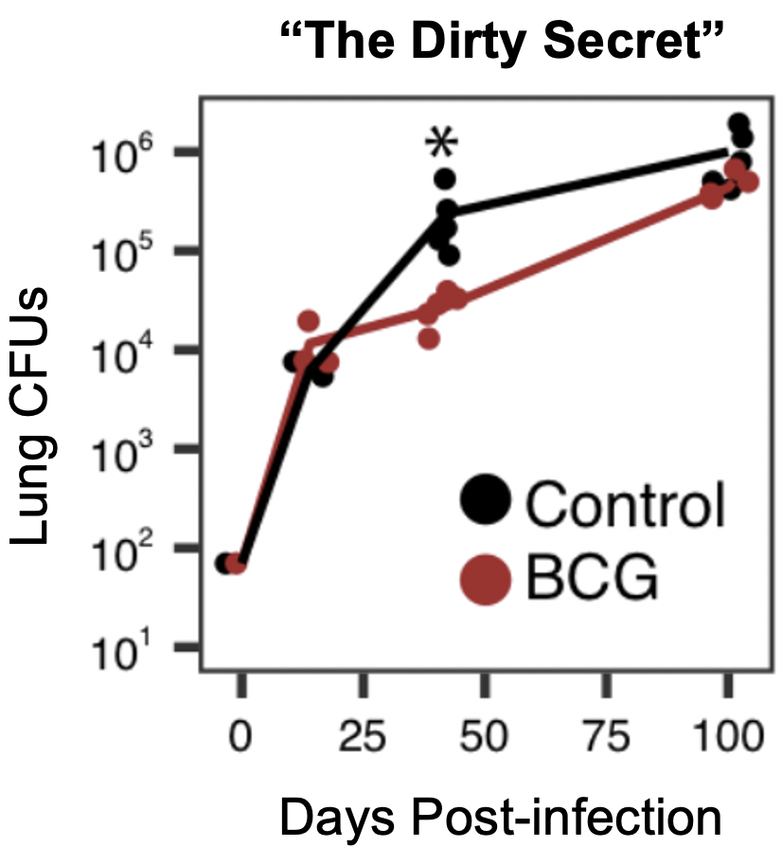
The “gold standard” for TB vaccines in animals
Johannes Nemeth

Slide 19
New gold standards in animal models

Slide 20
Sterilizing immunity in non-human primates
Attenuated CMV vectored TB vaccine
Hansen et al,
Nature Medicine, 2018.

Slide 21
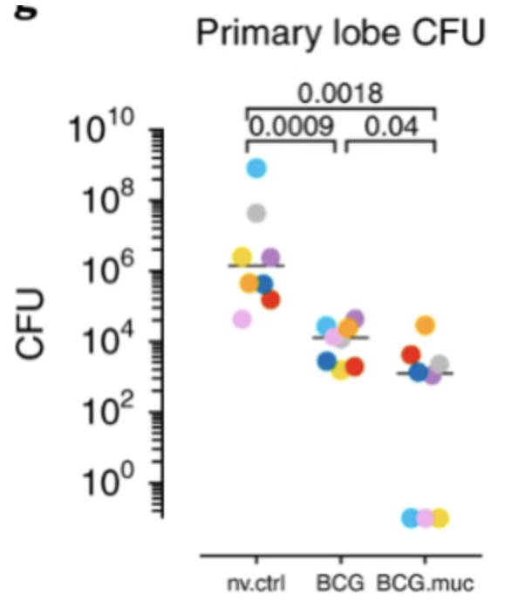
Sterilizing immunity in non-human primates
Dijkman et al, 2019, Nature Medicine

Slide 22
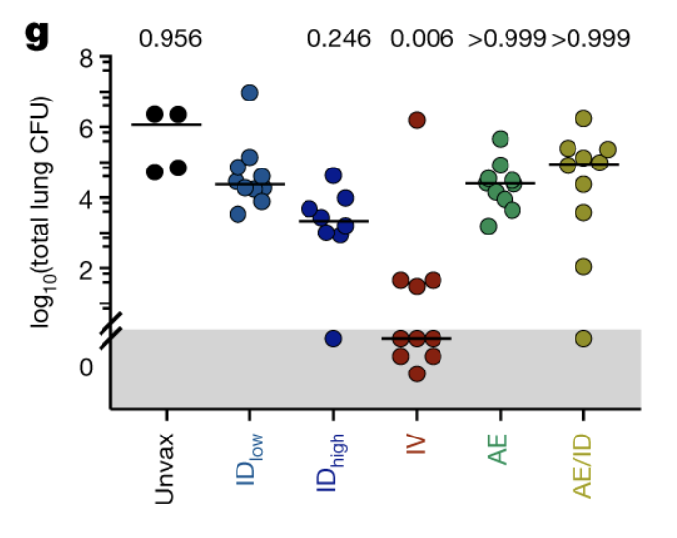
Sterilizing immunity in non-human primates
Darrah et al, 2020, Nature 577:95.

Slide 23
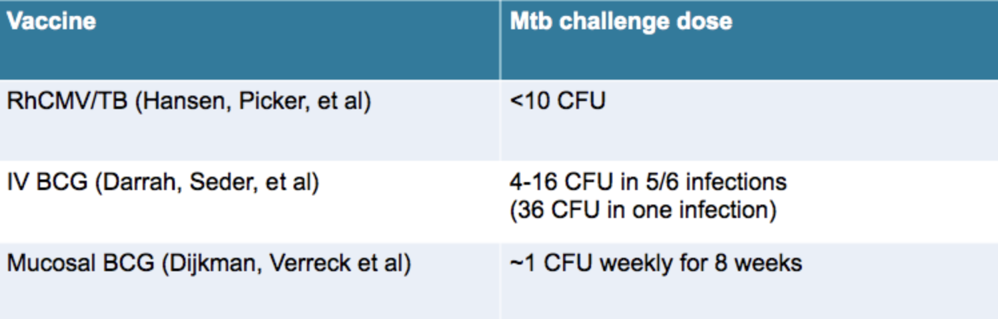
Sterilizing vaccines in non-human primates use low dose Mtb challenge

Slide 24
Is sterilizing immunity in mice possible
after a physiologic ULD challenge?

Slide 25
Sterilizing immunity in ULD-infected mice
Lung CFUs
BCG
Unimmunized
Courtney Plumlee

Slide 26
Vaccine-induced Mtb containment in ULD-infected mice
Courtney Plumlee

Slide 27
ULD model enables assessment of three distinct parameters of vaccine-induced immunity
Overall bacterial burden
Containment of infection
Sterilizing immunity
In the mouse, each of these types of immunity can be dissected mechanistically.

Slide 28
Exciting times in TB research

Slide 29
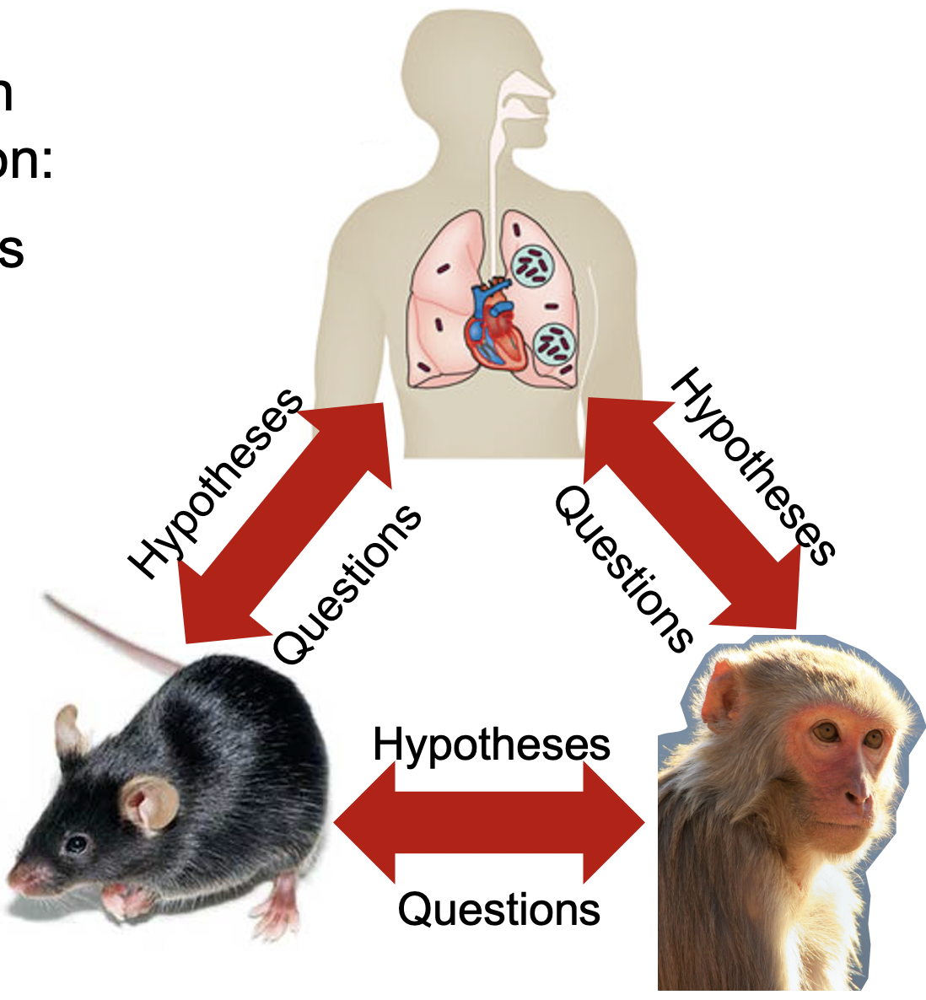
Exciting times in TB research

