Slide 1
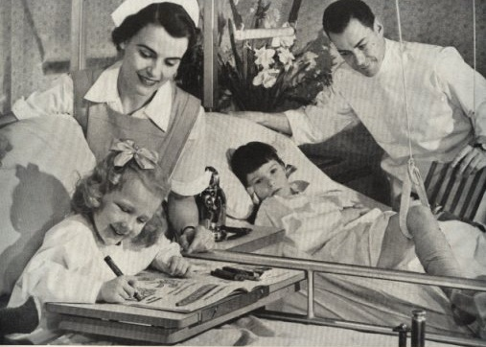
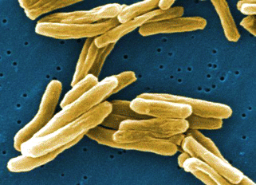
Pediatric Tuberculosis Special Considerations
Rafael E. Hernandez, MD PhD
Assistant Professor, Attending Physician
Division of Infectious Disease, Pediatrics
Seattle Children’s Hospital & University of Washington

Slide 2
Disclosures
No financial conflicts related to content in this presentation
Off-label use:
RIPE/HRZE regimens are FDA approved for use in children
Alternate antibiotics used for TB (e.g., fluoroquinolones) may not be approved for TB, or not approved in children
Research activity: I run a core lab at Seattle Children’s Research Institute that performs basic microbiology research for companies developing antibiotics for use in Cystic Fibrosis. I will not discuss any of these companies’ products here.

Slide 3
Objectives for Lecture
Global burden of TB in children
Understand key differences between TB disease in adults vs. children
Risk of severe disease is increased in young children
Infection is often ‘paucibacillary’ in lungs -
Infectious risk may be lower
Clinical presentation may differ from adults, overlap with other childhood illnesses
Diagnosis is challenging, diagnostic testing yield is low
Treatment principles similar to adults

Slide 4
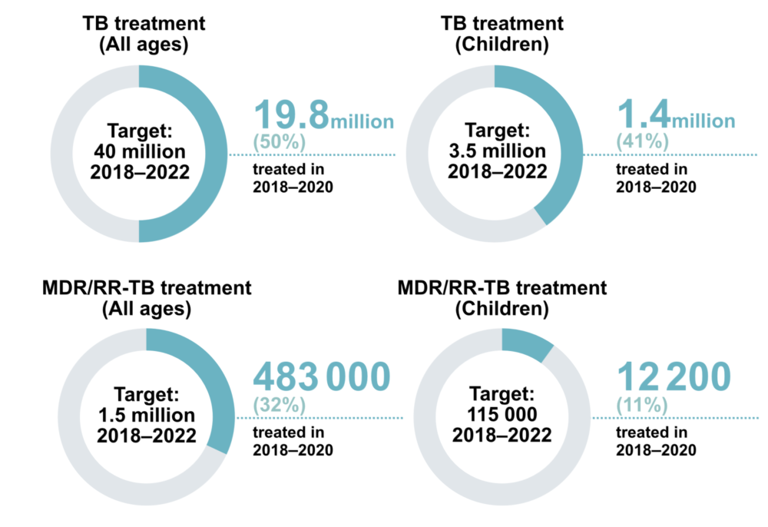
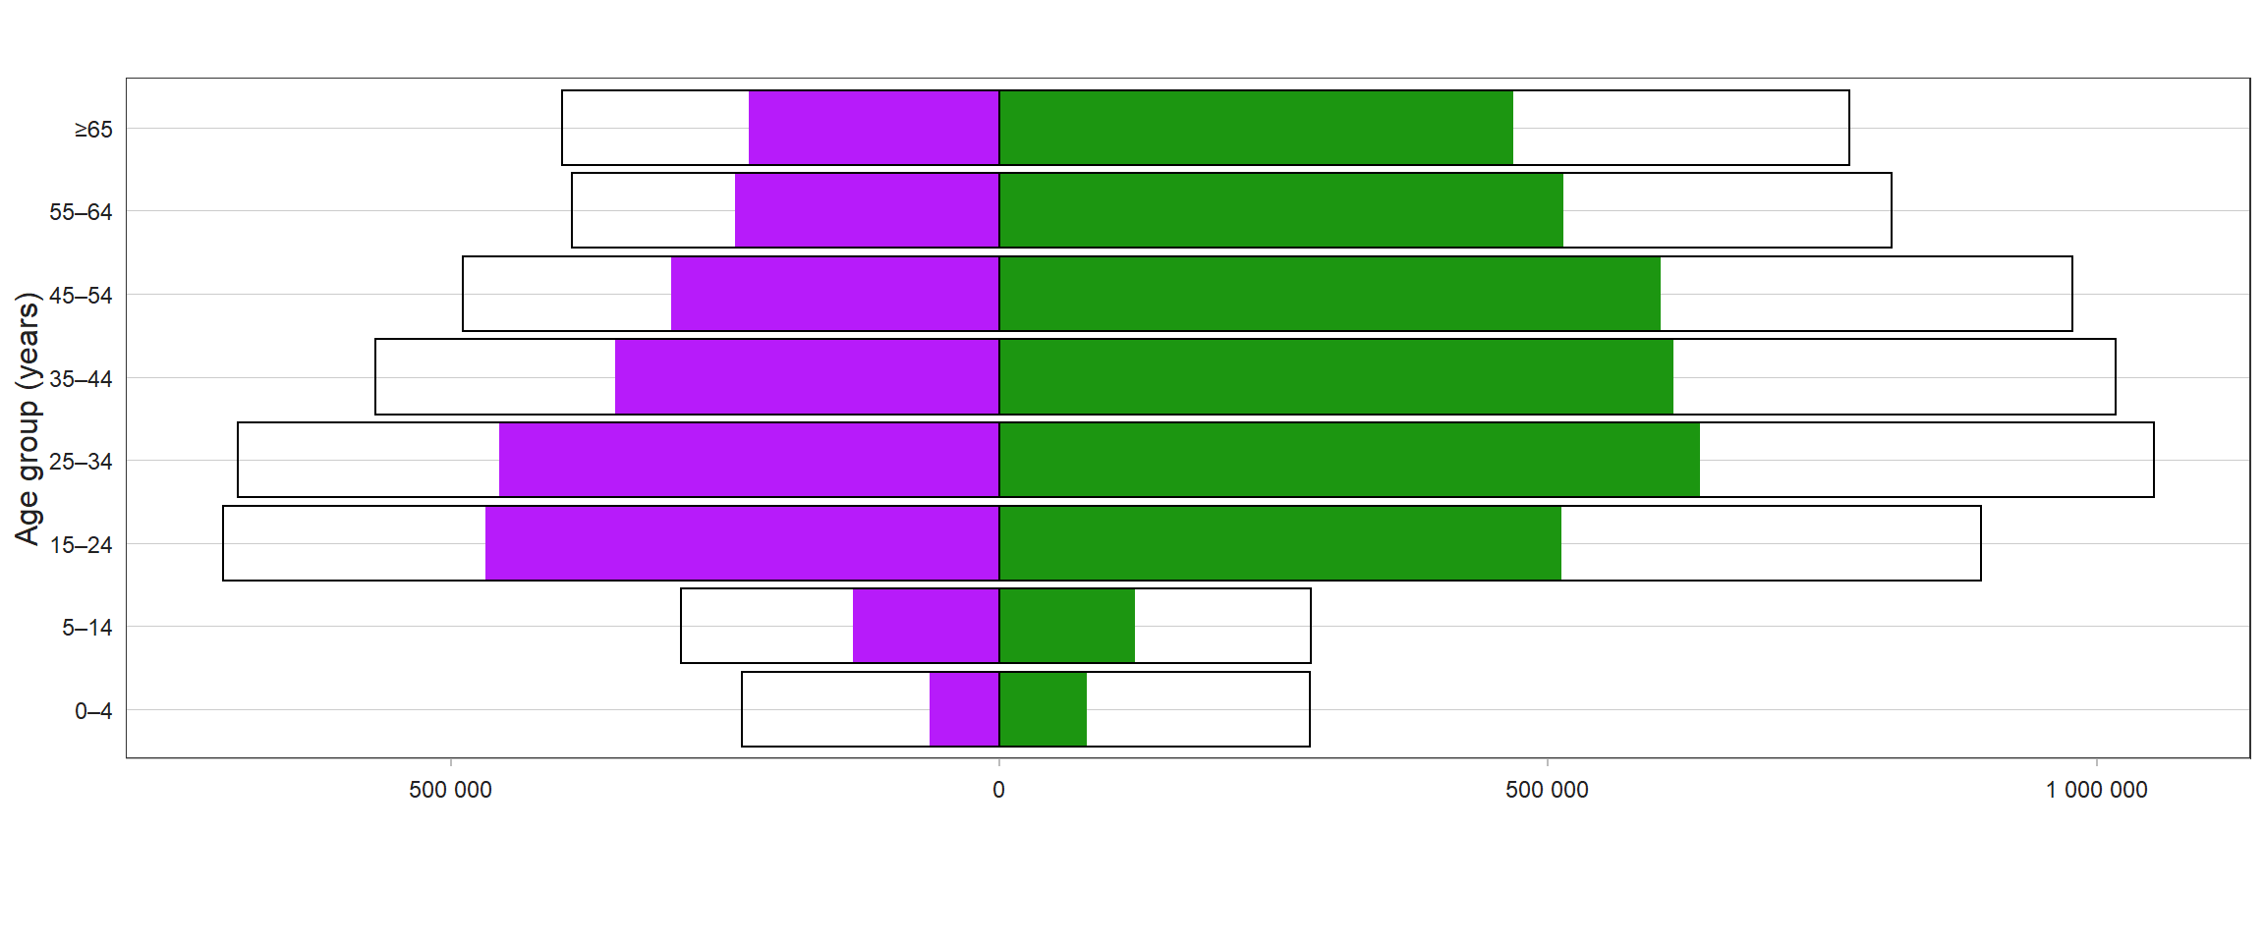
Global Burden of Tuberculosis in Children (< age 15)
Approximately 1.1 million new cases in children in 2020 (vs 317 in USA)
Over half of childhood TB cases are not diagnosed/reported
Treatment of childhood TB falls short of UN goals (less progress than adult cases)
Indirect impact – parental death, impact on family income, etc.
Female
Male
WHO Global Tuberculosis Report, 2021

Slide 5
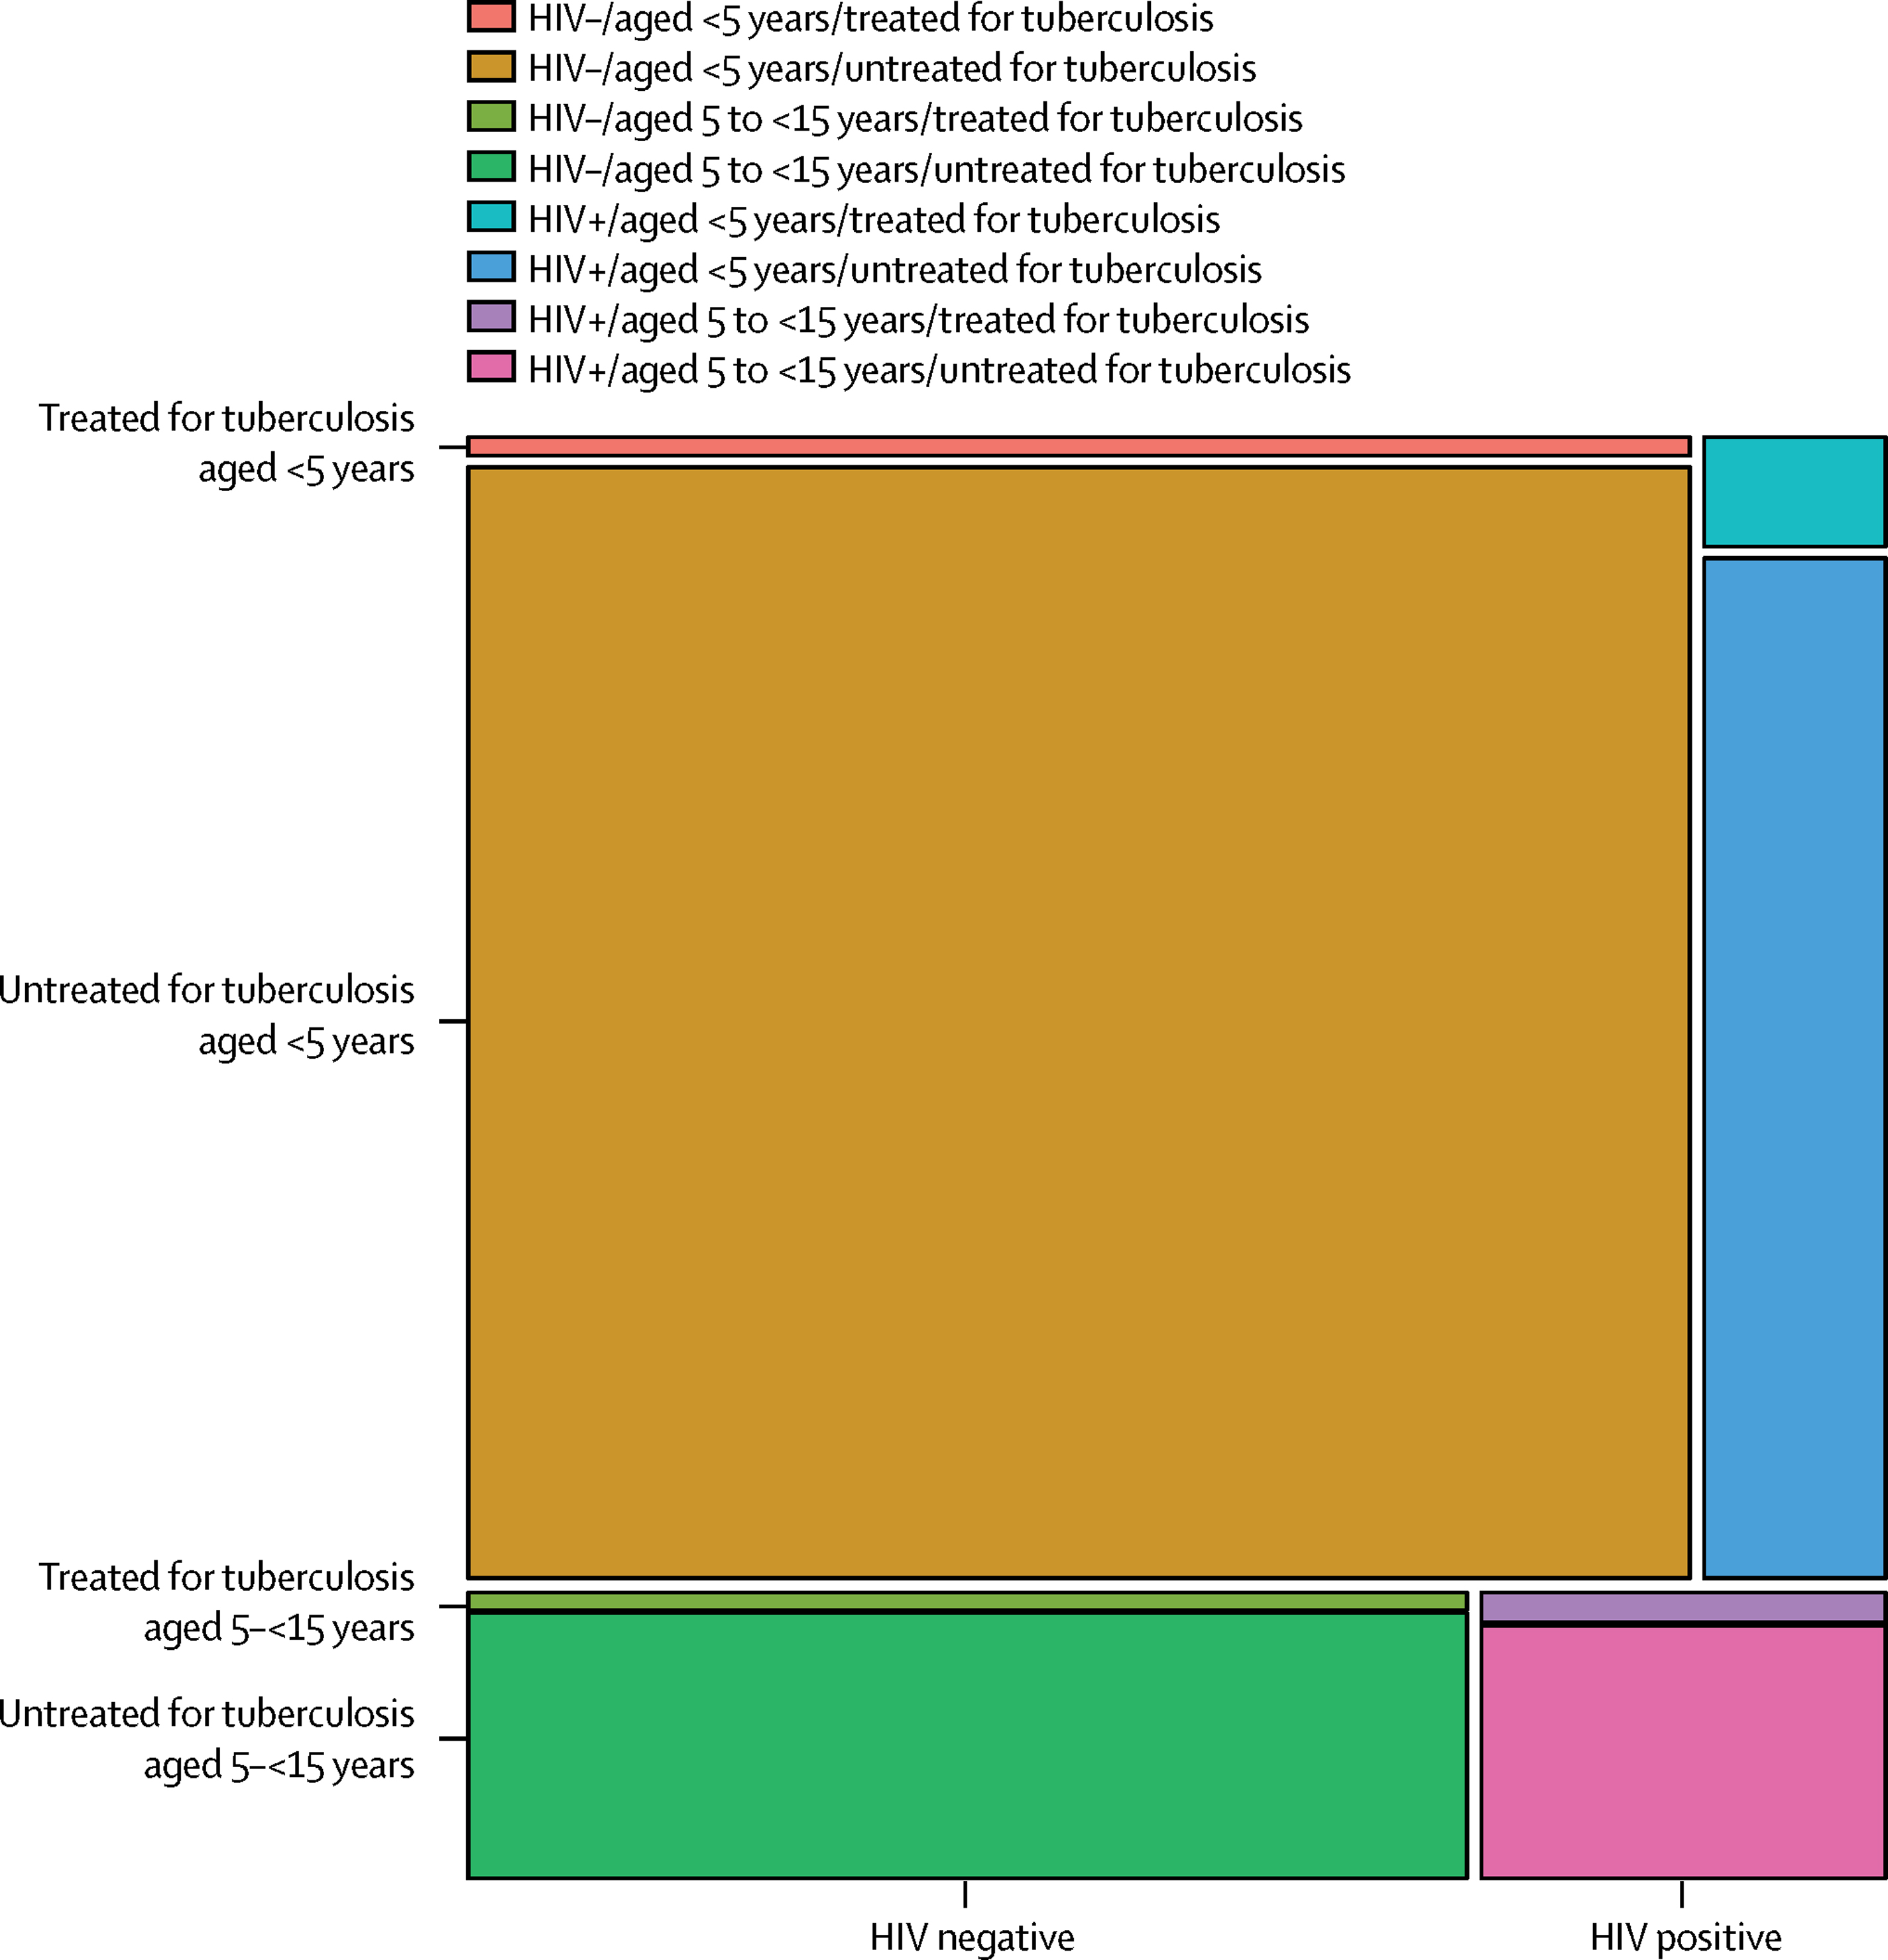
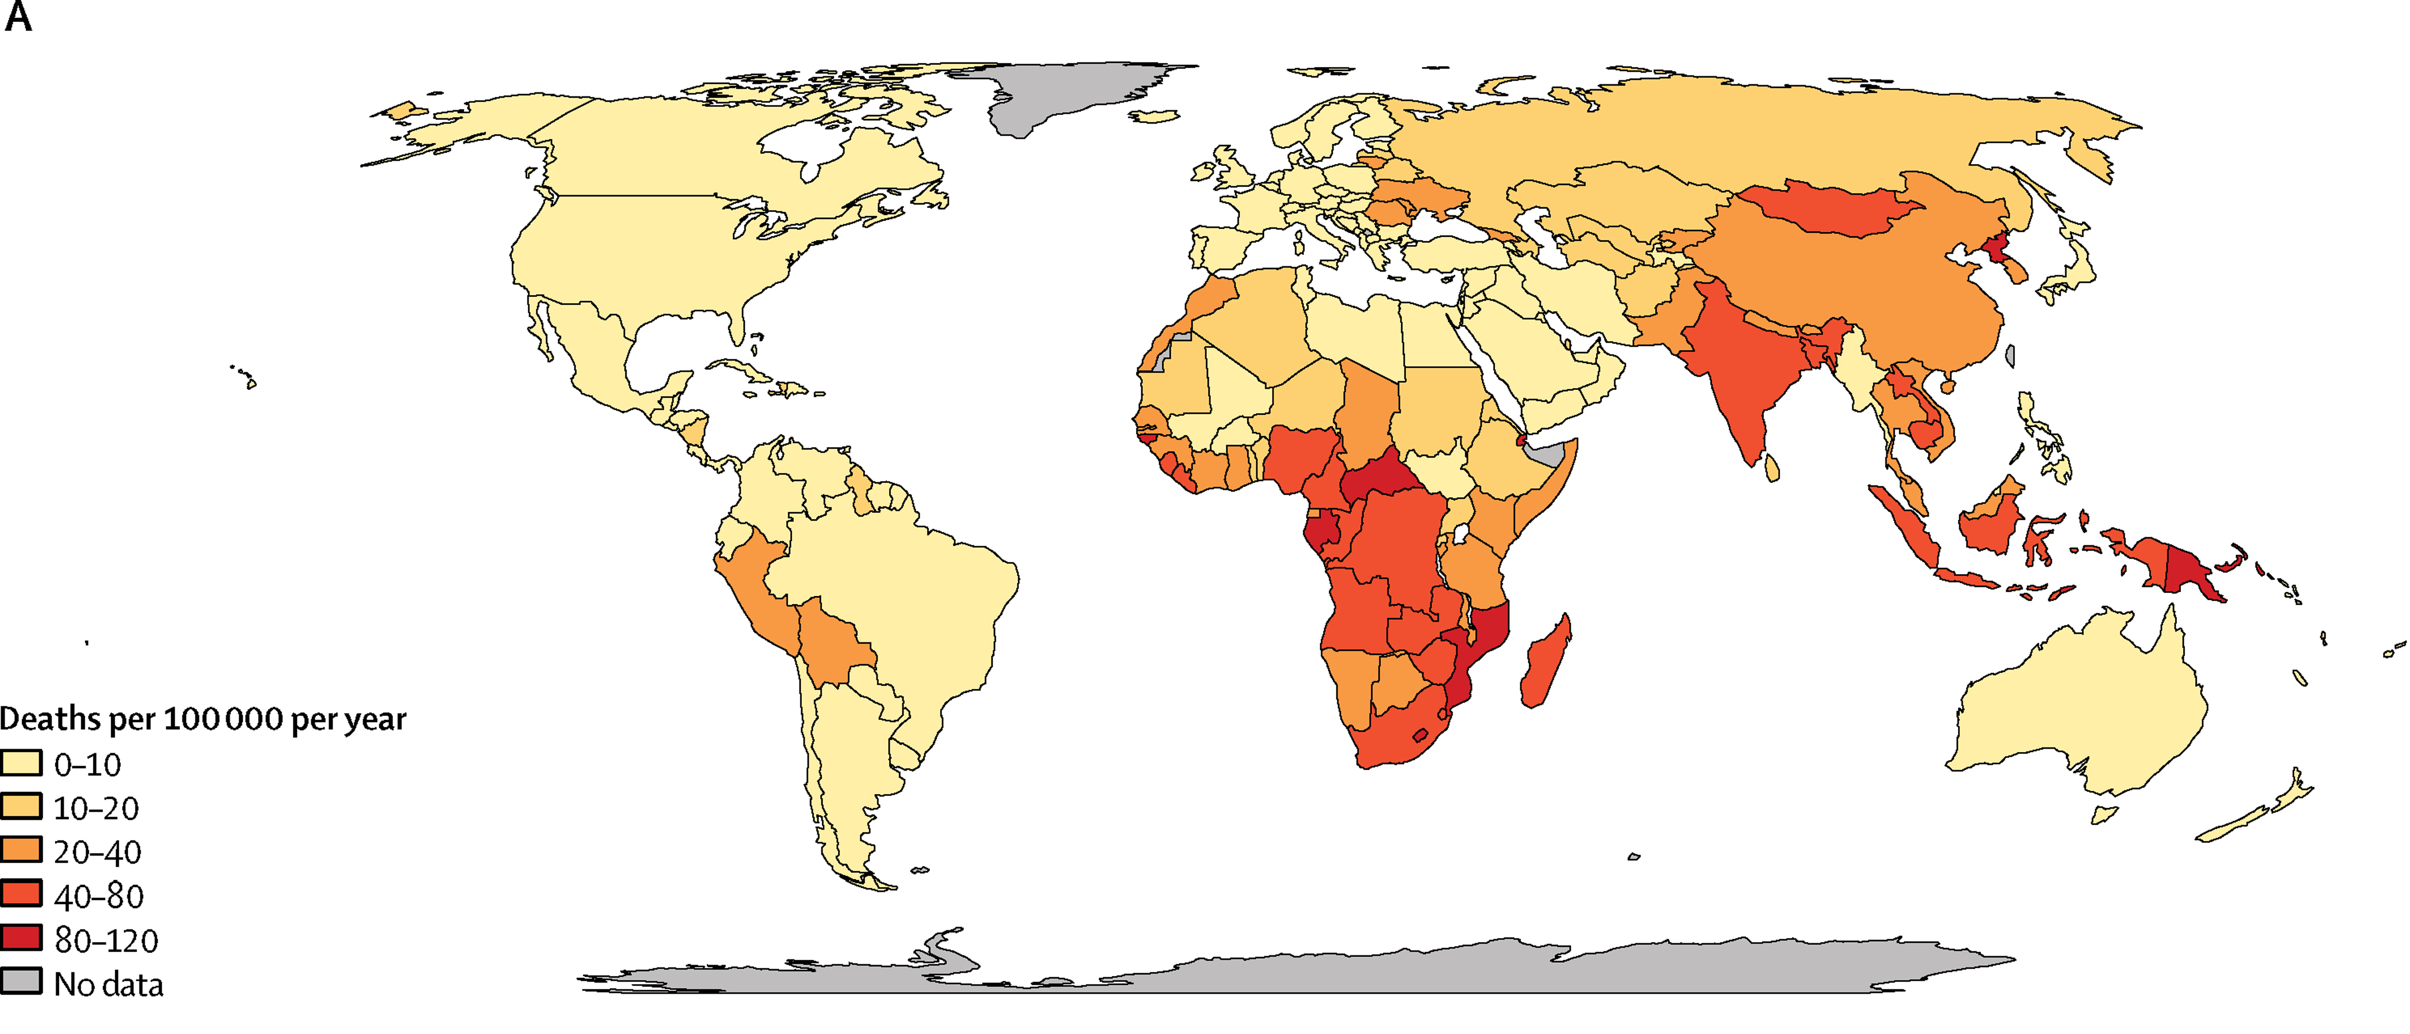
Global Mortality of Tuberculosis in Children (< age 15)
Modeling estimate of 239,000 deaths in children under 15 (2015)
Majority of children dying are NOT on treatment
TB is in top 10 causes of death for children < 5 yo (more than meningitis, AIDS, measles, pertussis)
TB mortality <5 yo
Dodd PJ, et al. Lancet Glob Health. 2017 PMID: 28807188

Slide 6
Risk of Disease Correlates with Age
No clear assoc. between age and risk of initial TB infection
BUT risk of TB disease is increased in very young
Based on review of pre-chemotherapy natural history studies of TB in children:
Highest progression to active disease in infants (<1 yo):
Disease risk 30-50% following infection
TB Meningitis or miliary disease = 10-20%
Mortality risk = 5-10%
Lowest risk in 5-10 yo
2% Disease following infection, disseminated disease uncommon
Older children (>10 yo) typically develop adult like disease
Children living with HIV have similar risk to very young
Marais, et al.
Int J Tuberc Lung Dis. 2004. PMID: 15141729

Slide 7
Percentage of TB Cases in Children with Extrapulmonary Involvement by Age Group 2013–2017
Lymphatic
Meningeal
Miliary
From CDC
Bone and Joint
Other
Pulmonary Only
Notes:
Meningeal disease is not very common for school age group (age 5-9) and the early adolescent group (age 10-14) where other sites of disease are more common (after lymphatic sites) than any other specific extrapulmonary site of disease. Among all pediatric age groups, bone and joint and miliary disease are the least common specified sites of disease.

Slide 8
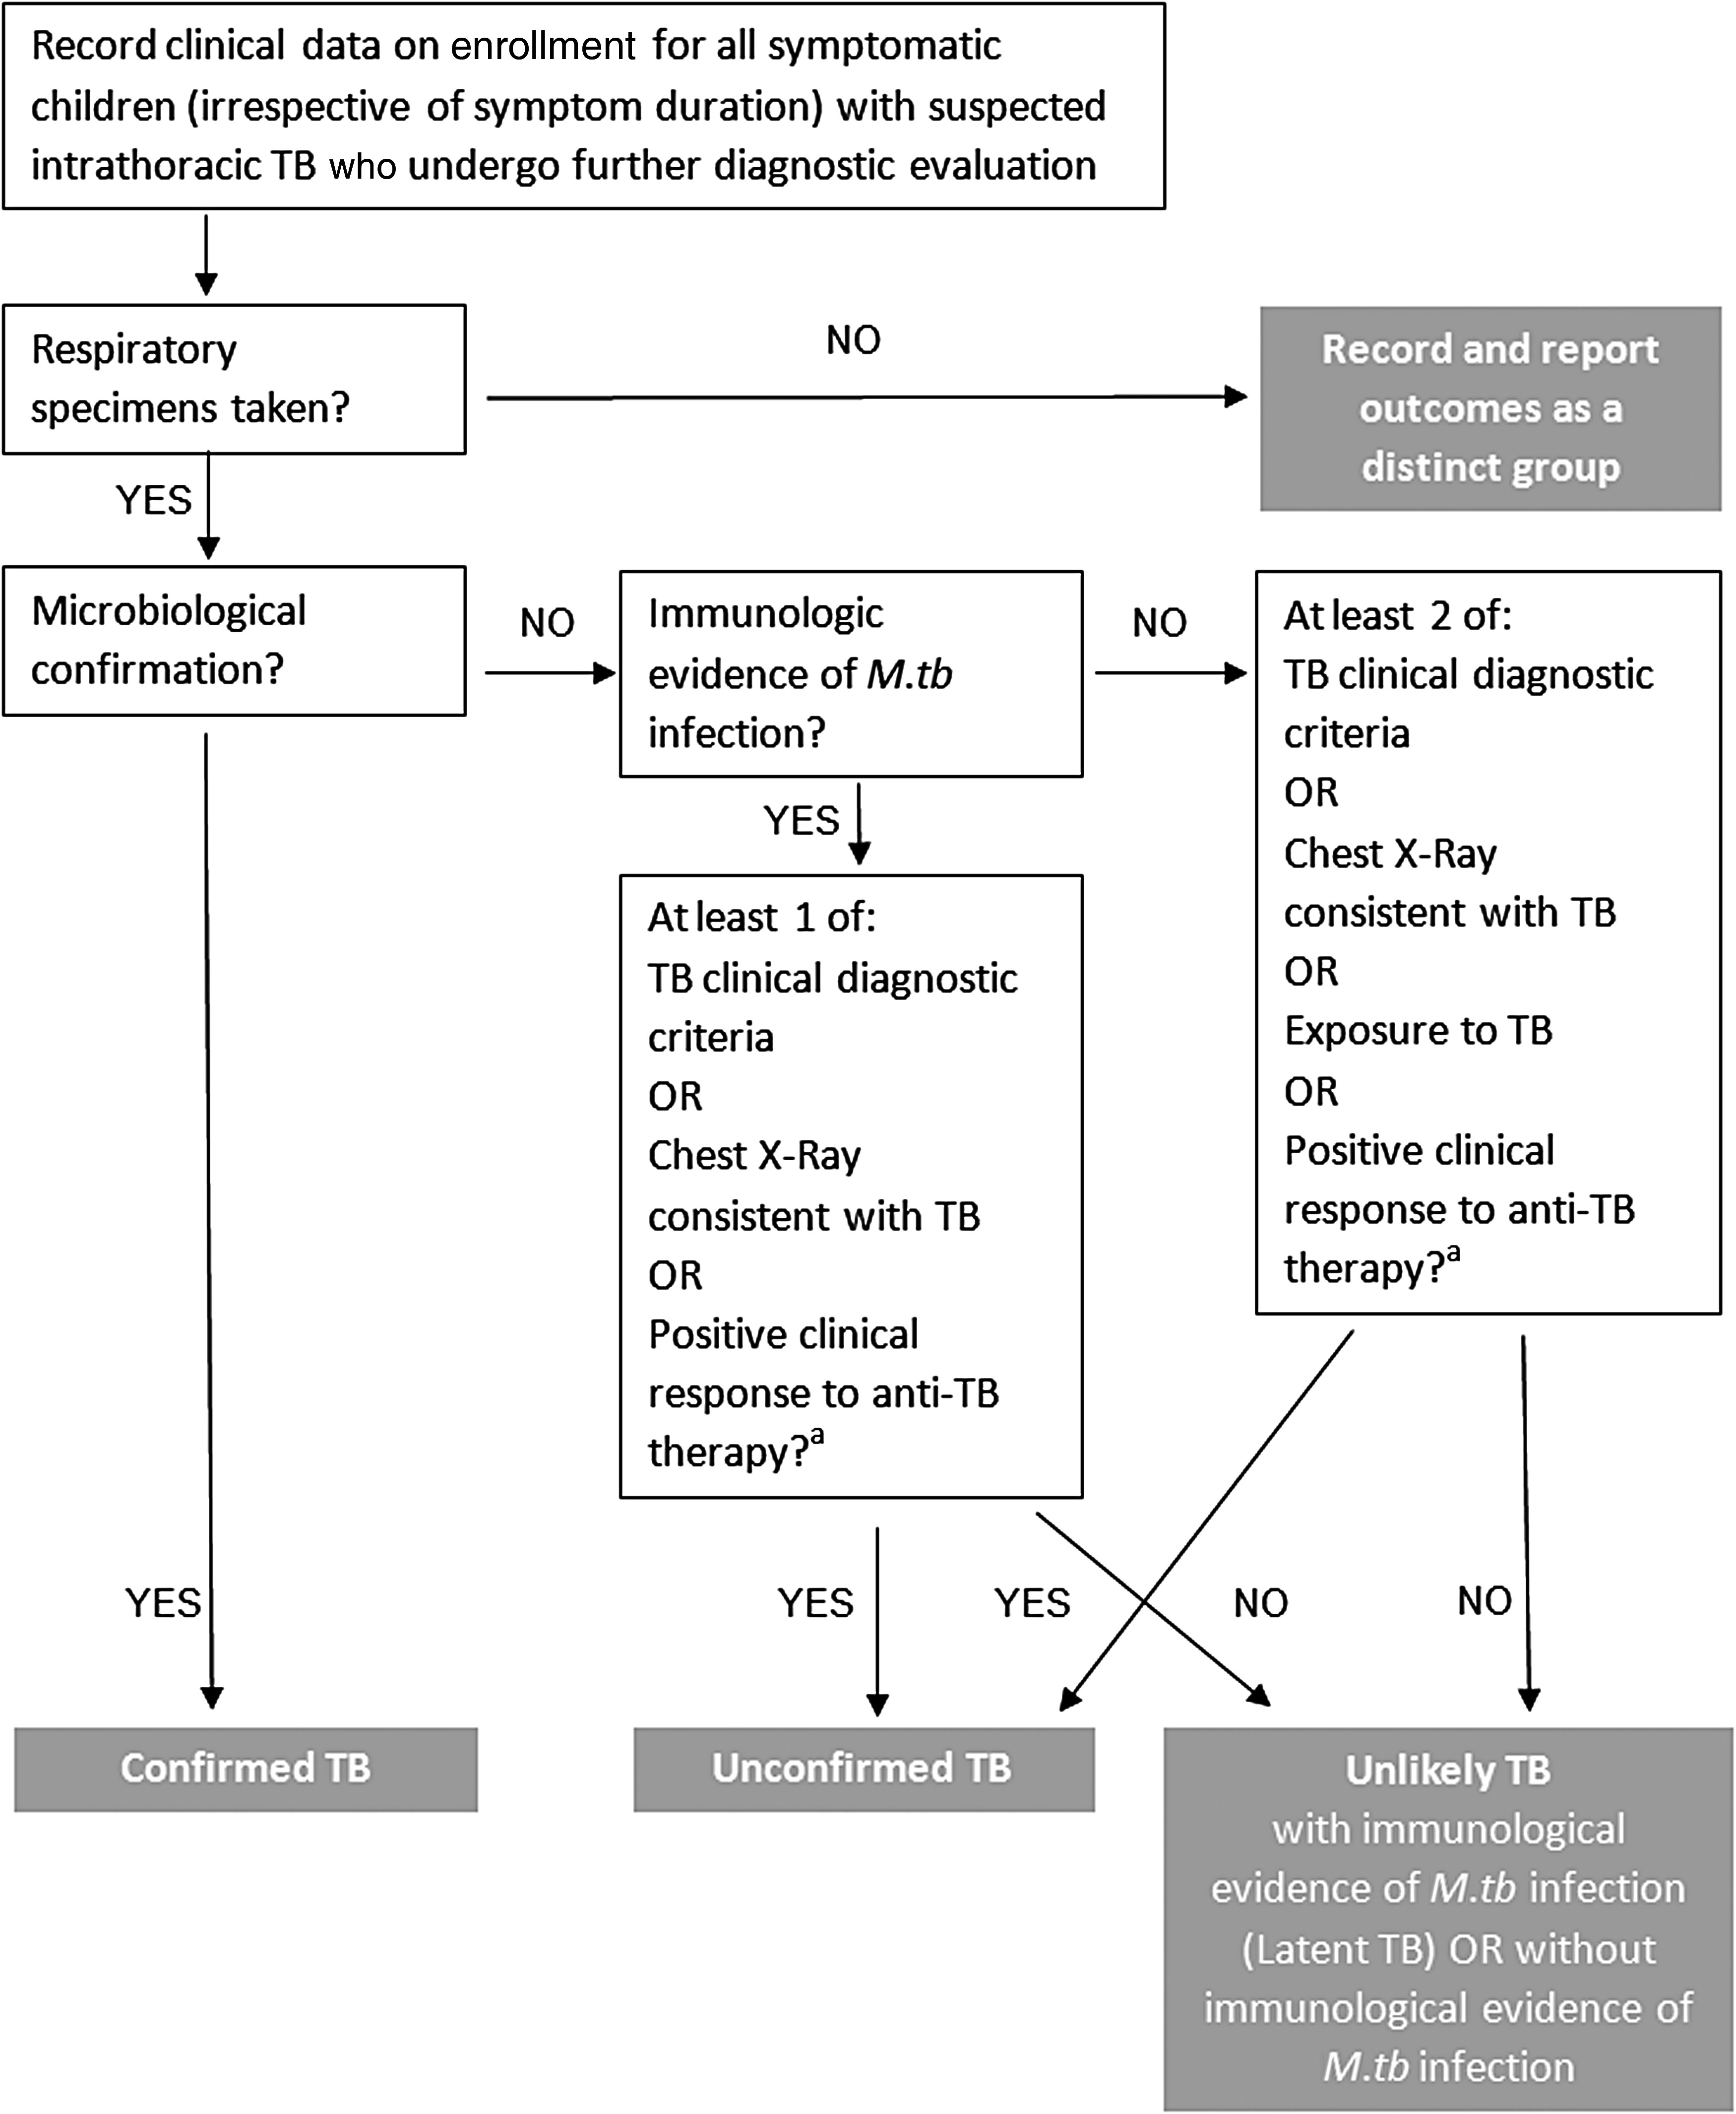
Childhood TB Diagnosis depends on clinical judgement
Childhood Thoracic TB Classification
Symptoms in children - variable and overlap with other common clinical syndromes
Persistent cough (>2wk)
Weight loss/failure to thrive
Fever (>38C) +/- night sweats (>1wk)
Fatigue, lethargy, decreased playfulness
Extrapulmonary symptoms
Chest Xray – normal, lobar PNA/opacity, lymphadenopathy, effusion (cavity, upper lobe lesion less common)
Microbiologic testing – culture > molecular
Research Dx of TB also captures clinical thought process for diagnosis in children
Graham SM, et al., Clin Infect Dis. 2015. PMID: 26409281

Slide 9
Negative diagnostic testing in children does NOT exclude tuberculosis
Especially in children < 10 years
High risk of severe disease in children < 2 years
Estimates vary between trials, but approximately 40-60% of childhood TB is culture positive compared to overall clinical diagnosis
The current gold standard relies on clinical judgement
Accept that some children without TB:
will be diagnosed with TB
start treatment
not improve (need alternate diagnosis) OR improve despite incorrect diagnosis (other condition improves without treatment)

Slide 10
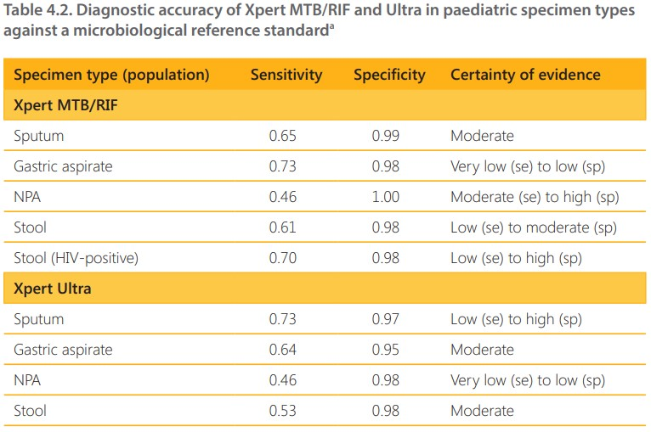
Specimens for diagnosis in children
Specimens for testing in children may include:
Sputum/induced sputum
Gastric contents/aspirate
Nasopharyngeal aspirate
Stool (new to WHO guidelines)
(Sites of extrapulmonary disease – CSF, node aspirate, etc.)
WHO operational handbook on tuberculosis Module 5: Management of tuberculosis in children and adolescents

Slide 11
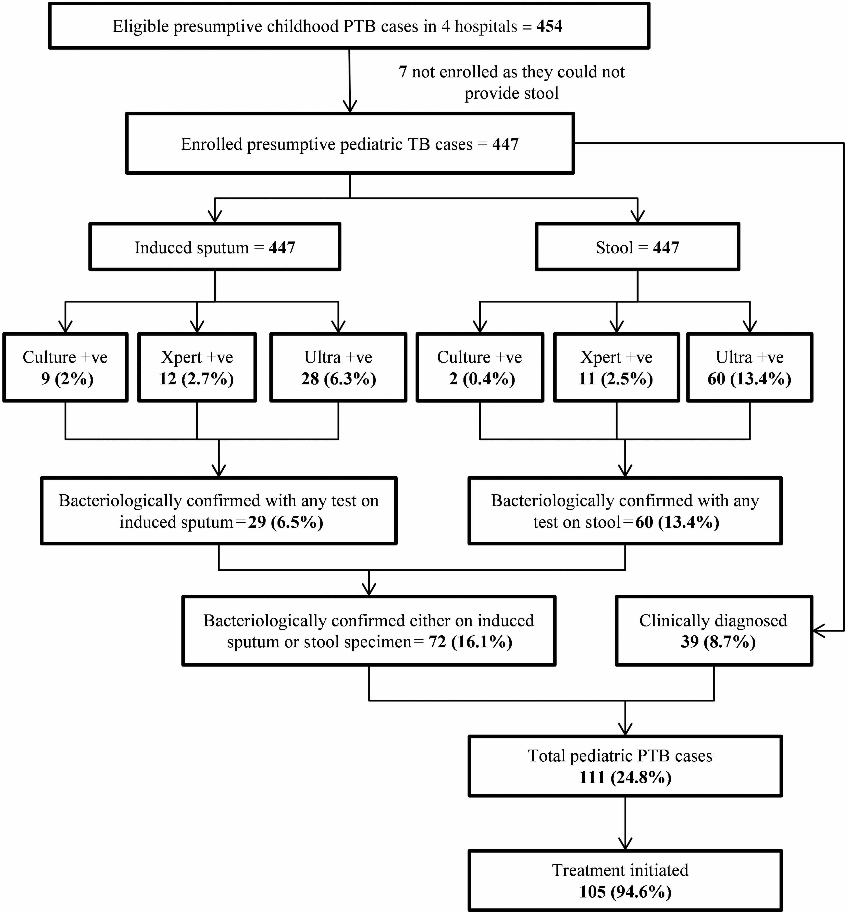
Stool for diagnosis in children
Stool is an attractive sample for testing:
Non-invasive, easily obtained
Does not require overnight collection
But - requires additional processing
But what to do with Xpert Ultra “Trace” positive results- (39% of sputum, 80% stool)
Kabir, et al. Clin Infect Dis, 2021
https://doi.org/10.1093/cid/ciaa583

Slide 12
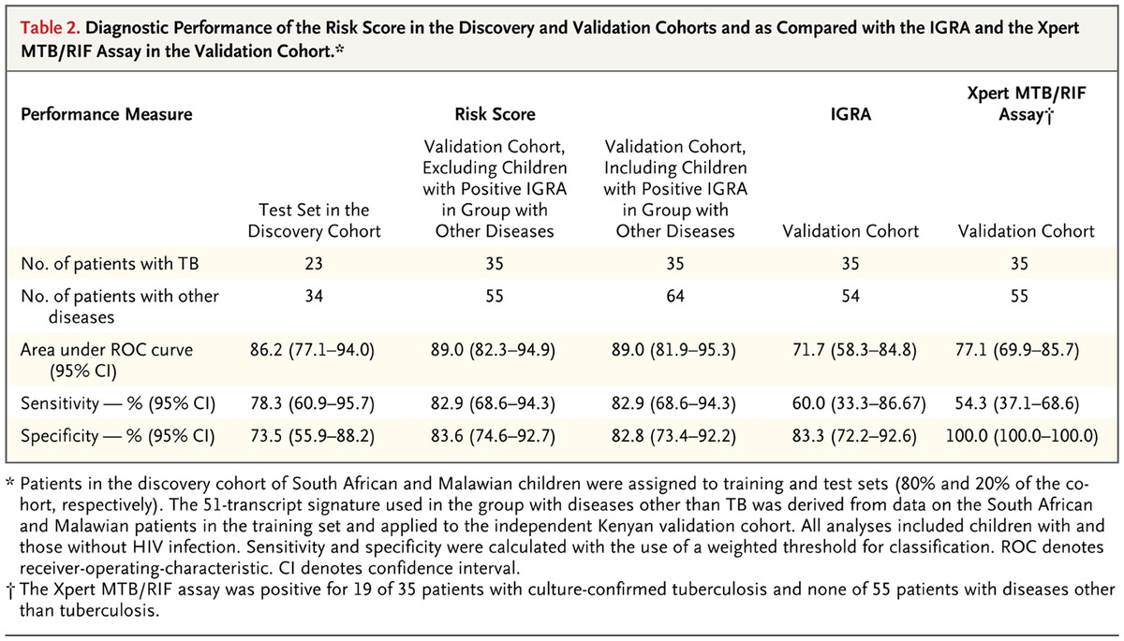
Alternate diagnostics – non-TB bacilli based
Children with clinical suspicion of TB or known exposure (Discovery - South Africa/Malawi, Validation - Kenya)
Clinical evaluation w/ cultures, classified: culture pos, highly probable, probable, possible, or other disease (alternate diagnosis or stable w/o treatment)
Whole blood transcriptomes by array - 51 gene risk score (RS)
82% specificity and 82% sensitivity (TB culture positive children)
RS + in 42% in probable TB
Anderson ST et al. N Engl J Med 2014;370:1712-1723.

Slide 13
Treatment of childhood TB mirrors adults
Historical standard for DS disease was 6-month regimen 2HRZE/4HR
12 mo for TB meningitis and skeletal TB
Dose per kg differs from adults (need different Fixed Dose Combos)
Consider formulation and administration (commonly crushed in water)
Consider strategies for giving medications to young children
Drug | Dose and Range (mg/kg/day) | Maximum Daily Dose (mg) | Formulation (Not all inclusive)
Isoniazid (H) | 10 (7-15) | 300 | Tabs: 100 mg, 300 mg Syrup: 10 mg/mL *
Rifampicin (R) | 15 (10-20) | 600 | Caps: 150 mg, 300 mg
Pyrazinamide (Z) | 35 (30-40) | 2000 | Tabs: 500 mg (400mg)
Ethambutol (E) | 20 (15-25) | 1000 | Tabs: 100 mg, 400 mg
General notes:
Weight band tables are helpful
Fixed dose combinations may alter max
Peds FDC = HRZ 50/75/150 mg for <25 kg
*contains sorbitol- risk of GI upset/diarrhea (consider crushing tablets)

Slide 14
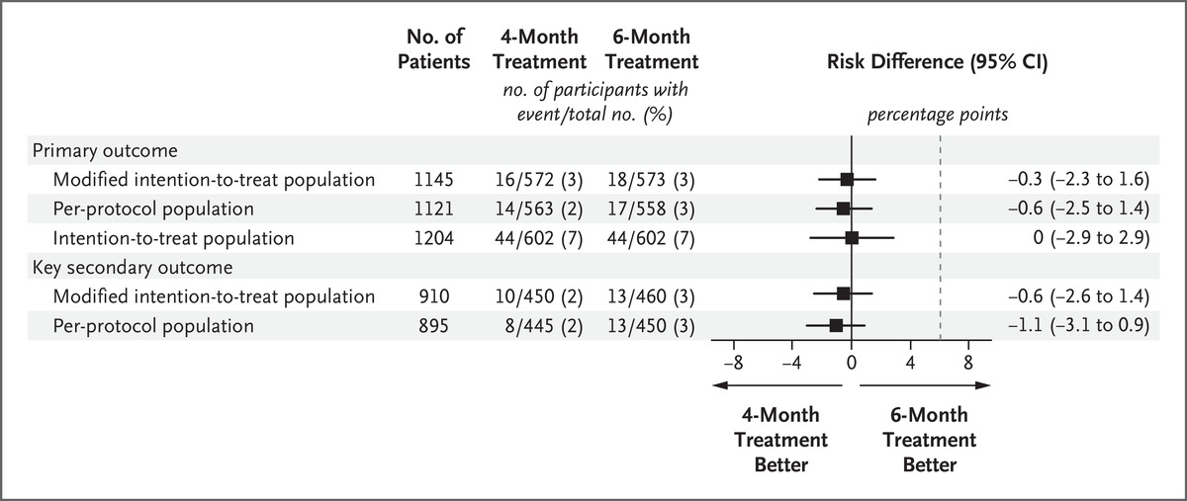
Duration of TB therapy – Maybe shorter in some children
SHINE Trial: shorter course for non-severe, drug susceptible TB (WHO adopted):
Age 3mo to <16yo
Non-severe pulmonary disease
Peripheral or thoracic lymph node
4 Months: 2HRZ(E)/2HR vs. 6 mo 2HRZ(E)/4HR
A Turkova et al. N Engl J Med 2022;386:911-922.
PMID 35263517

Slide 15
SHINE trial ex of challenges in diagnosing pediatric TB
Screening (n=1461):
144 (9.8%) did not have minimal TB (more extensive disease on CXR)
uncomplicated plural effusion
non-cavitary, single lobe involvement
31 (2.1%) had positive respiratory smear
82% were eligible to participate
Enrolled subjects (n=1204)
Only 14% had bacteriologic confirmation (positive culture or Xpert)
BUT 80% independently adjudicated to have TB disease
MAJORITY of children – resemble “culture negative TB” in adults

Slide 16
Shorter Rifapentine-Moxifloxacin regimens for children
4-month regimen
2 HPMZ/2 HPM vs 2HRZE/4HR
Only 12 yo or greater included
Could this regimen be used in children <12 years with severe pulmonary TB?
WE DON’T KNOW
But there is experience using rifapentine and moxifloxacin for TBI or TB disease in younger children
How could a follow up trial be designed to include children?

Slide 17
New drug development for TB in Children
Bedaquiline – example FDA approval:
Adults 2012
Adolescents (12-17 yo) 2019
Pediatrics (5-11 yo) 2020, with pediatric 20 mg dispersible tabs
Delamanid
Initially approved by EMA in 2014
Recommended for children 6-17 years by WHO in 2016
Dispersible tablet, included in age de-escalation down to birth (starting in 2013)
Without PK/dosing data it is difficult to include children in other trials

Slide 18
Key opportunities to improve tuberculosis diagnosis, treatment and outcomes in children
Improve identification of infection and disease cases
Implement and leverage contact tracing, especially for young children
Evaluate and treat young contacts of TB cases (for TBI or TB disease)
Develop better diagnostic testing for childhood TB – non-invasive, non-respiratory, etc.
Improved treatment
Implement TB Preventive therapy for exposed children
Treatment regimens for prevention or disease
Include in PK/PD and develop formulations for children
Inclusion of children in clinical trials for new regimens

Slide 19
Questions?

Slide 20
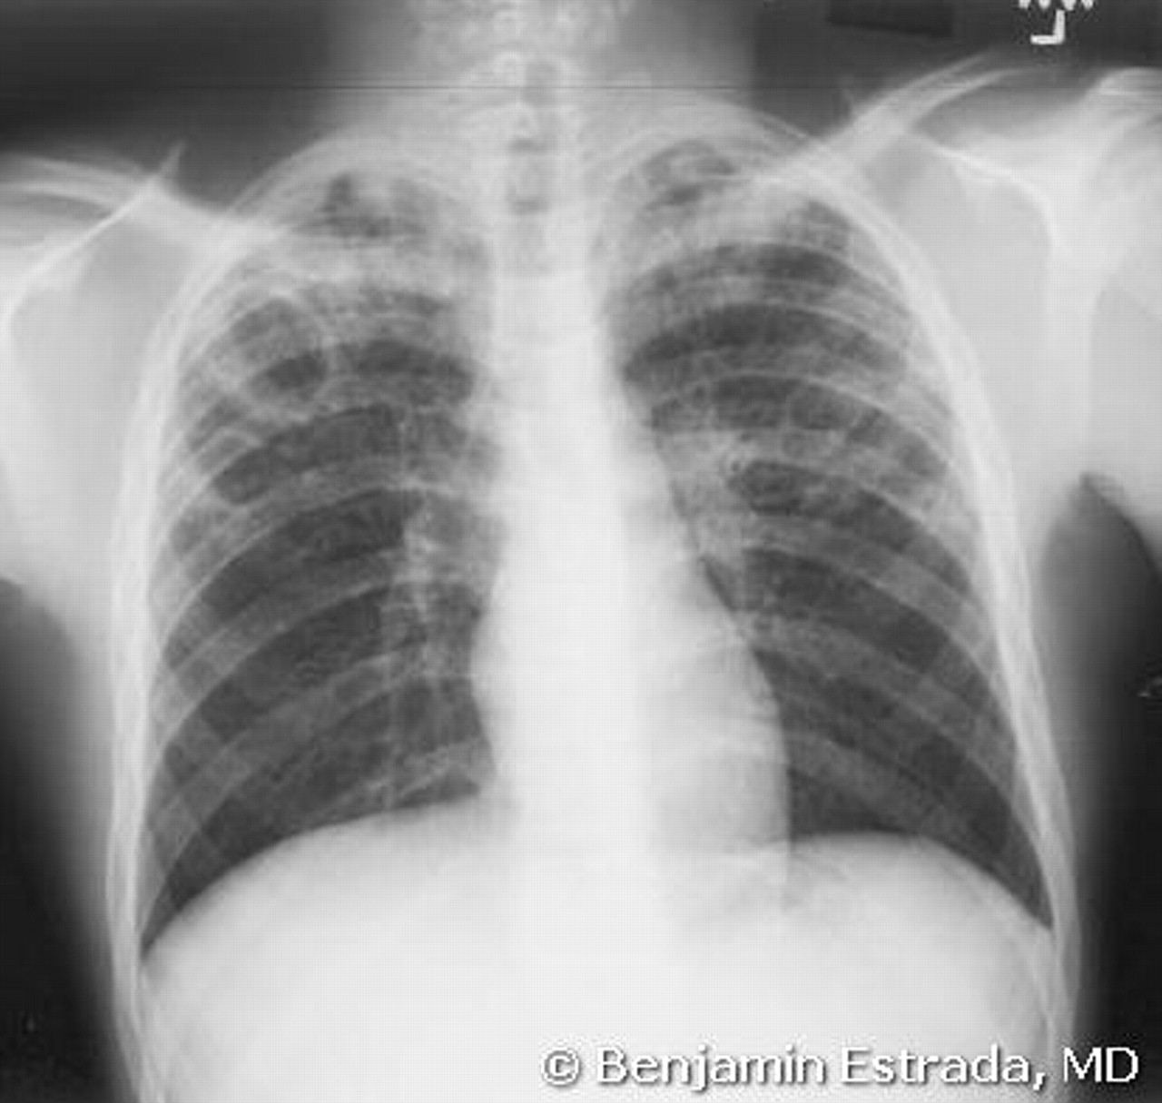
Childhood TB - Various X ray Presentations: Adult type pulmonary disease UNUSUAL for children (but more common in teens)
AAP RedBook 2012
Notes:
Tuberculosis, primary pulmonary, in a preschool-aged child. Upper lobe of the right lung is affected, and atelectasis is present

Slide 21
CXR
Nonspecific, intra-observer variation
Features suggesting TB:
Hilar lymphadenopathy
Bronchial compression
Chronic consolidation
Calcification
Miliary pattern
Cavity or Lesion in upper lobe(s) is less common in children
Notes:
Hallmark of primary pulm TB is mediatinal and hilar lymphadenopathy with variety of accompanying features:
Focal nodule, air-space disease, collapse, miliary nodules, pleural

Slide 22
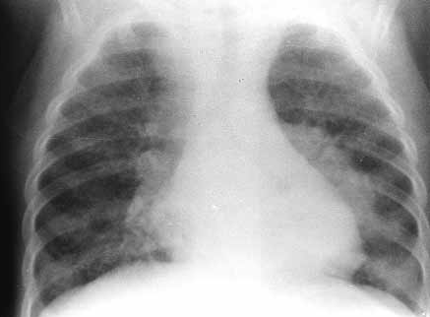
Hilar lymphadenopathy
Smith Curr Probl Pediatr 2001; 31: 5-30
Notes:
9 mo old child
Hilar adenopathy, prominent L

Slide 23
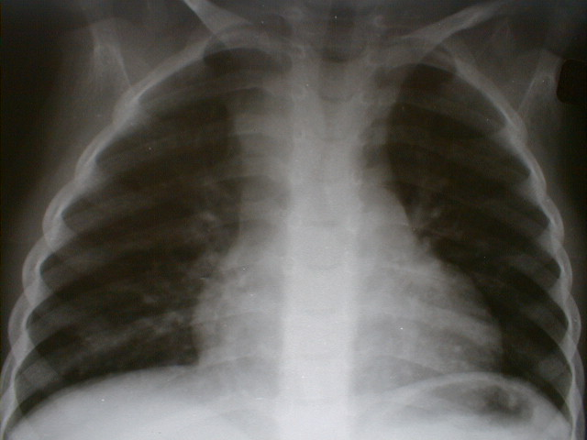
Paratracheal lymphadenopathy
Zar, H. University of Cape Town, 2009
Notes:
Airway compression an indirect feature of lymphadenopathy; especially in children <6 months of age

Slide 24
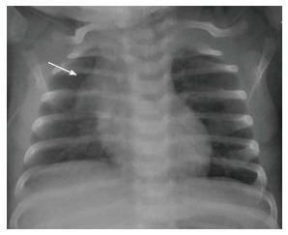
Lymphadenopathy ???
Thymus may be prominent in children up to 3 yo
World J Clin Pediatr. 2017 Feb 8; 6(1): 10–23.
Notes:
Airway compression an indirect feature of lymphadenopathy; especially in children <6 months of age

Slide 25
Algorithm for Diagnosis (preadolescent children)
Positive TST/IGRA
TB symptoms or close contact
IGRA/TST
(negative result not useful)
Clinical and CXR
Evaluation
Normal
More consistent with another Dx
Abnormal
Treat for LTBI
as indicated
Consistent with TB
No
Collect cultures
Start 4 Drug Therapy
Very stable condition?
Other Dx conformed or inconsistent with TB
Yes
Reassess at least weekly
Response to non-TB therapy?
Other signs/sx
Consider TB cultures
Work-up/treat other Dx
Avoid TB Abx

Slide 26
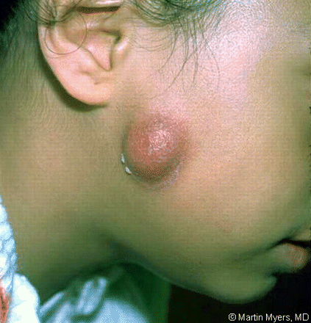
Assess for Extrapulmonary Tuberculosis
TB Meningitis — meningitis not responding to antibiotics, with a subacute onset, communicating hydrocephalus, stroke, and/or elevated intracranial pressure
TB Adenitis — painless, fixed, enlarged lymph nodes, especially in the cervical region, with or without fistula formation (may also be Non-TB mycobacteria)
Pleural TB
Pericardial TB
Abdominal TB
TB of bone/joints
Vertebral TB
Skin
Renal
Eye

Slide 27
Suggestions for medication administration
It may take a little while to get the child in a routine – avoid establishing a power struggle
If they can take pills, usually that is easiest
Practice with small candy and have a reward system
Try tipping head forward for capsules and back for tablets
If can do capsules but not tablets, consider crushing tabs and filling empty capsules
Crushed pills/capsules can be mixed in food
Practice first without medicine, then with crushed candies
Chocolate syrup, jelly/jam, apple sauce, peanut butter/Nutella
Crush and suspend in liquid (water) and give with syringe or medication pacifier
Syrups (INH) and suspension (RIF) may be available, but may cause GI upset (INH due to sorbital) or need to be compounded (RIF)
http://www.currytbcenter.ucsf.edu/products/pediatric-tuberculosis-online-presentation/resources

