Slide 1
Organizing, Funding, and Advocacy for TB Research and Access
David Branigan
TB Project Officer, Treatment Action Group
University of Washington Advanced TB Research Training Course
Friday, September 16, 2022
Notes:
Treatment Action Group (TAG) is an independent, activist, and community-based research and policy think tank.
We are committed to racial, gender, and LGBTQ+ equity; social justice; and liberation.
We are science-based activists working to expand and accelerate vital research and effective community engagement with research and policy institutions for an end to the HIV, TB, and HCV pandemics.

Slide 2
Overview
TB research funding
Community engagement
TB advocacy
Getting involved
Acknowledgement: Mike Frick and Lindsay McKenna, TB Project Co-Directors, developed some of the content for the following slides
Notes:
TB research funding: trends in funding, how insufficient funding is falling far short of targets, and advocacy strategies to increase investments
Community engagement: highlighting community advisory boards that TAG works with as well as different models of community engagement in TB research and access
TB advocacy: for improved research and access, and some specific campaigns TAG is involved with
Getting involved: how you can get involved in advocacy for TB research and access

Slide 3
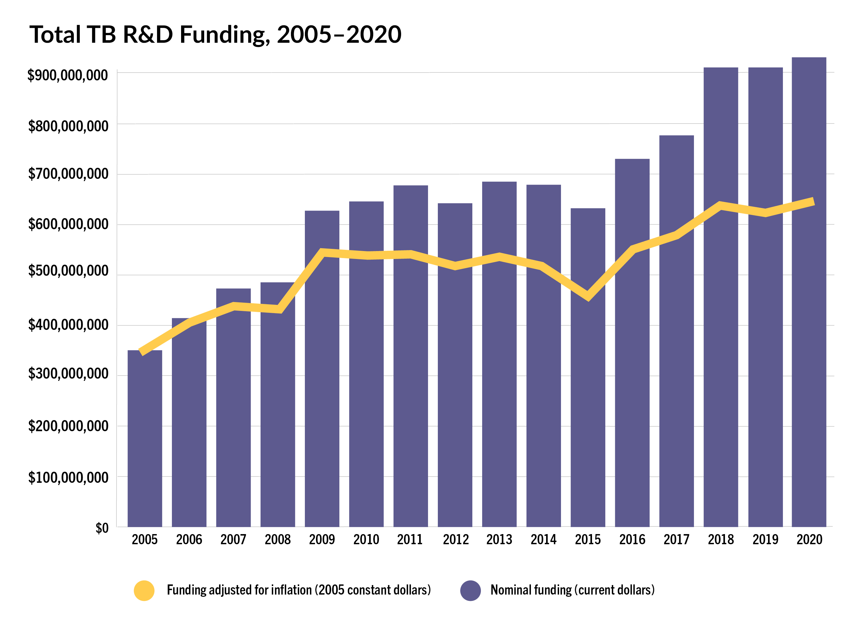
TB research funding
Universal agreement that TB research is underfunded relative to need and to potential.
The UN High-Level Meeting on TB (2018) called for USD$2 billion per year for TB R&D. In actuality, the world spends less than half of that ($915 million in 2020).
Notes:
TAG has tracked global TB research funding trends since 2005 as one way to assess public, private, philanthropic, and multilateral commitments to ending TB.
Over the past decade, annual funding for TB R&D has increased from just over $600 million per year to around $900 million per year. From 2010 through 2015, the mean annual investment in TB R&D was $656 million. Mean annual investments grew in 2016 and 2017 to $748 million, and then increased again to just over $900 million in 2018, where they have remained stubbornly flat for the past three years. Total TB research investments in 2020 were $915 million. Cumulative investments in TB research between 2016 and 2020 reached $4.2 billion—just shy of half of the $9 billion target set out in the Stop TB Partnership’s Global Plan to End TB 2016–2020, which sought to put the world on track to meet its goal to end TB by 2030.

Slide 4
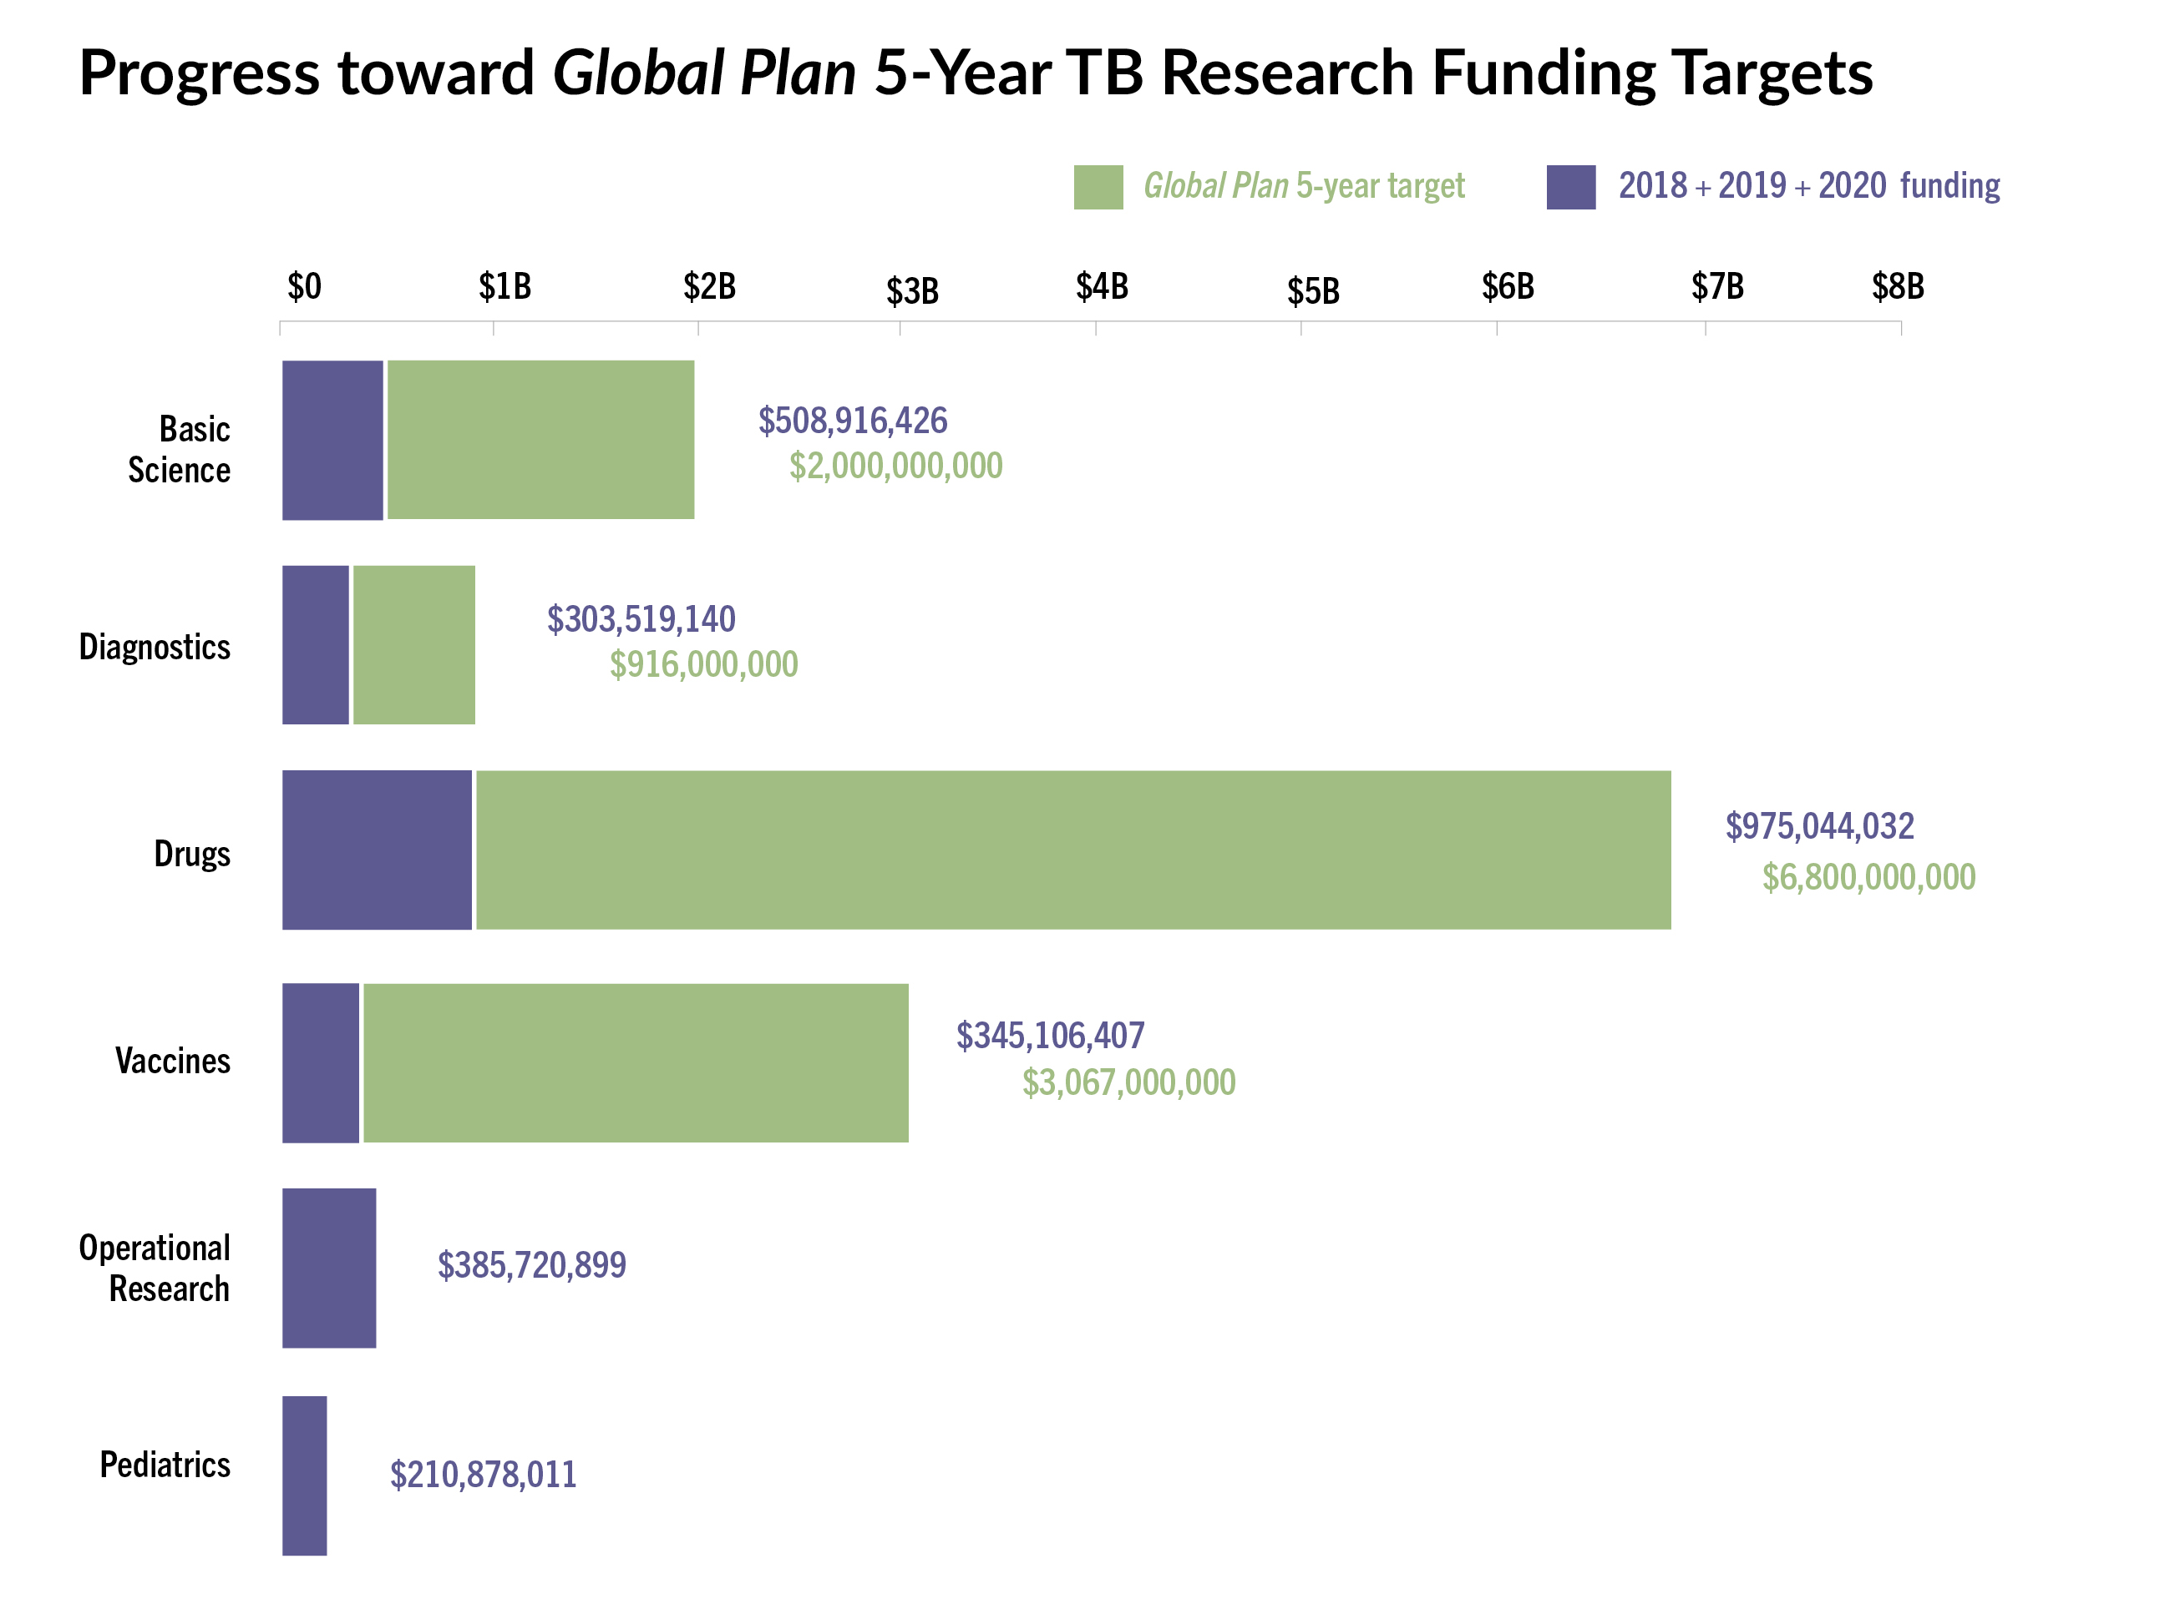
TB research funding
“Recognizing that funding shortfalls from previous years will need to be made up in subsequent years, the Stop TB Partnership updated its Global Plan to End TB in 2019. The updated plan increased annual research funding targets from $2 billion to $2.5 billion, to reach a total of $12.8 billion between 2018 and 2022.
Yet actual investments in TB research between 2018 and 2020 reached only $2.7 billion. This means an additional $10 billion would need to be invested over the next two years to close the funding gap—a feat that seems unlikely without a sea change in the magnitude of public pressure, political will, and investment directed toward ending TB.”
Notes:
Taking a big-picture view of the TB research funding landscape in 2020…
This graph on the right tracks progress toward the Global Plan 5-Year TB Research Funding Targets for 2018 through 2022. This shows the cumulative investments from 2018 through 2020 for different areas of TB research.
For example, diagnostic spending from 2018 through 2020 adds up to US$303.5 million, or 33% of the $916 million 5-year Global Plan target.
Drugs research funding for the three years adds up to $975 million – 14.5% of the $6.8 billion target.
Vaccine research funding has the largest deficit of any category, amounting to US$226 million, just over 11% of the US$3 billion target.
The Global Plan does not include funding targets for operational research or pediatrics.

Slide 5
TB research funding
Based on that evidence, set achievable + ambitious goals
Notes:
The fair-share targets are a metric for measuring countries’ investments in TB research against their ability to pay. The metric seeks to encourage solidarity and equitable investment by countries in ending TB.
The fair-share targets call on countries to invest at least 0.1% of their overall expenditure in R&D (gross expenditure on R&D or GERD) into TB research. Investment at this level by all countries would put the world on track to meet and exceed the $2 billion annual funding target committed to by governments at the 2018 United Nations High-Level Meeting on TB.

Slide 6
TB research funding
Fair share funding targets
UN High-Level Meeting (HLM) called on member states to “contribute appropriately” to TB R&D, and to see the promotion of TB research as “a shared responsibility,” one guided by the principles of affordability, effectiveness, efficiency, and equity.
UN HLM called for $2 billion/year for TB research. Stop TB Partnership has called for $2.5B/year, recognizing that funding shortfalls in previous years mean we now must spend more moving forward.
These targets are achievable if every country devotes just 0.1% of its overall spending on all forms of R&D to TB R&D. This 0.1% benchmark is referred to as the ‘fair share target’ for TB R&D spending. Only one country met its fair share target in 2020 (UK).
In its Global Strategy for TB Research and Innovation, WHO proposed measuring something very similar: “At the country level, proportion of gross domestic expenditure on research and development that is allocated to TB research.”
Notes:
In 2020, only the United Kingdom met the fair-share target—although expenditure by the country on TB R&D fell from $56 million in 2019 to $47 million in 2020.
In addition to the United Kingdom, which met its fair-share target in 2020, three other countries achieved at least two-thirds of the 0.1% funding target. The United States achieved 90% of the funding target, New Zealand achieved 81% of the target, and Canada achieved 80% of the fairshare target.
Governments at all levels of income and TB burden must substantially increase funding for TB research. By delineating each nation’s share of the overall financial need, the fair share targets establish a framework for holding governments accountable for meeting these global goals.

Slide 7
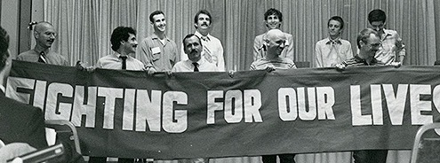
Community engagement
Engage communities early and often
Community engagement is the right thing to do.
Community engagement is the ethical thing to do.
Community engagement is a useful thing to do – i.e., it holds instrumental value for scientific endeavors.
Denver Principles–1983
Notes:
It is important to engage communities early and often…

Slide 8
Community engagement
People have a right to participate in medical research as more than trial participants (Denver Principles, CIOMS, Declaration of Helsinki, international human rights law).
Community engagement helps to ensure research generates social value; research without the potential to generate social value is unethical (Emmanuel 2000).
Communities that feel connected to research may be more likely to participate in clinical studies. (Community engagement may have beneficial effects for recruitment, enrollment, and retention into studies.)
Reciprocal partnerships between communities and researchers build lasting, durable relationships.
Communities can inform product development, helping to ensure that new technologies address the priorities + needs of people affected by a disease.
Communities that understand the science are better positioned to advocate for continued research before governments and other funders.
Communities that understand the science may be more likely to advocate for the uptake and adoption of research outputs.
Community engagement fosters community ownership of research and provides a forum to address myths/misinformation (e.g., about participation in clinical trials, vaccine hesitancy, etc.).
Inherent
Instrumental
Notes:
Community engagement is inherently respectful the rights of people affected by TB and is supports ethical research
Community engagement is also instrumental in promoting better research and product development, as well as strong relationships with communities to disseminate and translate the results of research into advocacy, investment priorities, and action by governments and policymakers to promote access.

Slide 9
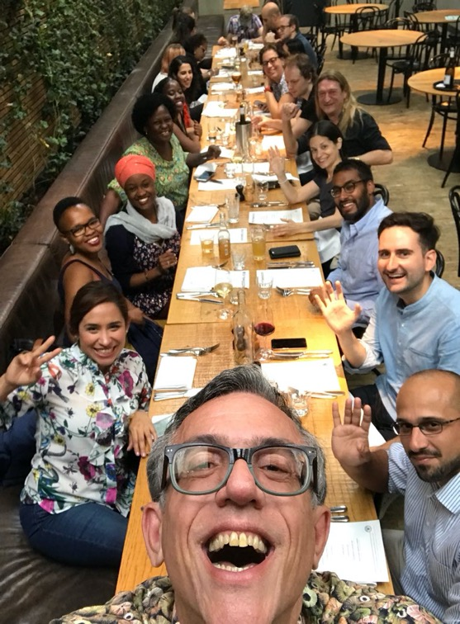
Community engagement
TB CAB is a group of research-literate activists from HIV and TB networks across the world. TB CAB was founded in 2011 and acts in an advisory capacity to:
product developers and institutions conducting clinical trials of new TB drugs, drug regimens, diagnostics and vaccines; and
provides input on study design, early access, regulatory approval, post marketing, and implementation strategies.
One of the main tools the TB CAB uses is protocol reviews.
TB CAB has just celebrated its 10-year anniversary. An evaluation of TB CAB impact of over the past decade found that it elevated community voices in TB R&D and led to a “transformative change” that has disrupted power dynamics on multiple levels in a way that has reshaped the overall environment of TB R&D.
TB CAB trained a generation of TB research activists and newly competed its membership to build the next generation.
The TB CAB 10-Year Anniversary Evaluation Report and podcast series are available here: https://www.treatmentactiongroup.org/publication/tb-cab-10-year-anniversary-evaluation-report-2011-2021-and-podcast/
Notes:
One community advisory board that TAG works very closely with is the Global TB CAB…
The TB CAB provides critical input on the design of clinical trial protocols to ensure that they are rigorous from a community perspective and to make sure that they answer questions important to communities.

Slide 10
Community engagement
The value of community engagement
TBTC Study 31: Through early and frequent protocol review, the Community Research Advisors Group (CRAG)—the community advisory board to the TB Trials Consortium—won major changes to the design of TBTC Study 31, including:
Inclusion of PLHIV at lower CD4 counts;
Inclusion of adolescents down to age 12;
Inclusion of people with extensive cavitary TB disease;
Commitments for enhanced, community-driven results dissemination (now in progress!)
These changes mean guidelines stemming from this study will be broader, more inclusive, and able to extend the benefits of this research much farther—and sooner rather than later.
Notes:
TAG also works closely with the CRAG, or TB Community Research Advisors Group, which is the community advisory board to the TB Trials Consortium, under the U.S. Centers for Disease Control, which conducts studies of new or existing drugs and regimens used in the prevention and treatment of TB.
The CRAG advised Study 31, a phase 3, randomized, controlled trial involving persons with newly diagnosed pulmonary tuberculosis from 13 countries, which found that the efficacy of a shorter 4-month rifapentine-based regimen containing moxifloxacin was noninferior to the standard 6-month regimen in the treatment of tuberculosis.
This regimen is the first successful short-course treatment regimen for drug-susceptible TB disease in almost 40 years.

Slide 11
Community engagement
IMPAACT4TB model for community engagement:
The Unitaid-funded IMPAACT4TB project aimed to catalyze the adoption and scale-up of the 3HP regimen to prevent TB in 12 high-burden countries.
The community and civil society engagement work under the project used a small grants model awarding $300,000 in small grant funding to support the work of civil society organizations in project countries.
Grants (of about $10,000 each) were focused on demand creation in communities, treatment literacy, national-level policy change, media engagement, parliamentary advocacy, and community-led monitoring of services.
This model is different but complementary to community engagement via CABs; it shows what's possible when we actually let grassroots civil society and community groups lead and when we provide them with resources.
Successes:
Enhanced community participation in TPT policy preparedness resulting in prioritization of newer, shorter TPT therapies—helping to move beyond the IPT-only era.
Increased TPT/3HP visibility and advocacy during PEPFAR COP & Global Fund proposal development processes → increased allocation for TPT/3HP commodities procurement and more ambitious TPT targets.
Evidence-informed community participation for integration of TPT into existing HIV and TB programs (e.g., TPT/3HP in DSD models).
Lynette Mabote + Mike Frick, civil society leads
Notes:
The project prioritizes the scale-up of short-course TB preventive therapy for people living with HIV and children under five, and subsequently all those in close contact with TB patients
in 12 high-burden countries—who represent 50 percent of the global TB burden:
- South Africa, Mozambique, Ghana, Malawi, Tanzania, Ethiopia, Indonesia, Cambodia, India, Kenya, Zimbabwe, Brazil

Slide 12
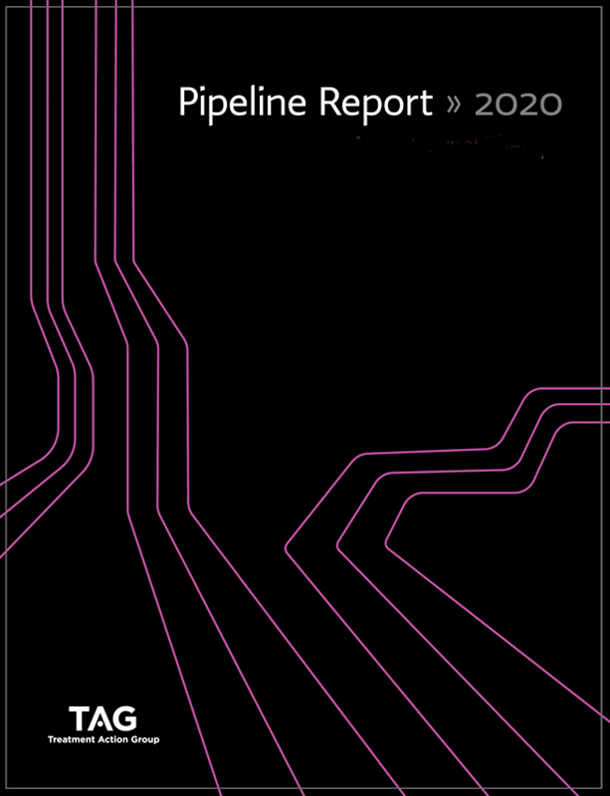
TB advocacy for improved research and access
TB diagnostics research
Need for increased investment in TB diagnostics R&D
Investments by donors and countries in the research and development of new TB diagnostics must be increased, in order to accelerate development of the TB diagnostic tools that are needed (new Unitaid investments: DriveDx4TB, START 4-ALL)
Funders and developers must engage TB-affected communities in all stages of TB diagnostics research and development to ensure that new TB diagnostic tools are developed with community input and reflect community needs and priorities (not as a check-box in late-stage R&D)
Current priorities include:
Pediatric TB diagnostics
Point-of-care urine LAM tests
Point-of-care molecular tests for TB and DR-TB
TB screening and triage tools
TB screening and diagnostic combinations and algorithms
Notes:
TAG pipeline report
TB diagnostic gap
Still no point of care TB test
Research networks including R2D2 and FEND TB
New TB diagnostics investments from Unitaid
– DriveDx4TB
- START 4-ALL

Slide 13
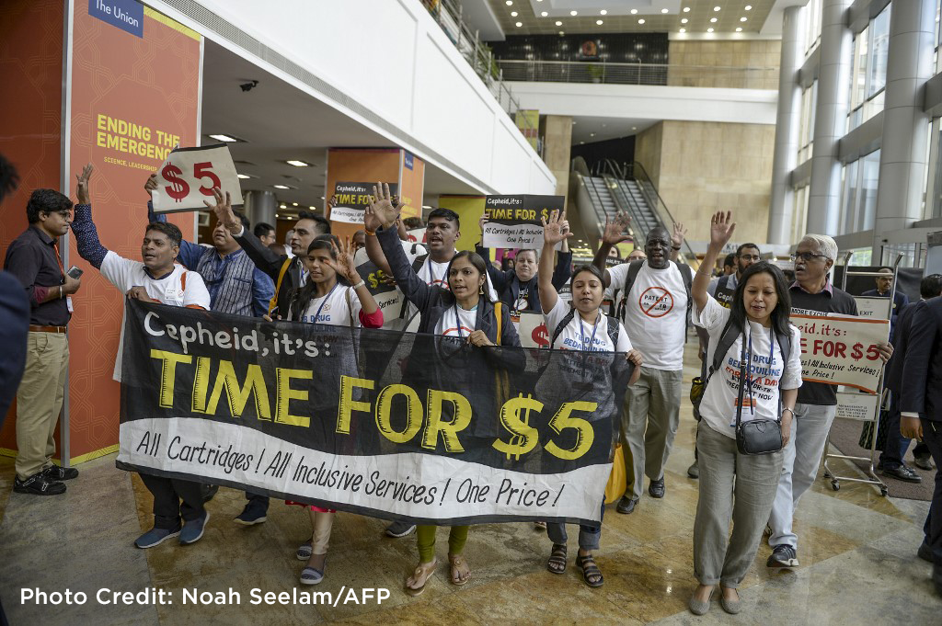
TB advocacy for improved research and access
TB diagnostics access
1. Country uptake and implementation of tools and policies
Countries should rapidly adopt new WHO policies and algorithms and fully implement them in country programs (e.g., replacing smear microscopy with molecular testing as the initial TB test; access to TB LAM for people living with HIV)
2. Transparent, equitable, and evidence-based pricing
TB diagnostic tools should be priced transparently, equitably, and based on evidence (i.e., cost-of-goods-sold [COGS]-plus pricing with volume-based price reductions; lowest sustainable pricing).
3. Access conditions on public funding
Donors should include access conditions (e.g., COGS-plus pricing, sufficient service and maintenance, commitment to meet orders/demand from LMICs) in all publicly funding agreements for TB diagnostics R&D
Notes:
Issue of TB LAM slow uptake

Slide 14
TB advocacy for improved research and access
TB diagnostics access
Principles for Access to Multi-disease Molecular Diagnostics
These 10 Access Principles are intended to help country governments, donors, and global health actors work together to navigate the complex process of improving global, regional, and national systems for the procurement and implementation of essential molecular diagnostic tests.
They articulate approaches and standards that country governments, donors, and global health actors can collaboratively apply to promote competition, increase efficiency, reduce costs, improve the terms and provision of service and maintenance, and put in place measures to ensure that pricing of molecular diagnostics is transparent, fair, equitable, and evidence based.
The Access Principles were developed based on discussions held between country program representatives, donors, members of civil society, and global health actors at the Roundtable on Access to Multi-disease Molecular Diagnostics, hosted by TAG and MSF in June 2022.
https://www.treatmentactiongroup.org/statement/ten-principles-for-access-to-multi-disease-molecular-diagnostics-a-global-call-to-action/
Notes:
Cepheid monopoly
Fragmented negotiations – need more leverage
Promoting competition
Pooling volumes across diseases
Access conditions on funding
Local R&D and manufacturing in LMICs
Integration across diseases – both procurement and implementation
Facilitating alignment for improved global collaboration across countries donors, and diseases

Slide 15
TB advocacy for improved research and access
1 / 4 / 6 x 24
A campaign to rally energy, political will & funding to end TB
1 = one-month or once weekly treatment regimens for TB prevention.
1HP, 3HP, 3HR from ACTG A5279 and TBTC Study 26 / ACTG A5259
4 = four-month treatment regimens for drug-sensitive TB.
4HPMZ, 4HRZ[E] from TBTC Study 31 / ACTG A5349 and the SHINE trial
6 = six-month treatment regimens for drug-resistant TB.
6BPaL[M] from TB-PRACTECAL and ZeNix trials
& priority research to extend the benefits of short treatment and prevention regimens to any groups who cannot currently use them due to data gaps or research exclusions.
x 24 = by the end of 2024.
A deadline for having in place the “staff, stuff, space, systems, and support” needed for shorter TB regimens to be made accessible to everyone, everywhere as a human right.
https://www.treatmentactiongroup.org/statement/1-4-6-x-24-campaign-launched-to-rally-energy-political-will-funding-needed-to-fight-tuberculosis/
Notes:
The COVID-19 pandemic and other concurrent global health, economic, social, and political crises have rolled back and continue to threaten progress in the fight against TB
We’ve already missed nearly all of the treatment and prevention targets set during the United Nations High Level TB in 2018
To get back on track to ending TB by 2030, we need an infusion of energy, political will, and funding – the generation of which requires something inspiring to rally around.
After 20+ YEARS (!!) of research and development, we can finally treat TB infection in as little as one month and most forms of drug-sensitive and drug-resistant TB in four and six months.
Yet virtually no one has access to these shorter regimens – the lack of access to these advances is a human rights issue that should inspire outrage.
But the 1/4/6x24 campaign is about more than the short-course prevention and treatment regimens….
This campaign is about claiming the right of people with TB to enjoy the benefits of scientific progress, which is a precondition for realizing the right to health.
It’s about getting in place the “staff, stuff, space, systems, and support” needed to successfully make available today’s short-course regimens – for everyone, everywhere.
And in doing so, to bring to the global fight against TB by the end of 2024, the energy, resources, and common cause necessary to get back on track to ending TB.
Inspired by the 3x5 initiative through which the WHO and UNAIDS sought to provide HIV treatment to 3 million people in LMICs by the end of 2005 – 1/4/6x24 is about setting a new, inspired interim goal to rally around to help get us back on track to ending TB.

Slide 16
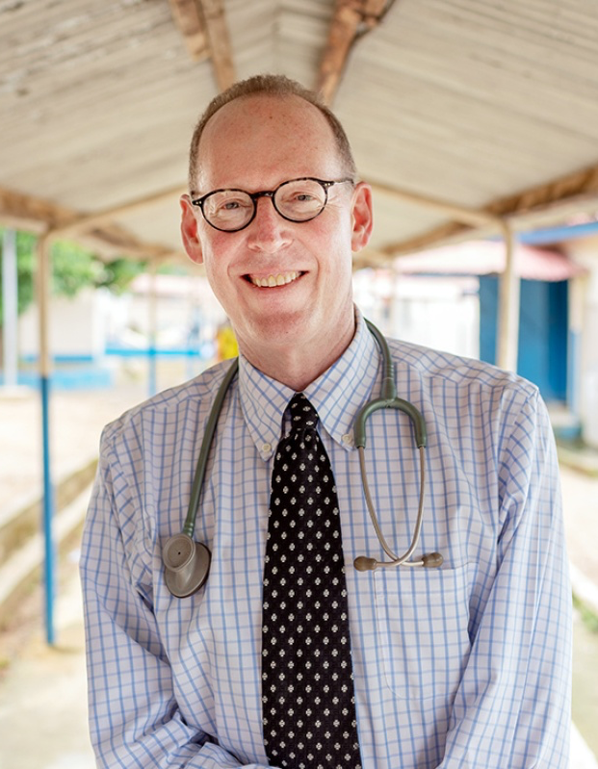
TB advocacy for improved research and access
REMEBERING PAUL FARMER (1959–2022)
“If everyone has a right ‘to share in scientific advancement and its benefits,’ where are our pragmatic efforts to improve the spread of these advances? … even as our biomedical interventions become more effective, our capacity to distribute them equitably is further eroded.”
— Pathologies of Power: Rethinking Health and Human Rights, AJPH 1999
The right of everyone to enjoy the benefits of scientific progress and its applications i.e., the right to science.
Governments have “a duty to make available and accessible to all persons, without discrimination, especially to the most vulnerable, all the best available applications of scientific progress necessary to enjoy the highest attainable standard of heath.”
— General Comment 25, Committee on Economic, Social and Cultural Rights

Slide 17
Getting involved
When advocating for investment in TB research:
Articulate the specific costs of inaction (e.g., what’s not funded).
How much farther ahead would we be if a certain project had been funded earlier, or if a supplemental budget request had been granted?
Connect your work as scientists to the BIG picture.
Between the cell and population-level biology are persons with or at risk of TB. And in the eyes of governments, these persons are constituents.
Engage people and communities affected by TB.
Community advisory boards (CABs) can provide critical input on research, trial design, and product development and should be engaged early and often. Are you already engaging CABs in your research? What steps can you take to move in this direction?
When advocating for access to TB tools:
Articulate the specific costs of insufficient access (e.g., missed opportunities for effective TB prevention, diagnosis, and treatment).
How would access to the highest standard of care increase TB prevention and reduce TB transmission, morbidity, and mortality?
Incorporate access considerations into all stages of TB research.
What conditions are in place to ensure that new TB tools and technologies will be made accessible, affordable, and scalable? How can future access to these tools and technologies be prioritized even at the earliest stages of research and development?
Invest in local civil society organizations.
Local CSOs can promote TB literacy among affected communities, generate demand for new TB tools, and advocate to shape national priorities and policies for the uptake and implementation of new tools.

