Slide 1
Evidence and Regimens for TB Prevention
Jennifer M. Ross, MD, MPH
Division of Infectious Diseases – University of Washington
Advanced TB Research and Training Course
September 12-16, 2022

Slide 2
Disclosures
Grant funding related to this topic from NIH/NIAID

Slide 3
Outline
Principles of TB preventive treatment/therapy
Who is indicated to receive it?
Regimens (among adults who are not pregnant)
Recent innovations & future directions
Shorter courses, ongoing trials

Slide 4
Principles of TB preventive treatment (TPT)
TPT – treatment offered to individuals who are considered at risk of TB disease in order to reduce that risk*
Must assess for active TB before initiating TPT
Leverages relatively slow TB progression (months to years)
Tradeoff - most people at risk do not develop TB. Much research into identifying people most likely to benefit and developing shorter, safer regimens.
*WHO consolidated guidelines on tuberculosis. Module 1: Prevention. 2020.

Slide 5
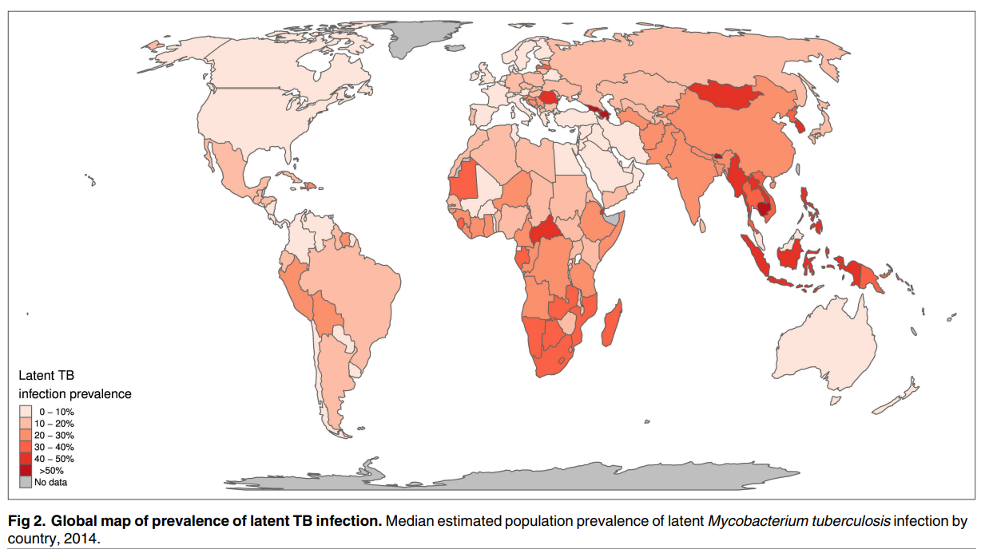
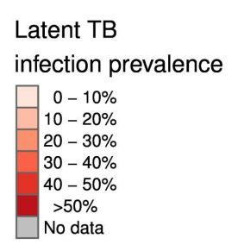
How to maximize benefit, reduce harms, and prioritize?
Massive population (1.7 billion, ~23% global) estimated to have LTBI in 2014*
*Houben and Dodd. PloS Med. 2016.

Slide 6
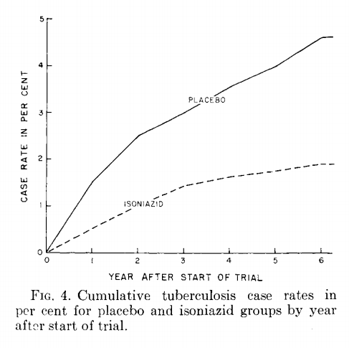
TPT history – Abbreviated list of trials
Community-wide isoniazid household RCT among Alaska Native communities¹
Household contacts (child, adult) of people with pulmonary TB in Kenya²
People living with HIV in Haiti (pre-ART)³
People living with HIV taking ART^{4,5}
¹Comstock, et al. American Review of Resp Dis. 1967.
²Egsmose, et al. Bull WHO. 1965.
³Pape, et al. Lancet. 1993.
⁴Rangaka, et al. Lancet. 2014.
⁵Danel, et al. NEJM. 2015.

Slide 7
TPT history – different outcome
Cluster-randomized trial of >78,000 miners at 15 sites in South Africa (Thibela TB)¹
Reduced risk of TB while taking isoniazid, but rapid loss of protection following treatment.
¹Churchyard, et al. NEJM. 2014.

Slide 8
Who is indicated to be evaluated for and receive TPT?
Infection
Progression
Increased likelihood of exposure in home or community
Immunosuppression, young children

Slide 9
Evaluation Guidelines
WHO Guidelines 2018, 2020¹
US Guidelines (ATS/IDSA/CDC)² (USPSTF)³
Increased likelihood of infection
Household contacts
Children <5 (all settings)
Low incidence country – age >5 if LTBI
High incidence country – age >5, confirmation of LTBI is desirable
Prison, experiencing homeless, injecting drugs (low incidence country)
OR
Increased risk of progression
Adults and adolescents living with HIV with TST+ or unknown TST
Infants and children living with HIV
Immunosuppressive meds, organ transplant, silicosis
Test for LTBI with IGRA or TST
Increased likelihood of infection
Recent household contact
Immigrant from high incidence country
Resident of high-risk congregate setting (prison, shelter)
OR
Increased risk of progression
HIV+, immunosuppressive medications, organ transplant, silicosis
¹WHO consolidated guidelines on TB: prevention. 2020.
²Lewinsohn, et al. Clin Inf Dis. 2017.
³USPSTF. JAMA. 2016.

Slide 10
Benefit by TST or IGRA status
Many studies showing higher risk of TB in people with positive tuberculin skin test (TST) or interferon gamma release assay (IGRA)
Mixed findings on whether TPT benefit is limited to people with TST+ or IGRA+
Akolo, et al. Cochrane Database of Systematic Reviews. 2010.
TST or IGRA is commonly used to guide TPT decisions in high-resource settings, but may not be available in all settings
Generally, WHO guidelines recommend not withholding TPT among people who are otherwise eligible in settings where TST and IGRA are not available.

Slide 11
TPT with ART by patient subgroup
Individual participant data meta-analysis¹⁻³
Greater incidence of TB among men, CD4<200, IGRA+
No evidence of a difference in benefit of TPT by IGRA status.
Group | HR for TB (ART+IPT) vs ART alone | 95% CI | Interaction p
Gender |  |  | 0.32
Female | 0.77 | 0.52 – 1.14
Male | 0.53 | 0.29 – 0.97
CD4 |  |  | 0.25
<200 | 0.62 | 0.37 – 1.03
200 – 499 | 0.92 | 0.55 – 1.55
≥500 | 0.37 | 0.13 – 1.07
TST |  |  | 0.14
Positive | 0.92 | 0.43 – 1.99
Negative | 0.42 | 0.21 – 0.84
IGRA |  |  | 0.23
Positive | 0.82 | 0.46 – 1.46
Negative | 0.45 | 0.22 – 0.89
Ind | 1.37 | 0.37 – 5.08
1. Rangaka, et al. Lancet. 2014.
2. Hakim, et al. NEJM. 2017.
3. Badje, et al. Lancet Global Health. 2017.
Ross, et al. The Lancet HIV. 2021.

Slide 12
Recommended adult regimens (drug-susceptible)
Regimen | Description | CDC¹ | WHO² | Citation
3HP | 3 months of isoniazid and rifapentine taken weekly | Preferred | Recommended | Martinson, et al. NEJM. 2011. Sterling, et al. NEJM. 2011.
4R | 4 months of rifampin taken daily | Preferred | Alternative | Diallo, et al. NEJM. 2018. Menzies, et al. NEJM. 2018.
3HR | 3 months of isoniazid and rifampin given daily | Preferred | Recommended
6H-9H | 6-9 months of daily isoniazid | Alternative | Recommended | See earlier slides.
1HP | 1 month of isoniazid and rifapentine taken daily | --- | Alternative | Swindells, et al. NEJM. 2019.
¹Sterling, et al. MMWR. 2020. doi: 10.15585/mmwr.rr6901a1
²World Health Organization. 2020. https://www.who.int/publications/i/item/9789240001503
MDR guidelines. Nahid, et al. Am J Resp Crit Care Med. 2019.

Slide 13
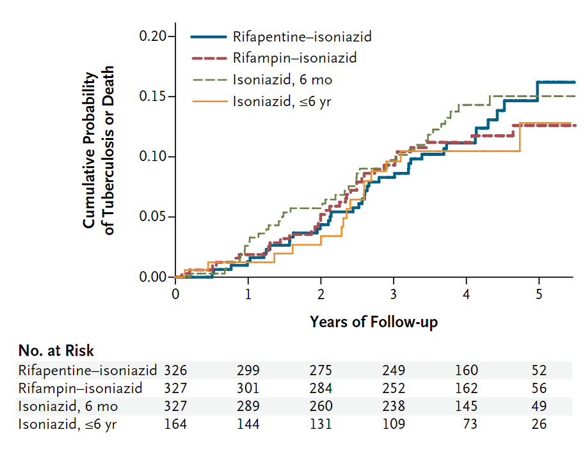
3HP deeper dive - 1
1184 participants with HIV and TST+, not on ART, living in Soweto
Randomized trial
Rifapentine & isoniazid weekly x 12 weeks
Rifampin & isoniazid 2x weekly x 12 weeks
Isoniazid daily x years
Isoniazid daily x 6 months (control)
Nearly 4 years follow-up
No significant differences in incidence of TB or death between any regimen and control*
Martinson, et al. NEJM. 2011.

Slide 14
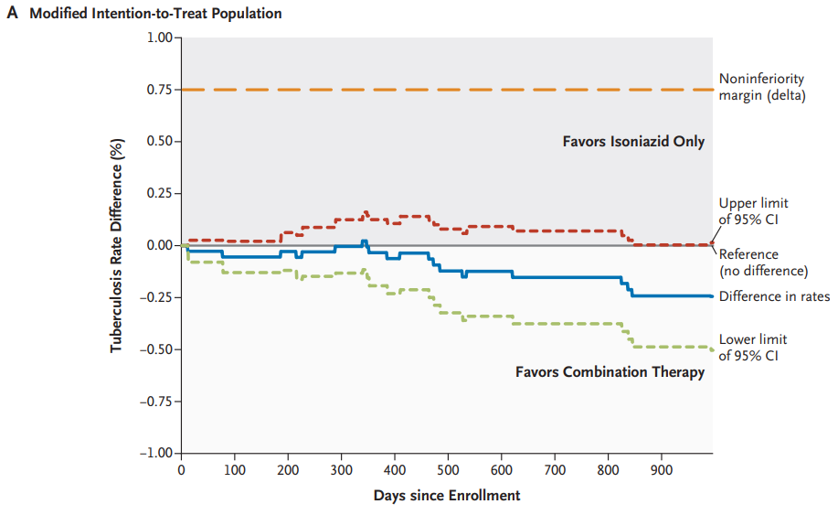
3HP deeper dive - 2
7731 participants primarily in US and Canada, most with recent household contact and TST+
Randomized trial, noninferiority
Rifapentine & isoniazid weekly x 12 weeks
Isoniazid daily x 9 months
Follow-up 33 months
3HP non-inferior in preventing TB and death and better treatment completion (82% vs. 69%)
Sterling, et al. NEJM. 2011.

Slide 15
Recent advances and ongoing trials
1HP vs. 9H non-inferior among people living with HIV¹
Multiple 1HP and 3x weekly HP trials ongoing²
3HP in people with diabetes (PROTID, ongoing)³
RCT among 3000 HIV- people with diabetes and TST+ or IGRA+
Adults in Tanzania and Uganda
Intervention is 12 weeks 3HP vs placebo
Outcome is TB incidence through 24 months
¹Swindells, et al. NEJM. 2019.
²Treatment Action Group. Pipeline Report 2021: Tuberculosis Preventive Treatment.
³Ntinginya, et al. Trials. 2022.

Slide 16
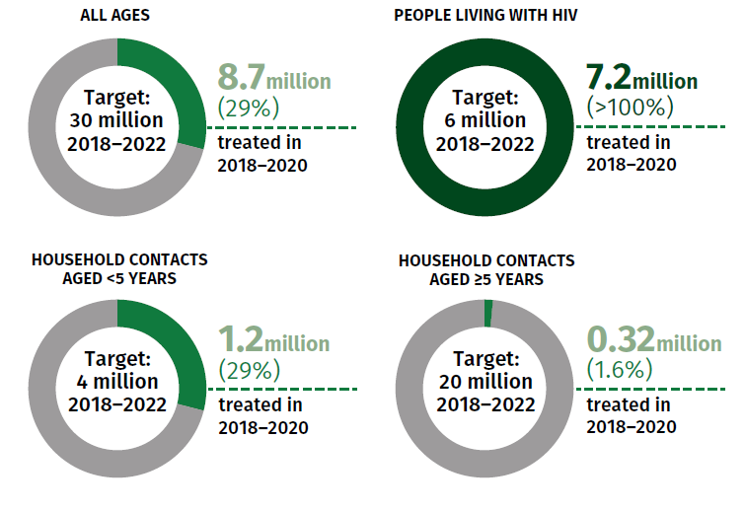
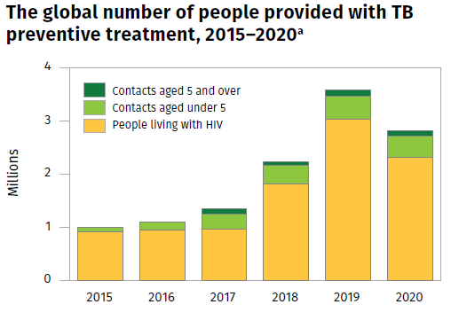
TPT Progress Toward UN High-Level Meeting Targets
World Health Organization. Global TB Report 2021.

Slide 17
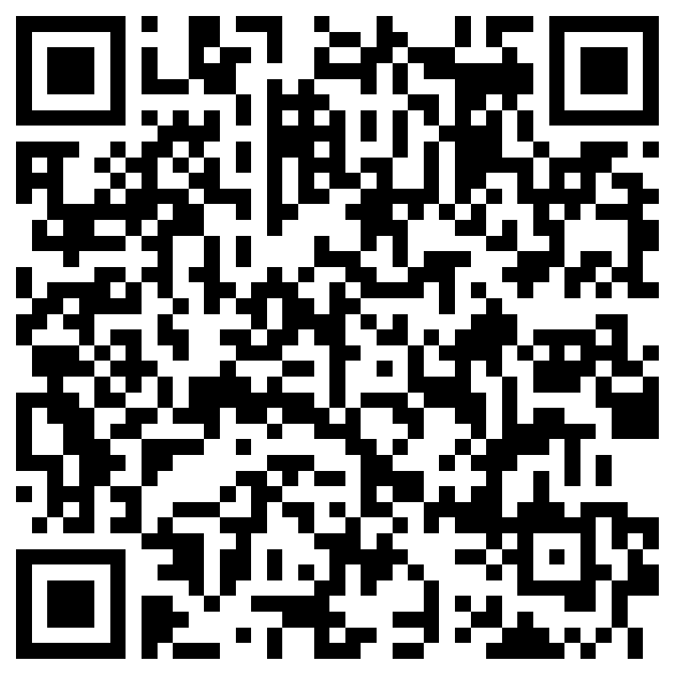
Thank you!
Questions and comments to jross3@uw.edu
Peer teaching evaluation requested from UW faculty, staff, and clinical trainees.

