Slide 1

Aerosol Biology & TB Transmission
Advanced TB Research Training Course 2022
David Horne, MD, MPH
Division of Pulmonary, Critical Care & Sleep Medicine
Harborview Medical Center
University of Washington

Slide 2
Disclosures
No conflicts of interest to disclose
I receive grant funding from NIH and U.S. CDC

Slide 3

Miasmatic Theory of Contagion
"For when the morning breezes blow toward the town at sunrise, if they bring with them mist from marshes and, mingled with the mist, the poisonous breath of creatures of the marshes to be wafted into the bodies of the inhabitants, they will make the site unhealthy.“
Vitruvius on miasma, 1st Century AD
Notes:
In addition to the Hippocratic oath, Hippocretes gave us the miasmatic theory of disease spread. Exposure to noxious air was thought to be responsible for many diseases including TB.

Slide 4
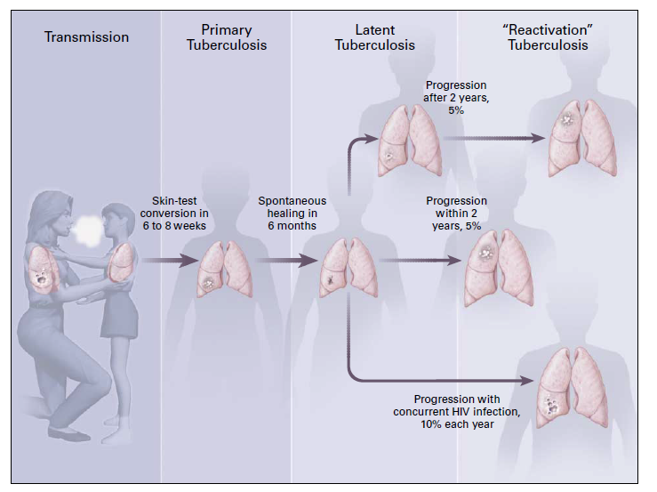
Interrupting transmission key to TB control
Low Burden settings
“Index”
High Burden settings
Reinfection Happens!
S. Africa, ARTI 2.5% - 4.2%
Cape Town, recurrence rate after successful TB treatment 16.4/1000 person-years
Not driven by HIV
“Contact”
Small NEJM 2001; Behr BMJ 2018; Dowdy Lancet ID 2022; Shanaube PLoS One 2009; Hermans CID 2021
Notes:
INTERRUPTING TRANSMISSION IS KEY TO CONTROL
We now know that TB is transmitted person-to-person. This figures depicts the natural history of TB in which a person with pulmonary TB (the index) produces infectious particles that are inhaled by a susceptible person (“contact”). In 30-40% of contacts this results a positive skin test or IGRA, indicative of TB exposure. Approximately 10% of these persons will go on to develop active TB either rapidly after infection (<2 years) or remote from the time of infection.
While remote progression to TB accounts for 80% or more of TB cases in low burden settings, Behr & colleagues in a series of papers have persuasively argued that rapid progression is the rule in high burden settings due to repeated TB exposures and re-infection.
Interrupting transmission is key to TB control.
Recurrence - recent paper with Professor Wood as Sr. author found high recurrence rates after TB treatment in Cape Town – not driven by HIV and likely driven by exogenous re-infection

Slide 5
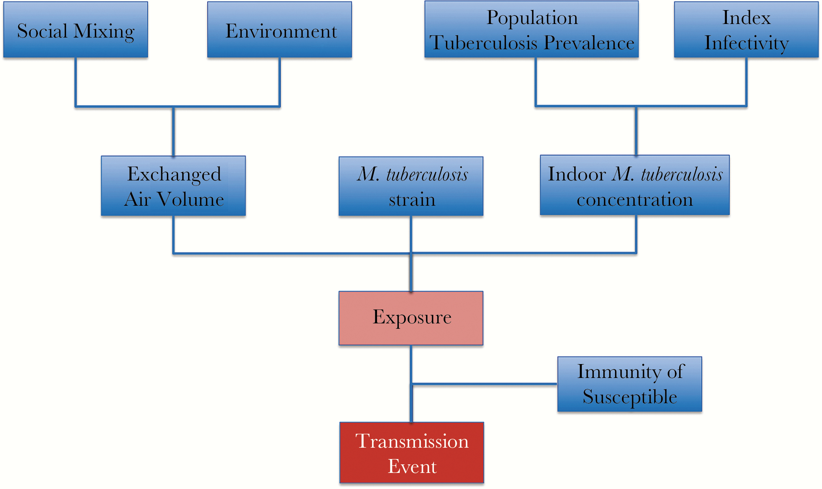
Determinants of Transmission
Engineering
Identify community amplifiers
Active screening
TPT
Early Dx/Tx
“Superspreaders”
Vaccines
Treatment of co-morbidities
Mathema, JID 2017
Notes:
SEVERAL FACTORS DETERMINE WHETHER A TRANSMISSION EVENT (INFECTION OF CONTACT OCCURS) AND DIFFERENT INTERVENTIONS MAY ADDRESS
There are a number of factors that impact on the occurrence of a transmission event (i.e. new infection in a contact). These include the Index infectivity which will be the focus of this talk and can be intervened upon through early diagnosis and treatment, including correctly diagnosing TB when patients present for health care.
Population TB prevalence determines in part the frequency of TB exposures; Possible interventions include active case finding and administration of TPT to be discussed by Jen Ross and Sylvia LaCourse today.
The environment heavily influences transmission events including room size, crowding, ventilation, etc and could be addressed through engineering controls.
Strain of M. tuberculosis may impact transmission – Josh Herbeck will be discussing TB phylogenetics.
The Susceptibility of contacts is the final component that determines the outcome of an exposures and may be addressed through treatment of co-morbidities such as HIV and diabetes or vaccines. Jason Simmons will discuss genetically determined resistance to TB infection and disease after my talk.

Slide 6
Index Infectiousness

Slide 7
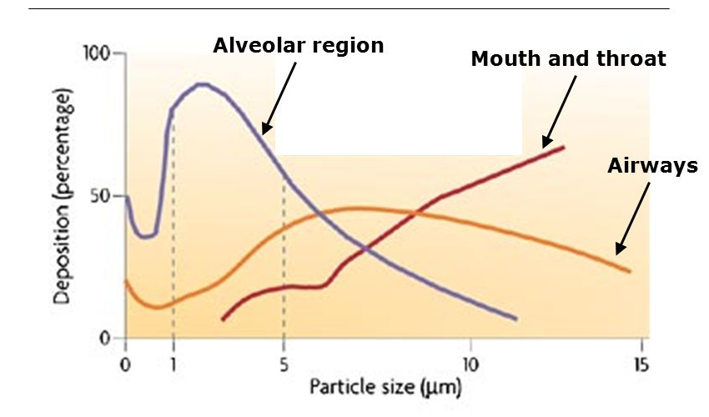
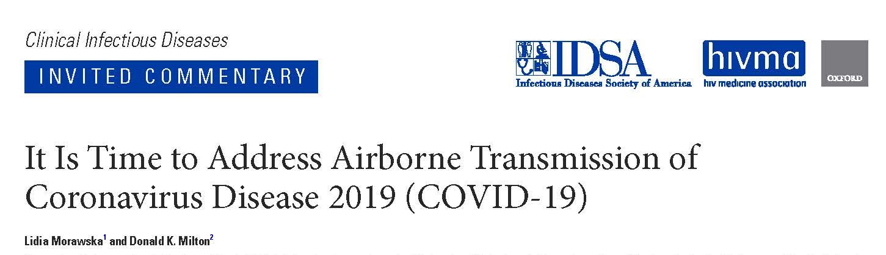
Infectiousness: TB an aerosolized disease
Aerosols - suspensions of solid or liquid particles in a gas, usually air
Infectious aerosols are suspensions of pathogens in these particles
Particle size is the most important determinant of aerodynamic
  </= 5 microns may remain airborne indefinitely under most indoor conditions
    These are also most likely to deposit into the lower respiratory tract
  6-12 micron particles deposit in the upper airways
Notes:
TB IS AN AEROSOLIZED DISEASE (LIKE MEASLES, MERS, SARS, COVID-19)
Robert Koch Suspected but could not prove airborne person-to-person spread
Infection control guidelines for the past 2 decades have suggested that ‘airborne transmission’ is rare, and that only TB and possibly varicella could be transmitted by aerosolization
Particle size is the most important determinant of aerodynamic behavior due to their settling velocity determined primarily by gravity and diameter
</= 5 microns may remain airborne for 2 to 40 hours under most indoor conditions
These are also most likely to deposit into the lower respiratory tract
Larger particles are airborne for minutes to seconds.
10 studies of cough aerosols of Mycobacterium tuberculosis, Pseudomonas aeruginosa, influenza and mixed viruses by various investigators all found that most of the pathogens were in particle sizes < 5 microns.
Not only do smaller particles remain airborne (and thus infectious for much longer durations, but the particles < 5 um in size are much more likely to make into the gas exchanging areas of the lungs known as alveoli.

Slide 8
Identified Risk Factors for Infectiousness

Slide 9
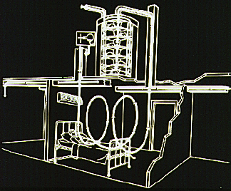
Infectiousness: Variability in Infectiousness
“Superspreaders”?
Like measles & SARS-CoV-2, TB is over dispersed
  Pareto: 10-20% of infected, responsible for 80-90% of transmission events
Wells & Riley & guinea pigs
  13% responsible for GP infections (Riley RL et al. Am Rev Respir Dis 1962)
  4% of patients produced > 73% of GP infections (Sultan, Am Rev Respir Dis 1967)
Case reports in literature reflect episodic nature of outbreaks
  Smear+ patient responsible for 6% of all TB in SF in 2 years (Small NEJM 1994)
  Smear+ patient infected 41/97 bar patrons (Kline NEJM 1995)
Patterson, Tuberculosis 2018
Notes:
SUPERSPREADERS LIKELY IN TB
Super-spreaders were described for many infectious diseases. Like measles & SARS-CoV-2, When the observed variance is higher than the variance of a theoretical model, overdispersion has occurred. TB is an overdispersed pathogen, spreads in clusters
Multiple lines of evidence →minority of patients with TB are responsible for most transmission events (“Superspreaders”)
Pareto principle means that a small number of events or people are responsible for the majority of consequences. Pareto’s insight is sometimes called the 80/20 principle—80 percent of outcomes of interest are caused by 20 percent of inputs.
Wells & Riley performed seminal studies of TB transmission. Atop the Baltimore VA Hospital, they constructed an air-tight closed ventilation system that connected a six-room tuberculosis ward to an exposure chamber with 150 guinea pigs. (Among rodent animal models, only guinea pigs could cough and sneeze, making them ideal for studying how respiratory diseases spread.) The guinea pigs were exposed to the infected air over a four-year period. A second group of 150 guinea pigs acted as controls: their air ducts were irradiated with UV-C lamps to kill TB bacilli.

Slide 10

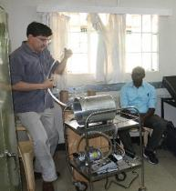
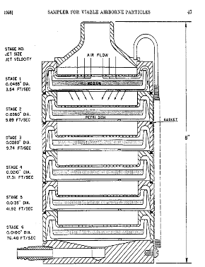
Cough Aerosol Sampling System: CASS
Fennelly KP. Lancet Resp Med 2020
6-stage Andersen cascade impactor
Notes:
Although we lack robust clinical tools to estimate infectiousness, CASS is a research tool that has been around for almost 2 decades, developed by our NIH collaborator Kevin Fennelly.
We are using this to estimate infectiousness in TBAIT participants
CLICK
Outcome of infectiousness defined by CASS-collected culturable aerosols. CASS is an acronym for Cough aerosol sampling system
In the photograph you can see our collaborator Dr. Kevin Fennelly of the NIH during our trip to Nairobi in February. The tubing that he is holding is part of CASS. Inside the CASS is the piece of equipment in the drawing – a 6 stage Andersen cascade impactor.
Patients forcefully cough into the mouthpiece attached to the tubing for 5 minutes. A vacuum pump is attached to the exit port to provide a constant suction. Each level of the Andersen cascade impactor has a metal plate with progressively smaller holes and a culture plate with solid media. Aerosolized particles cascade from one level to the next until they can no longer fit through the metal plate holes at which point they settle on the culture plate. TB patients with culturable aerosols have the highest yields at stage 4/5 which correspond to aerosol particles in the 1-4 micrometer size.
Culturable aerosols, especially as the CFUs on a plate increase, are indicators of higher levels of infectiousness.
CASS positivity vs. Highly infectious
Sputum microscopy is a poor correlate of infectiousness. The figure shows CASS aerosol CFUs on the vertical axis on the left, displayed by the solid red bars, and sputum smear quantification graded as discrete integers 0 to 4 , on the right and indicated by the bule dots. On the horizontal axis are individual participants, 112 in total.
As you can see, the minority of participants with the highest grade of sputum smear assessment, 4+, had culturable aerosols. There were some with lower grades that also had significant Mtb CFUs.
Among participants with culturable aerosolized Mtb, showing aerosolized Mtb CFUs – which is on a logarithmic scale – you can see that there is a wide range in CFUs and presumably in infectiousness.
Outcome of infectiousness defined by CASS-collected culturable aerosols. CASS is an acronym for Cough aerosol sampling system
In the photograph you can see our collaborator Dr. Kevin Fennelly of the NIH during our trip to Nairobi in February. The tubing that he is holding is part of CASS. Inside the CASS is the piece of equipment in the drawing – a 6 stage Andersen cascade impactor.
Patients forcefully cough into the mouthpiece attached to the tubing for 5 minutes. A vacuum pump is attached to the exit port to provide a constant suction. Each level of the Andersen cascade impactor has a metal plate with progressively smaller holes and a culture plate with solid media. Aerosolized particles cascade from one level to the next until they can no longer fit through the metal plate holes at which point they settle on the culture plate. TB patients with culturable aerosols have the highest yields at stage 4/5 which correspond to aerosol particles in the 1-4 micrometer size.
Culturable aerosols, especially as the CFUs on a plate increase, are indicators of higher levels of infectiousness.
Size distribution of aerosolized mtb – bars with arrows correspond to stages 4 and 5 of Andersen.

Slide 11
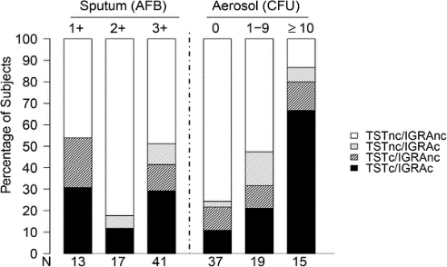
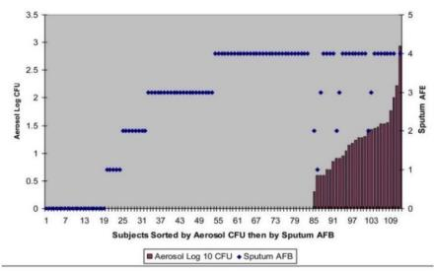
Mtb bacilli in aerosols differ from sputum
CASS also associated with magnitude of test response, TB in HHCs
Jones-Lopez EC PLoS One 2015
Notes:
CASS positivity vs. Highly infectious
Sputum microscopy is a poor correlate of infectiousness. The figure shows CASS aerosol CFUs on the vertical axis on the left, displayed by the solid red bars, and sputum smear quantification graded as discrete integers 0 to 4 , on the right and indicated by the bule dots. On the horizontal axis are individual participants, 112 in total.
the minority of participants with the highest grade of sputum smear assessment, 4+, had culturable aerosols. There were some with lower grades that also had significant Mtb CFUs. Among participants with culturable aerosolized Mtb, showing aerosolized Mtb CFUs – which is on a logarithmic scale – you can see that there is a wide range in CFUs and presumably in infectiousness.
In a series of studies, CASS results have been independently associated with tuberculin skin test conversions and positive interferon gamma release assay results among household contacts . Further more, the magnitude of infterferon gamma release assay response and the size of induration on skin testing correlate with CASS results. Finally TB disease was associated with exposure to CASS-determined highly infectious TB patients – highly infectious defined by 10 or more colony forming units.
Mtb bacilli in cough aerosols differ from sputum. Different gene expression profiles Different mycolic acid profiles. CASS CFUs associated with: TST conversions in HHCs, Positive interferon-gamma release assays in HHCs, Magnitude of IFN-γ and TST responses, TB disease in household members

Slide 12
Cough Frequency & Infections
Risk factors (multivariate) for higher CASS CFUs
Characteristic aOR (95% CI)
Symptom score 0.8/unit (0.7-0.9)
Stronger cough 10 per 10 units (10.0-10.1)
Time to cx positivity 0.8/d (0.7-0.8)
HIV positive 0.4 (0.2-0.8)
Loudon RG Am Rev Respir Dis 1969
Theron G Nat Med 2020
Notes:
What is known regarding cough. In this 51 year old study, it was shown that overnight cough frequency was associated with positive tuberculin skin tests in household contacts. Can we apply technology to glean more information from cough?
A recent study published is the largest CASS study to date that enrolled 500 participants: drug-susceptible vs. rifampin-resistant vs. XDR-TB.
In multivariate analysis, several patient patient/pathogen characteristics associated with CASS-positivity/infectiousness. Symptom score assess TB symptoms, BMI, MUAC and ranges 0-13; IQR in participants was 2-5. A lower symptom score was associated with higher infectivity.
Peak coughs were measured and IQR was 240-400. Investigators found OR of 10 per 10 unit increase in peak cough flow.
HIV-negative status associated with CASS-positivity; PLHIV 49% on ART, median CD4 200
You can speculate that with fewer symptoms, highly infectious patients more likely to leave home to work or socialize.

Slide 13

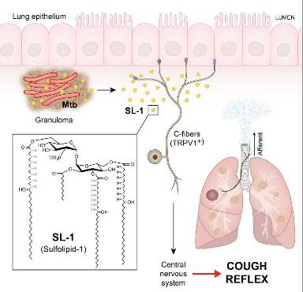
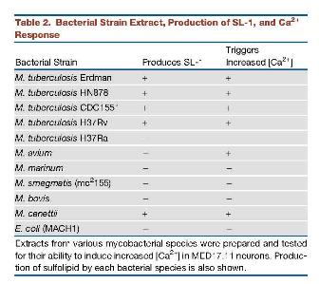
MTB Induces Cough
Ruhl. Cell 2020
Notes:
SL-1 component of outer wall of Mtb; not found in M. bovis or H37Ra. GP’s cough! Those infected with SL-1 deficient Mtb mutant do not cough
– I am not aware of studies that have assessed differences in SL-1 production between high and low transmissibility isolates.
d An Mtb organic extract activates nociceptive neurons and induces cough in guinea pigs d Mtb sulfolipid-1 is necessary and sufficient to trigger neuronal activation and cough d Guinea pigs infected with an SL-1-deficient Mtb mutant do not cough

Slide 14
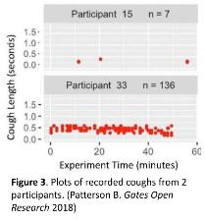
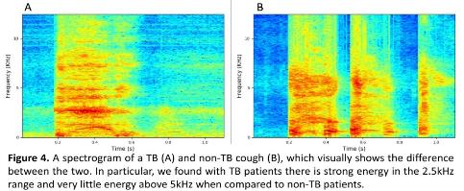

Cough and Infectiousness
Spontaneous cough frequency associated with Mtb positive aerosols (p-value = 0.02) (Patterson Gates Open Res 2017)
  Varied by HIV status: cough cut-point lower if HIV-neg (9 vs. 18 coughs)
Cough characteristics – computer deep learning techniques differentiated TB cough from other etiologies (Sens 82%, Spec 97%)
  Can accurately associate cough with person (Whitehill 2020)
3
Pahar M. Automatic Cough Classification for TB Screening
Notes:
Multiple groups working on AI for cough analyses
Among the co-investigators on are grant are Dr. Shwetak Patel, in the CS department at UW, and his team in the ubicomplab.
Dr. Patel’s research interests are in the areas of Human-Computer Interaction.
Dr. Patel demonstrated that spontaneous cough frequency was associated with culturable bio-aerosol production of Mtb (p-value = 0.02), while neither cavitary disease on chest X-ray nor sputum smear positivity were significant associated. There was a difference by HIV status: for HIV-negative participants, cough cut-point was lower (9 vs. 18 cough episodes) and area under the receiver operating characteristic (ROC) curve higher (AUC, 0.87 vs. 0.68)
Using advanced deep learning algorithms, his team has been exploring cough spectrograms – 2 of which are depicted here. They found that the computer is able to discriminate TB related cough from other etiologies with a sensitivity of 82% and a false positive rate of 3%. And entering the realm of creepy technology, they have developed computer algorithms that can identify individuals based on their cough signature.

Slide 15
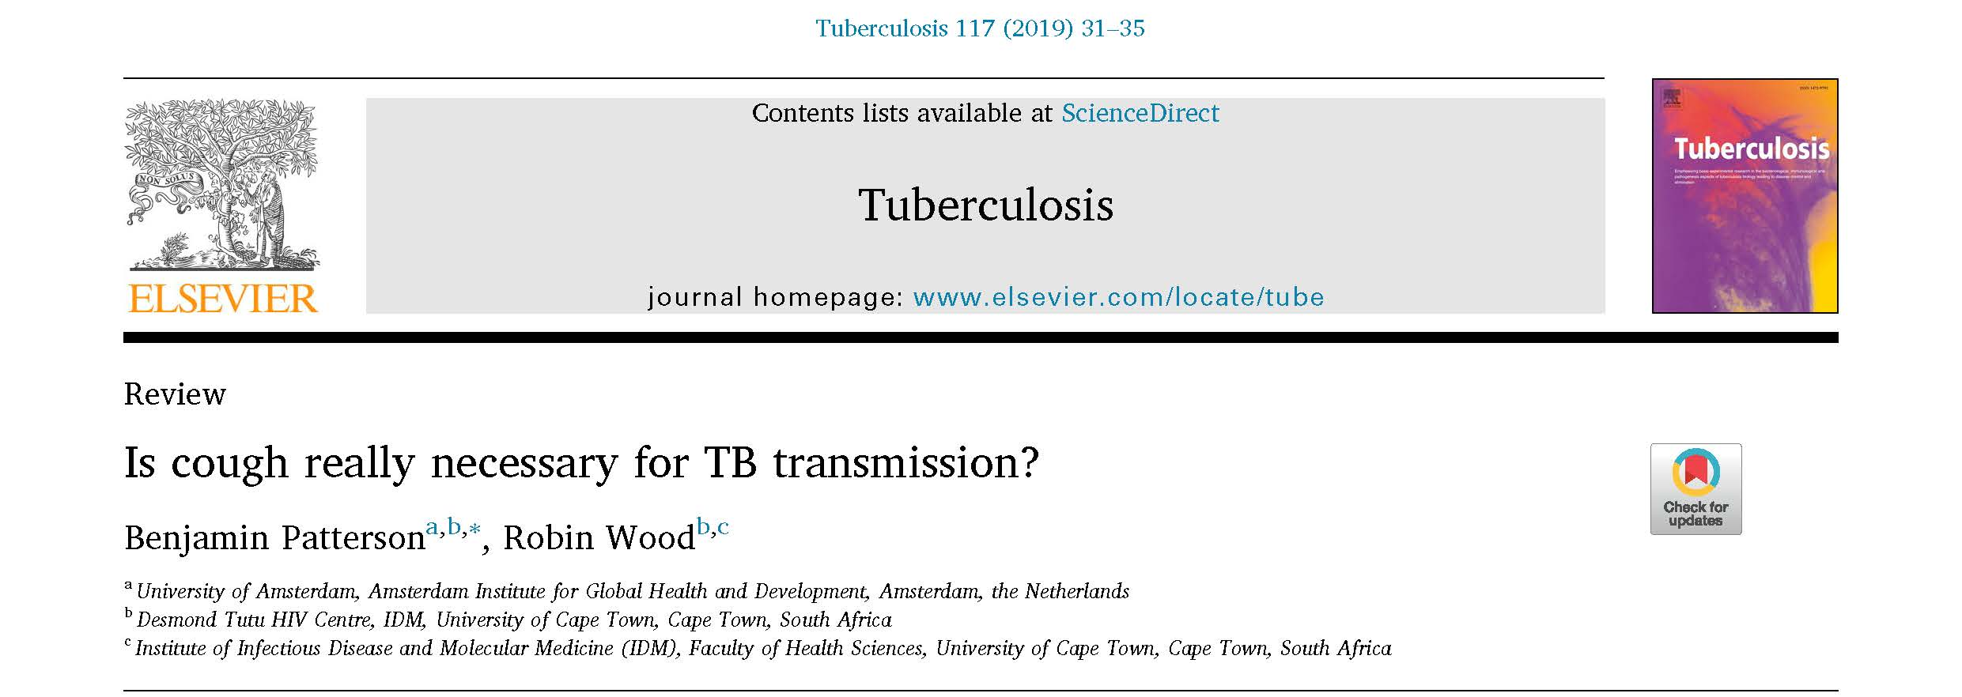

Slide 16
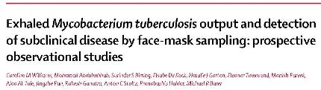
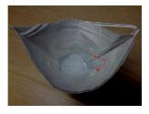
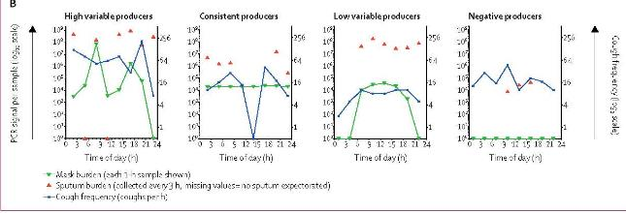
No association between face mask MTB output and cough frequency, radiological measures of disease extent, or bacterial burden in baseline sputum samples
Mask
Sputum
Coughs/hr
Among TB suspects, 8/20 Dx’d with TB, 6 were only positive on face-mask
4 of the six became Xpert positive over 6 weeks
Notes:
Novel non-invasive sampling technique used in Pulmonary TB Patients in South Africa. (PVA strips on mask, Mtb detected with RD-9 directed PCR or Xpert Ultra) - Worn for 1-hr during 3-hr periods throughout 24 hr day
Most were CONSISTENT producers (~60%), 10% high variable, 20% low variable, 10% negative
A consistent pattern described 16 patients in whom hourly outputs varied predominantly within a ten-fold range (median 3・4 × 10⁵ IS6110 copies per 24 hr). By contrast, six patients had variability in their longitudinal output over at least two orders of magnitude. Within this group, a distinction between high variable output (median 1・2 × 10⁸ IS6110 copies per 24 h; n=2) and low variable output (median 6・0 × 10⁴ IS6110 copies per 24 h; n=4) was made (appendix p 11). These patterns were not associated with any clear diurnal cycle

Slide 17
Population TB Prevalence

Slide 18
Active Case-Finding: Does it Reduce Community TB Prevalence?
Mixed findings from 2 cluster RCTs of ACF
  ZAMSTAR: RSA/Zambia, intervention – over 3 yrs, community mobilization, access to smear microscopy, HHC activities
    No effect of interventions
  ACT3: Vietnam, intervention = collection of sputum (regardless of Sx) x 3 yrs for Xpert testing
    Yr 4- intervention clusters had less TB: 0.56 (0.40-0.78); P<0.001
  Difference due to intensity of screening? Does ACF identify early disease or stable/non-progressive TB?
Burke, Lancet Pub Hlth 2021
Ayles, Lancet 2013
Marks, NEJM 2019
Notes:
SR by Burke identified 2 cluster randomized controlled trials that evaluated community TB prevalence using active case-finding strategies.
ZAMSTAR, set in Zambia and S. Africa. The active case-finding intervention included community mobilization, education about tuberculosis in schools, fast-track sputum collection points in health-care facilities, and mobile community sputum collection points. Tuberculosis diagnosis in the active case-finding intervention was based on smear microscopy.
In the ACT3 study, Marks and colleagues evaluated an active case-finding intervention in Vietnam that involved 3 years of annual household tuberculosis screening using sputum Xpert MTB/Rif assays for all people aged 15 years or older, regardless of symptoms. A tuberculosis prevalence survey was done in the fourth year. In the intervention group, the prevalence of tuberculosis was 126/100000 people and 226/100000, a 45% reduction (adjusted prevalence ratio of 0·56, 95% CI 0·40–0·78)
ZAMSTAR used a less intensive case-finding approach
Hans Rieder + “We suggest that mass active case-finding does not detect individuals at an earlier stage of disease, but rather an entirely different group of people with relatively stable disease who survive for many years; if they are less contagious, active case-finding will have little effect on transmission”

Slide 19
Transmission Variation by MTB strain?

Slide 20
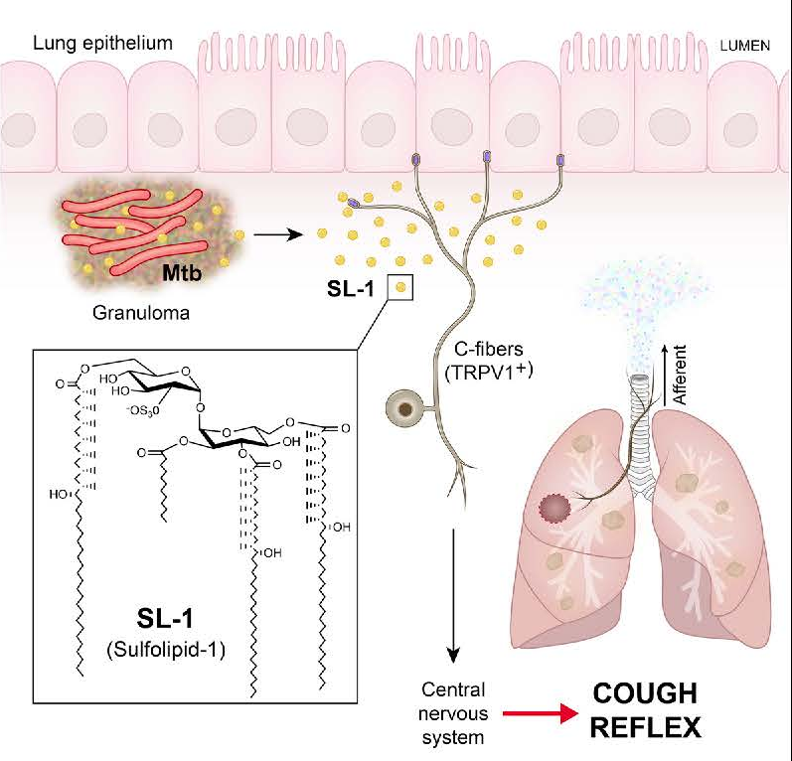
MTB Strain: Differences in Transmissibility
Data lacking that phylogenetic strain impacts transmission
  Unlike progression to disease, disease presentation, DR
Highly transmissible isolates caused less lung damage & less inflammatory (Shanley Tuber 2018)
Sulfolipid-1 activates GP nociceptive neurons→cough (Ruhl, Cell, 2020)
Increased exposures associated with TB disease (Lee ERJ 2016, Ackley R Soc Open Sci 2019)
Notes:
SL-1 component of outer wall of Mtb; not found in M. bovis or H37Ra. GP’s cough! Those infected with SL-1 deficient Mtb mutant do not cough
– I am not aware of studies that have assessed differences in SL-1 production between high and low transmissibility isolates.

Slide 21
Environment

Slide 22
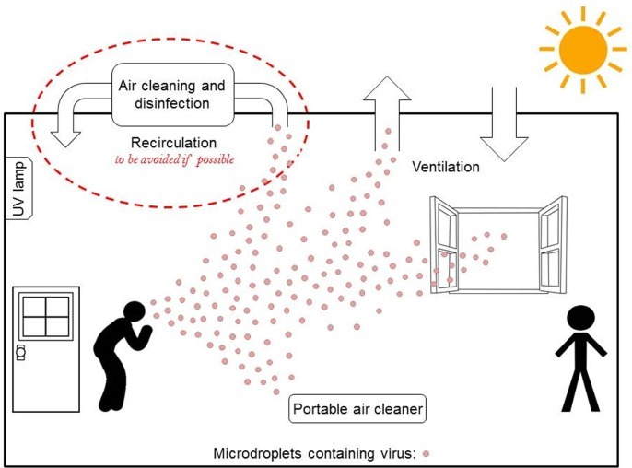
Environment
Engineering approaches to decrease
TB transmission are effective
  Ventilation/air exchange/filtration
  UV
However, we don’t know where
transmission occurs
  TB endemic settings: >80% transmission events outside home
Notes:
Transmission in endemic settings: >80% outside home

Slide 23
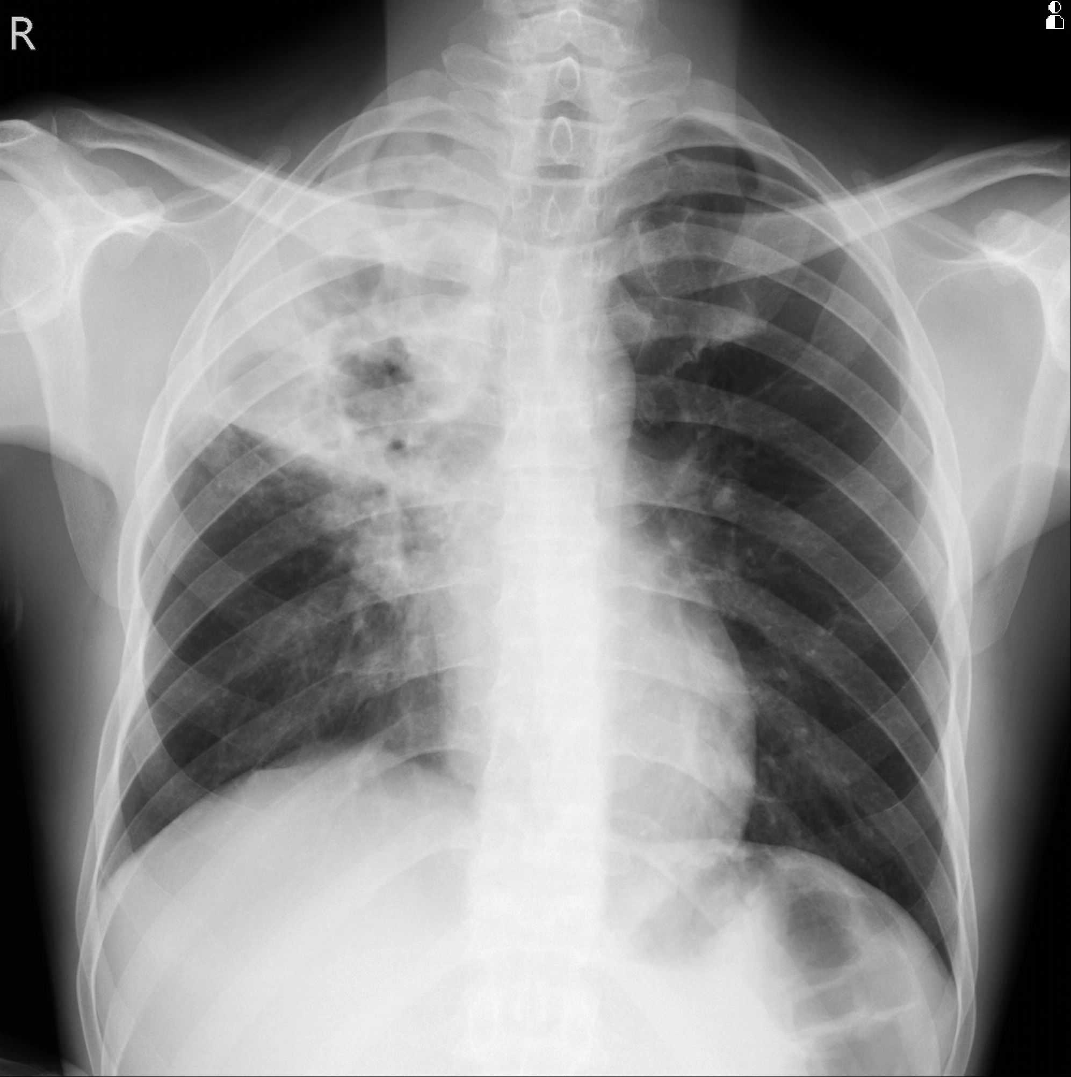
TB Transmission – Knowledge Gaps
Who is transmitting TB?
  Super-spreading likely
  How to identify most infectious individuals?
  Means of transmission
  Little data linking infectious aerosols to new infections
  Is cough required?
Where does transmission occur?
  Transmission in endemic settings: >80% outside home
  Extent of undiagnosed in transmitting TB (incl. sub-clinical)
Martinez Am J Epi 2017; Behr BMJ 2018; Mathema, JID 2017
Notes:
Important knowledge gaps that we will investigate
Similar to other infectious diseases, “superspreaders”, individuals with TB who are responsible for the majority of TB transmission, may have an outsized role in TB endemic settings. Studies from the pre-chemotherapeutic era, epidemiology and modeling studies support that a minority (~20%) of patients with TB are responsible for 80% transmission events. Additionally, they may be spreading TB for quite a while – in high burden settings estimated that average amount of time from TB onset to diagnosis is 2-3 years.
Identification of most infectious could: Inform treatment management (e.g. DOT, DST); Identify community sites of transmission; Support targeted TPT
Where does transmission occur? Different from low burden settings like the US, up to 80% of transmission events in TB endemic settings occur outside of the household and that traditional epidemiologic links are not identified. determining where tuberculosis transmission specifically occurs outside of households is considerably more challenging.
Institutional amplifiers - concentration of tuberculosis transmission in certain settings and subpopulations also leads to transmission heterogeneity
Nosocomial transmission was a major driver of MDR-TB outbreaks, Prisons: Brazil, >25% of all incident cases among men aged 20–29 years occurred within prisons; Other high-risk community settings include public transportation churches schools bars [31], and informal settlements
Importance of hotspots for TB control: Modeling studies indicate that the targeting of TB control interventions at highly infectious individuals would greatly amplify TB control returns. Highly infectious TB patients could be prioritized for DOT and DST; where they go could allow for identification of community sites of transmission and support targeting TB preventive therapy on their contacts.

Slide 24


Acknowledgements
dhorne@uw.edu
NIH KEMRI
Kevin Fennelly Videlis Nduba
UW
Tom Hawn
Shwetak Patel
Manuja Sharma

