Slide 1

TB vaccines and the status of ongoing development
Andrew Fiore-Gartland, Ph.D.
Vaccine and Infectious Disease Division
Fred Hutchinson Cancer Research Center
TRTC: Advanced Research Training Course
September 12, 2022

Slide 2
No financial interests in vaccine development
I have no financial interests to declare
Funding received from NIH and BMGF who actively support TB vaccine development
Kaufmann, Lancet, 2011

Slide 3
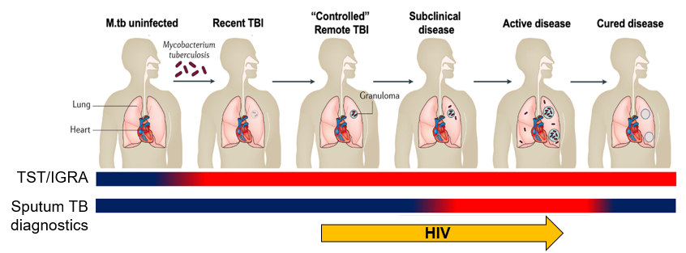
Prevention of disease progression
TB disease is leading infectious cause of death worldwide (10.4 M new cases and 1.7 M deaths in 2016)
TB notifications decreased, while TB deaths increased during COVID pandemic
HIV co-epidemic: HIV-infected individuals have 17-fold increased risk of TB disease
Infection with M.tb leads to immune sensitization, measured by conversion of IFNγ release assay (IGRA)
Prevalence of IGRA+ ranges globally: as high as 80% in high burden areas
Many may clear infection, though cumulative lifetime risk of TB disease is ~12% among IGRA+
Preventive therapy reduces disease risk, though still at risk for reinfection
TB disease is the clinical endpoint for preventive vaccine trials
(Pai et al., Nat Rev, 2016; Scriba, 2020; Hatherill et al., Front. Microbiol., 2020;
Scriba, Netea and Ginsberg, Seminal Immunology, 2020)
Notes:
Scriba, Netea and Ginsberg, Seminal Immunology, 2020

Slide 4
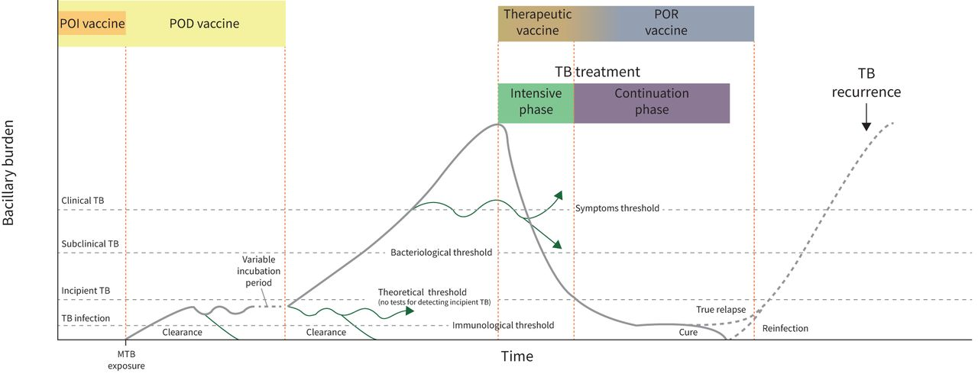
Opportunities for vaccine intervention
Transmission?
Age
(Garcia-Basteiro A, et al., Eur Resp Rev, 2022)
Notes:
Clinical endpoint: microbiologically-confirmed TB disease
POI
POD
POR
Interrupting transmission also a consideration
Age: POI targets infants and adolescents, POD for adults and PLWHIV

Slide 5
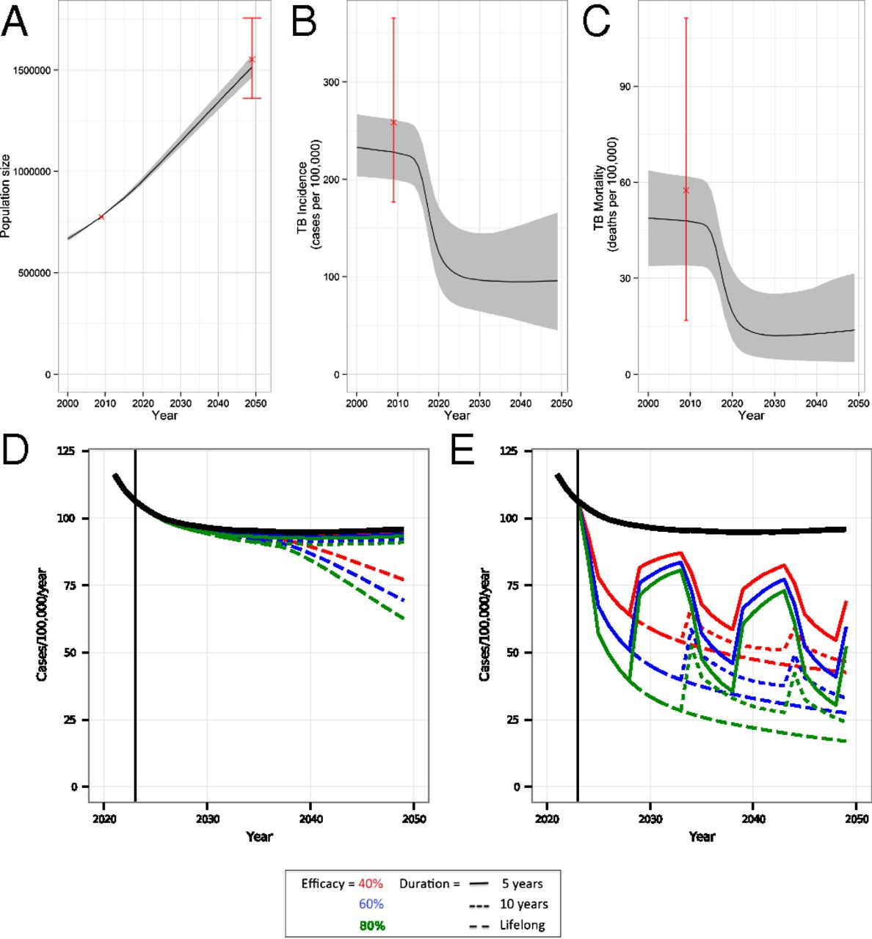
Modeling suggests focus on adolescents and adults
Modeling is helpful to focus resources for largest, fastest impact
Pre-exposure vaccines for infants have limited population-level impact on TB disease
Post-exposure vaccines for adolescents and adults have moderate to large population-level impact
Both are important.
Pre-exposure vaccines targeting infants
Post-exposure vaccines targeting adolescents and adults
(Knight, PNAS, 2014)
Notes:
For example, mass vaccination of adults using a new TB vaccine with only 40% efficacy would achieve the same initial reduction in TB incidence 20 years earlier than an infant vaccine with 80% efficacy and lifelong protection (Knight et al., 2014).

Slide 6
Clinical phases of vaccine development
Phase | Objectives | Endpoints | Population | Approx. sample size (N per group) | Approx. follow-up
Pre-clinical | Establish efficacy and study mechanism in animal models | Disease (lung CFU, histopathology), survival, immunogenicity, toxicity | Mice, hamsters, NHP | Depends on model; may screen many vaccines
1 | “First in human”, dose-finding, timing | Reactogenicity, adverse events (+ immunogenicity) | Healthy adults | 10 – 50 | 6 – 12 mos
2a | Establish safety and immunogenicity, regimen finalization | Reactogenicity, adverse events and immunogenicity | Targeted population | 50 – 200 | 6 – 12 mos
2b | Detect rare safety events and efficacy signal (POI or POD) | Disease (POD) or sustained IGRA conversion (POI, “stage-gate”) | Targeted population | 300 – 1500 | 12 – 24 mos
3 | Product licensure | Disease, recurrent disease or TB-related death | Diverse, indicated population | 2000 – 5000 | 2 – 5 yrs
“4” | Post-licensure, open-label, real-world effectiveness | Rare safety events, disease | Real-world | 5000+ | Long term
Notes:
Trial designs and clinical pathways: randomize, placebo controlled, double-blinded studies required; potentially target high-risk populations; sample size is a challenge for slow moving disease

Slide 7
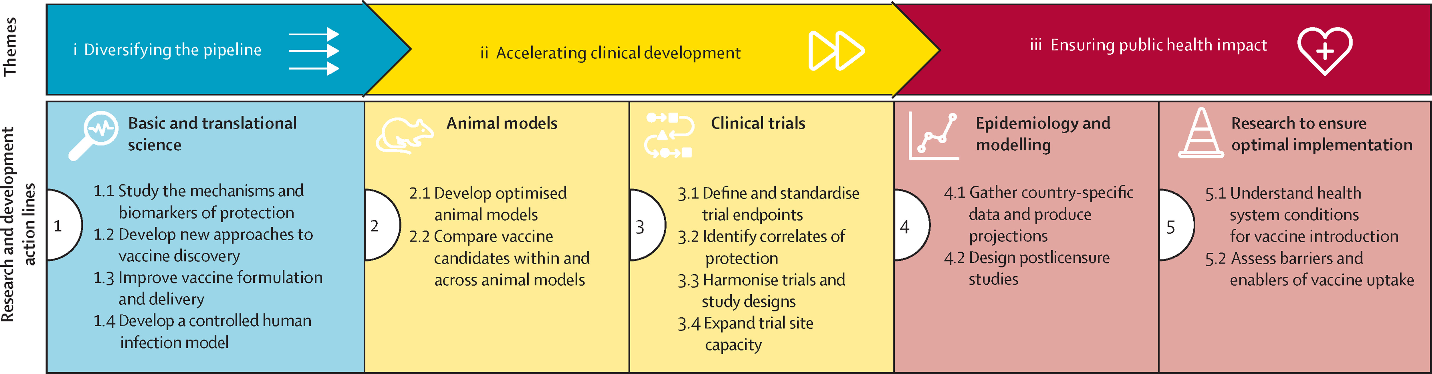
TB Vaccine Roadmap
(Cobelens et al, Lancet Inf Dis, 2022)
Notes:
For example, mass vaccination of adults using a new TB vaccine with only 40% efficacy would achieve the same initial reduction in TB incidence 20 years earlier than an infant vaccine with 80% efficacy and lifelong protection (Knight et al., 2014).

Slide 8

Global Clinical Pipeline of TB Vaccine Candidates
Phase 1
Phase 2a
Phase 2b
Phase 3
AdHu5Ag85A
McMaster, CanSino
RUTI
Archivel Farma, S.L
DAR-901
Dartmouth, GHIT
VPM 1002
SIIPL/VPM
POI
POI
POD (HHC)
POR
AEC/BC02
Anhui Zhifei Longcom
TB/FLU-04L
RIBSP
M72/AS01E
GSK, IAVI, Gates MRI
Immuvac
Cadila, ICMR
POD
POD (HHC)
ChAdOx185A/MVA85A
(ID/IM/Aerosol)
Univ of Oxford
BCG Revaccination
Gates MRI
POI
MTBVAC
Biofabri, TBVI, Zaragoza, Aeras/IAVI
POI
POD
H56/IC31®
SSI, Valneva, IAVI
POI = Prevention of Infection; POD=Prevention of Disease;
POR = Prevention of Recurrence;
HHC = household contact(s)
POR
Viral Vector
Protein / Adjuvant
ID93/GLA-SE
IDRI, Wellcome Trust, Quartis
POR
Mycobacterial – Killed or Lysate
POI
Mycobacterial – Live attenuated
GamTBvac
MoH Russia
Working Group on New Vaccines
Ginsburg, Hanekom and Hawn, 2021
TBVI
N.B. Information self-reported by vaccine sponsors
Notes:
Types of vaccines: protein+adjuvant, LAV, whole-cell, viral vectors, nucleic acid
Scriba, Netea and Ginsberg (Seminars in Immunology, 2020)

Slide 9
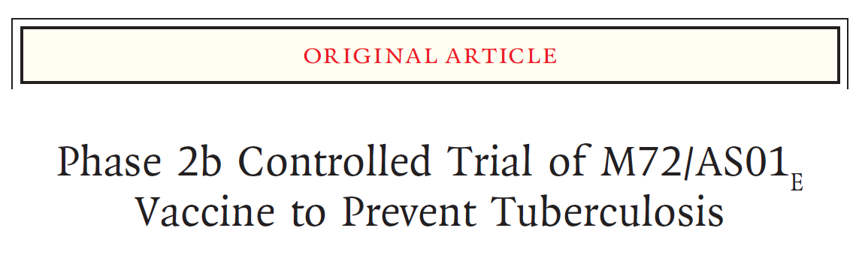
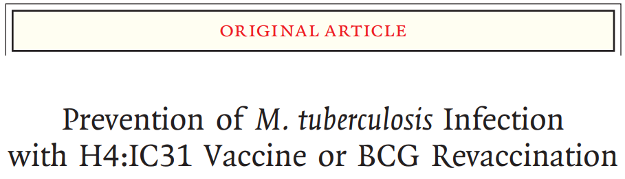
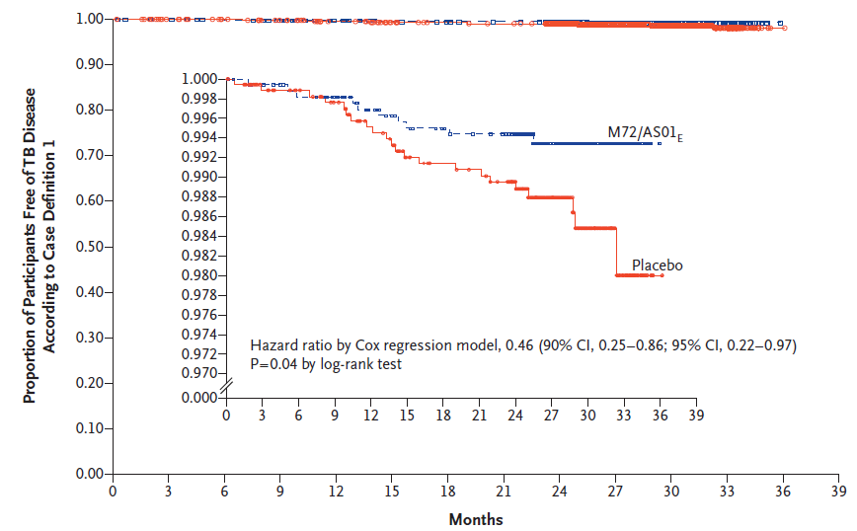
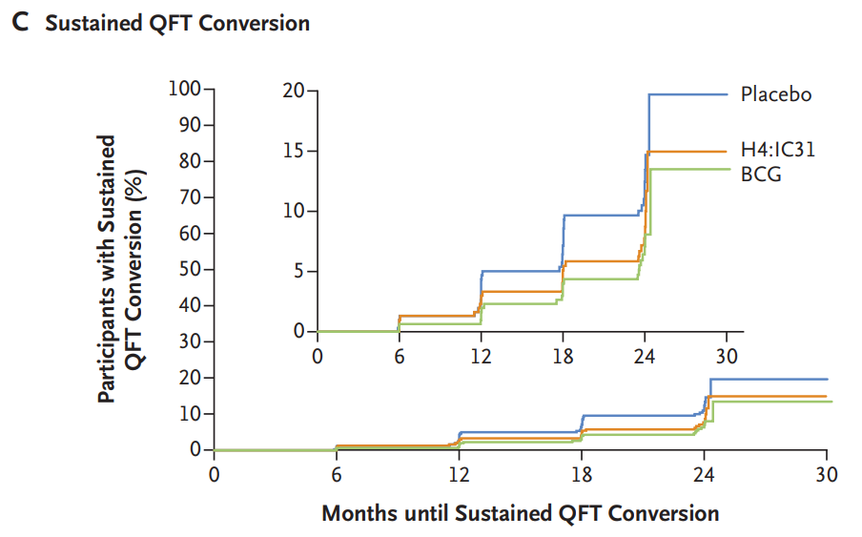
Two recent reasons for optimism
POSI VE = 45%
POD VE = 50%

Slide 10

Validation of BCG Re-vaccination POI
BCG is already licensed: goal is to add indication for adolescent revaccination, and support change in WHO recommendation and country-level changes in policy
Primary completion estimate:
Apr 2023
Sample collection provides opportunity to validate CoP
Randomized, placebo-controlled Ph 2b | Randomized, placebo controlled
Sample size | 910 vaccine, 910 placebo
Population | South African adolescents
Follow-up | 3 – 4 years
Endpoint | 6-month sustained IGRA conversion
https://clinicaltrials.gov/ct2/show/NCT04152161

Slide 11
Phase 3 design for M72/AS01E
M72/AS01E Ph2b: IGRA-negative only
Gates MRI leading efforts to design and implement Ph 3 licensure trial
Implementation must target general adult population (IGRA+/-) including PLWHIV
Latest projections indicate a need for ≥10K volunteers per group, followed over 4 – 5 years
Lesson from COVID vaccine trials: LARGE trials yield FAST answers
Factors that influence power in Ph 3 trial
Overall VE needed for regulatory success
Sample size: IGRA-positive
Sample size: IGRA-negative
Follow-up time
Drop out rate
Incidence of disease: IGRA-positive
Incidence of disease: IGRA-negative
Incidence of infection in IGRA-negative
True VE: IGRA-positive
True VE: IGRA-negative
Knowable or
designable
Estimable
Assumptions
Notes:
Large slow POD continue to vex the field

Slide 12
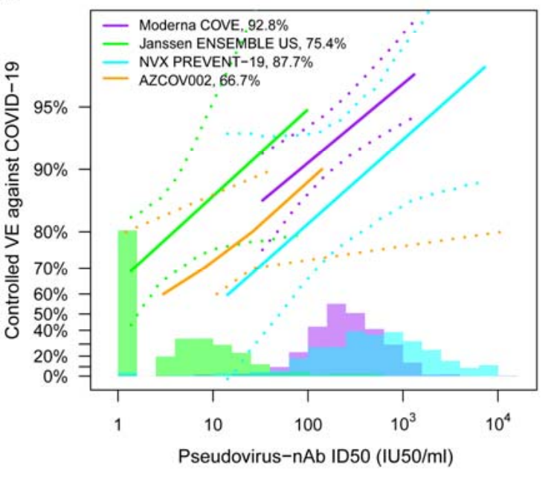
Immune correlates of vaccine efficacy
Mechanisms of protection are not a requirement of licensure
BUT, biomarkers that predict protection accelerate vaccine development
Can aid selection of promising candidates in Phase 1
Provide immunobridging to new populations (e.g., PLWHIV) or new vaccines
(Fong et al., medarxiv, 2022)
Notes:
Many cite the excitement that COVID vaccines have been developed so quickly: what we will hopefully see soon is how immune Cop (spike-specific IgG) can further accelerate licensure of more vaccines that are desperately needed.

Slide 13
The immunological space
ADAPTIVE IMMUNITY
“INNAPTIVE” IMMUNITY
Cellular responses
Conventional T cell
function, phenotype, specificity, etc
Humoral responses
Ab titers, isotype, subclass, avidity, Fc-mediated effector functions, etc
DURT
Donor-unrestricted
T cell
function, phenotype, specificity, etc
Trained immunity
Epigenetic
reprogramming of monocytes, NK
MILIEU
Whole blood composition
- Baseline and post-vaccination inflammatory response
Cell counts
Cytokines
Gene expression
Pre-existing immunity
(NTM)
Viral infections
MYCOBACTERIA CLEARANCE / CONTROL
Nemes, et al., Vaccine Insights, 2022
Notes:
Immune responses include innate, “inaptive”, cellular, humoral, but we don’t know which protect
Immune correlates of protection: bridging, pipeline acceleration
Validated animal models also needed to screen and evaluate vaccines

Slide 14
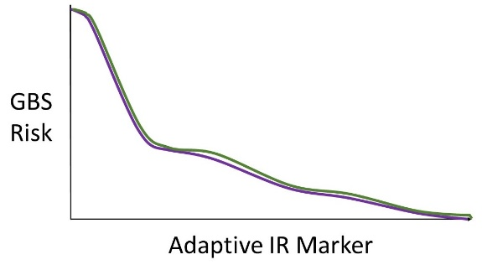
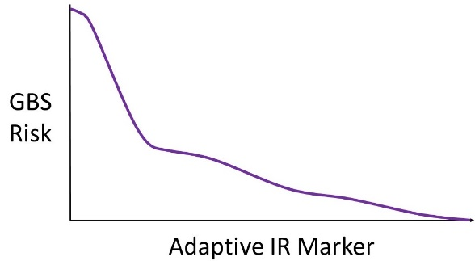
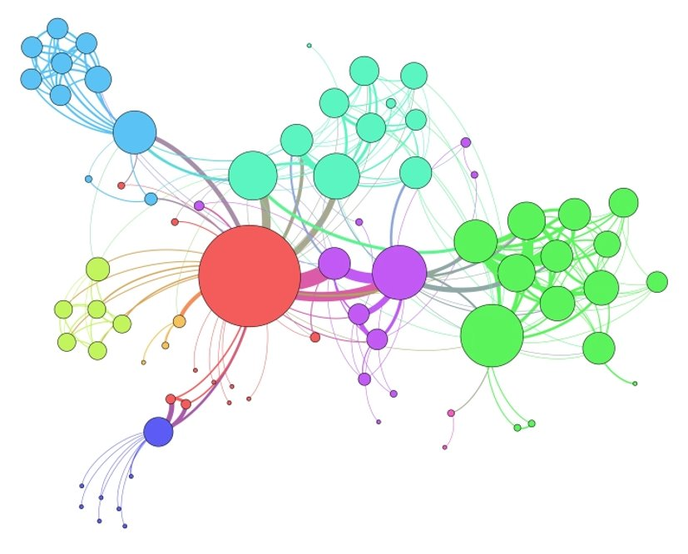
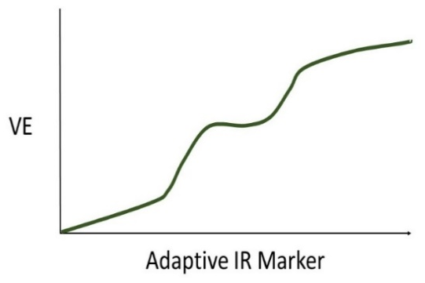
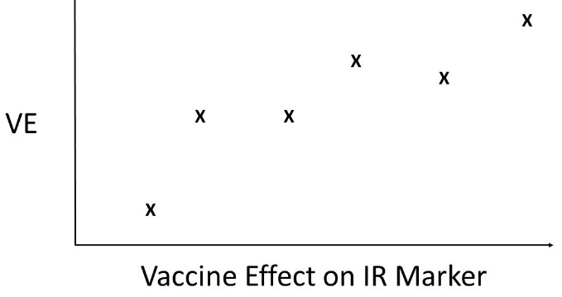
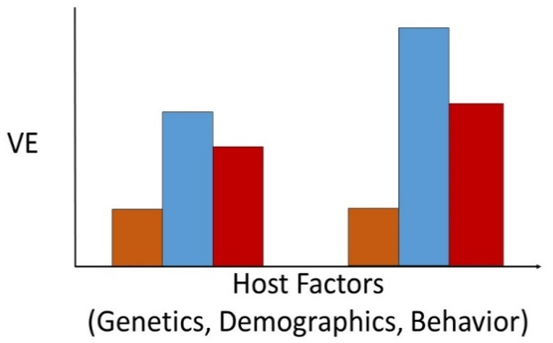
Which markers are associated with the endpoint? Is the association different in vaccine vs. placebo group?
Is CoR association same in vaccine and placebo group, and does vaccine-induced change explain VE?
Is the biomarker a sufficient surrogate endpoint?
Group-level CoP /
Prentice surrogate endpoint
Group-level
Correlate of Risk
TB
risk
CoP
TB
risk
CoR
Individual-Level
Signature of Risk
Immunological
Correlates Analysis
Can we predict endpoints from marker data?
ROC-AUC
sensitivity
Vx
TB
1 - specificity
What proportion of VE is mediated by post-vaccination marker levels?
Immune
resp.
Correlate of VE
Estimate VE within marker-defined subgroups: does it differ by subgroup?
Causal mediation
CoVE
Meta-Analysis
Correlate of VE
Is the association consistent across trials? (e.g. countries, populations)
Baseline Correlate
of VE
Are pre-vaccine or host characteristics predictive of VE? (i.e., impacting risk via a CoP)
(e.g. genetics, demographics, exposure)
Notes:
Phrase, “immune correlates analysis” has taken on many different definitions/uses
Only some are applicable to TB (draw contrast with HIV)
Key differences from HIV: pre-existing immunity at baseline, sieve analyses NA since data not obtainable

Slide 15
How can we accelerate vaccine development?
Broaden the early phase pipeline with vaccine candidates
Screen vaccine candidates against POI to identify priority candidates
Evaluate vaccines against populations with high risk of TB disease, e.g., POR, HCWs, adolescents
Identify immune correlates of risk and protection: can inform vaccine design or possibly lead to surrogate endpoints
Prepare for success: have safety and immunogenicity data ready for PLWHIV, IGRA+/- so licensure and implementation can move quickly
Advocate for funding, recruit researchers: large trials are needed for rapid answers!
Ask our panelists!
(Kaufmann, Lancet, 2011)

Slide 16
EXTRA SLIDES

Slide 17
Spectrum of disease and vaccine intervention
Prev. of disease
POD
Clinical endpoint: microbiologically-confirmed TB disease
Ph 3 POD and POR depend on prevention of clinical endpoint
POI: premise that preventing infection will prevent disease
POI and POR also “stage-gate” for screening vaccines
POI can target infants and adolescents
POD and POR target adults, PLWHIV
Interrupting transmission also a consideration
Prev. of infection
POI
Prev. of recurrence
POR
Age
(Pai et al., Nat Rev, 2016; Scriba, 2020; Hatherill et al., Front. Microbiol., 2020;
Scriba, Netea and Ginsberg, Seminal Immunology, 2020)
Notes:
Scriba, Netea and Ginsberg, Seminal Immunology, 2020

Slide 18
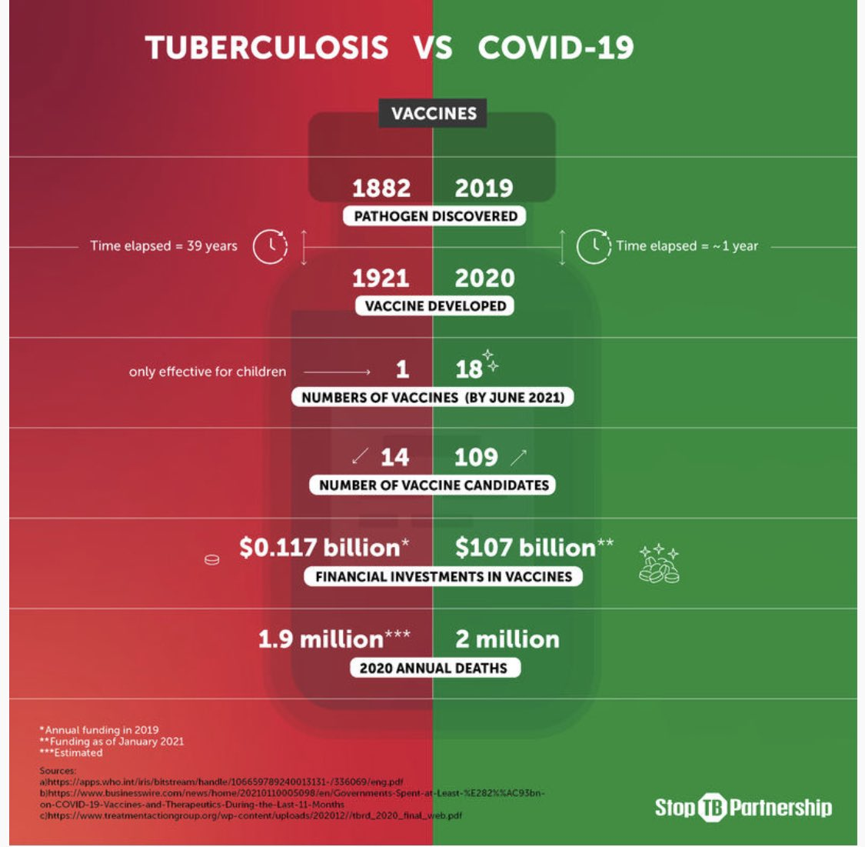

Slide 19




Leveraging Early Adolescence to Prevent TB
Phase 1b study of the safety and immunogenicity of
VPM1002 vs. BCG re-vaccination
Includes IGRA+/- and HIV+/-
Primary objective is safety and immunogenicity
Findings may be valuable for “immunobridging”
  Randomized (3 arm), blinded, with stratification on IGRA/HIV status:
    HIV−, IGRA− (n = 40 per arm)
    HIV−, IGRA+ (n = 40 per arm)
    HIV+, IGRA− (n = 40 per arm)
    HIV+, IGRA+ (n = 40 per arm)
160 per arm
480 total

Slide 20
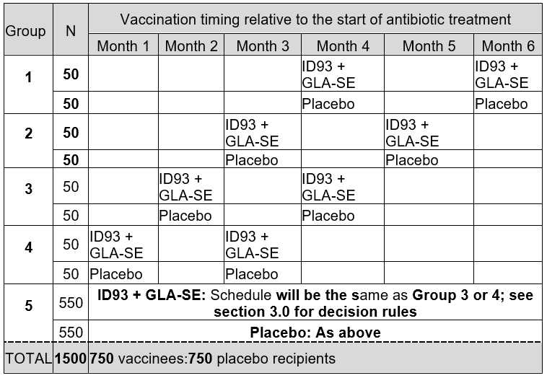

Phase 2a/b: Safety and immunogenicity of therapeutic ID93 + GLA-SE vaccination
Ph 2a: select a safe and immunogenic time to vaccinate during treatment
Ph 2b: evaluate VE against TB recurrence and treatment failure
Includes PLWHIV
Careful considerations for safety of therapeutic vaccination
Epidemiology, and data from treatment meta-analyses was critical to design and power calculations (Rada Savic, et al. for modeling and power analysis)
Notes:
PoR is an important clinical target in the TB epidemic
(esp. MDR and X-MDR TB)
PoR is also an enrichment design: efficient path to establish VE in a high-risk group could act as “stage-gate” for pivot to Ph 3 PoD
Careful considerations for safety of therapeutic vaccination
(e.g. pauses, adequate group sizes, overlapping safety signals): could be applied to enrollment of PLWHIV in other trials

Slide 21
Vaccine | Category, trials | Notes
AdHu5Ag85A (McMaster, CanSino) | Viral vector, Ph 1 | China; recombinant aerosolized Ad5
AEC/BC02 (Anhui Zhifei Longcom) | Protein/adjuvant | China; Ag85b and fusion protein ESAT6-CFP10 CpG and an aluminum salt-based adjuvant system
RUTI (Archivel Farma, S.L) | Killed or lysate | Spain; killed Mtb, components of cell wall
TB/FLU-04L (RIBSP) | Viral vector, Ph 2 | Kazakhstan; Ag85A and ESAT6 recombinant influenza virus
MTBVAC (Biofabri, TBVI, Zaragoza, Aeras/IAVI) | LAV | Spain; deletion of phoP and fadD26 (two major virulence factors) for attenuation
ChAdOx185A/MVA85A (ID/IM/Aerosol; Univ of Oxford) | Viral vector, Ph 2; novel route/dose | UK; previous trial of MVA85A was not efficacious, now trying heterologous prime-boost with novel chimp Ad prime
DAR-901 (Dartmouth, GHIT) | Killed or lysate; POI | whole cell inactivated non-tuberculous mycobacterial vaccine
M72/AS01E (GSK, IAVI, Gates MRI) | Protein/adjuvant Ph2b/3 | MTB32A and MTB39A; GSK adjuvant used in Shingrix and RTS,S vaccines; monophosphoryl lipid A (MPLA), a TLR-4 agonist based on lipopolysaccharide (LPS), to elicit CMI; QS21 based on naural saponins
BCG Revaccination (Gates MRI) | LAV, Ph2b; POI
H56/IC31 (SSI, Valneva, IAVI) | Protein/adjuvant, Ph 2; POR | Denmark; also H107 form Staten Serum Institute
ID93/GLA-SE (IDRI, Wellcome Trust, Quartis) | Protein/adjuvant, Ph 2a/b; POR | RV3619, RV1813, RV3620, RV2608; synthetic TLR4 agonist, squalene emulsion
GamTBvac (MoH Russia) | Protein/adjuvant | Ag85a, ESAT6, CFP10, and a dextran-binding domain (DBD); dextran 500 kDa, diethylaminoethyl (DEAE)-dextran 500 kDa, and CpG oligodeoxynucleotides (ODN)
VPM 1002 (SIIPL/VPM) | LAV, Ph3; POI, POD, POR | Serum Inst of India; a recombinant live BCG vaccine (rBCGΔureC::hly); improved safety for children and PLWHIV
Immuvac (Cadila, ICMR) | Killed or lysate, Ph3; POD (HHC) | India; mycobacterium indicus pranii (MIP); heat-killed bacili

Slide 22
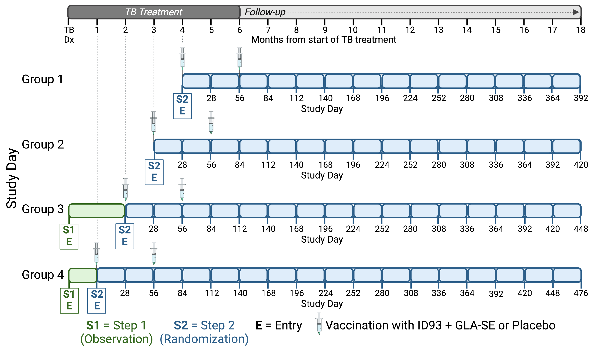
HVTN 603 / ACTG 5397: ID93 / GLA-SE therapeutic vaccination
Groups 1-4: Phase 2a “de-escalation” (n = 400)
ID93 + GLA-SE is a subunit fusion protein + adjuvant (TLR4-agonist) product
Phase 2a/2b therapeutic vaccination for prevention of TB recurrence (PoR; n = 1500)
Objectives: safety, immunogenicity, efficacy against TB-related unfavorable outcome
Phase 2a is a “de-escalation design” for safety and immunogenicity: evaluate timing of first dose relative to treatment start
Phase 2b (n = 1100) evaluates prevention of recurrent TB over 15 months
PoR is an important clinical target in the TB epidemic
(esp. MDR and X-MDR TB)
Epidemiology and data from treatment meta-analyses were critical to inform design and sample-size calculations
PLWHIV included: Will enroll moderate and hard-to-treat TB including HIV+
Group 5: Phase 2b efficacy cohort (n = 1100)
[vaccination timing selected from Groups 1 – 4]
Protocol co-chairs:
Gavin Churchyard, MBBCh, MMED, FCP, PhD
Jim Kublin, MD, MPH
Notes:
Inlcusion criteria: HIV+, ART for 6 mos, VL < LOD within 90 days, CD4 ct >250 within 90 days

Slide 23

HVTN 604 / IMPAACT 2035: Safety and immunogenicity of VPM1002 in South African pre-adolescents
Ph 2a (n = 480) evaluation of safety and immunogenicity: randomized comparison of BCG, VPM1002 and placebo
VPM1002 is a recombinant BCG that is designed to be safer and easier to manufacture consistently
Fully factorial design (Vx / IGRA / HIV) is powerful and resource efficient
Provides for greater power to detect and estimate main effects and enables discovery of interactions
Trial builds on BCG re-vaccination efficacy for prevention of infection (POI) demonstrated in 2018 (VE = 45%)
Will generate excellent data for immuno-bridging of BCG and VPM1002 immune response to IGRA / HIV sub-populations
  Randomized (3 arm), blinded, with stratification on IGRA/HIV status:
    HIV−, IGRA− (n = 40 per arm)
    HIV−, IGRA+ (n = 40 per arm)
    HIV+, IGRA− (n = 40 per arm)
    HIV+, IGRA+ (n = 40 per arm)
160 per arm
480 total
Protocol chair:
Lisa Marie Cranmer, MD, MPH

Slide 24
HVTN 605 / ACTG: Safety and immunogenicity of MTBVAC in South Africans, including PLWHIV
Ph 2a (n ≈ 200 - 300) evaluation of safety and immunogenicity of MTBVAC and BCG in adults and adolescents
MTBVC is a recombinant attenuated M.tb. that is designed to be safe and immunogenic
Phase 3 (non-HVTN) opening shortly with infants as a BCG replacement
HVTN study will include PLWH: Group 2 w/ well-controlled HIV at diagnosis and Group 3 w/ advanced HIV disease at HIV diagnosis
Trial aims to generate safety and immunogenicity data to motivate Ph2b efficacy study and inclusion of PLWH in future study populations
Inclusion of BCG group will allow for comparison of safety and immunogenicity of BCG and VPM1002 in IGRA+/- and HIV+/-
Group | Randomized treatment | N†
Group 1: Participants without HIV | MTBVAC | 56
 | BCG | 28
Group 2: Participants with well-controlled HIV, prior to ART initiation | MTBVAC | 80
 | BCG | 28
Group 3: Adult participants with advanced HIV disease at diagnosis | MTBVAC | 56
 | BCG | 28
†Stratified 50/50 by IGRA status

